Slide 1


Equine Atrial Fibrillation: Correction with Transvenous Electrical Cardioversion
Jordan Bishman
University of Florida, 2028
Dr. Lisa Edwards, DVM, DACVIM (LAIM), DACVECC

Slide 2
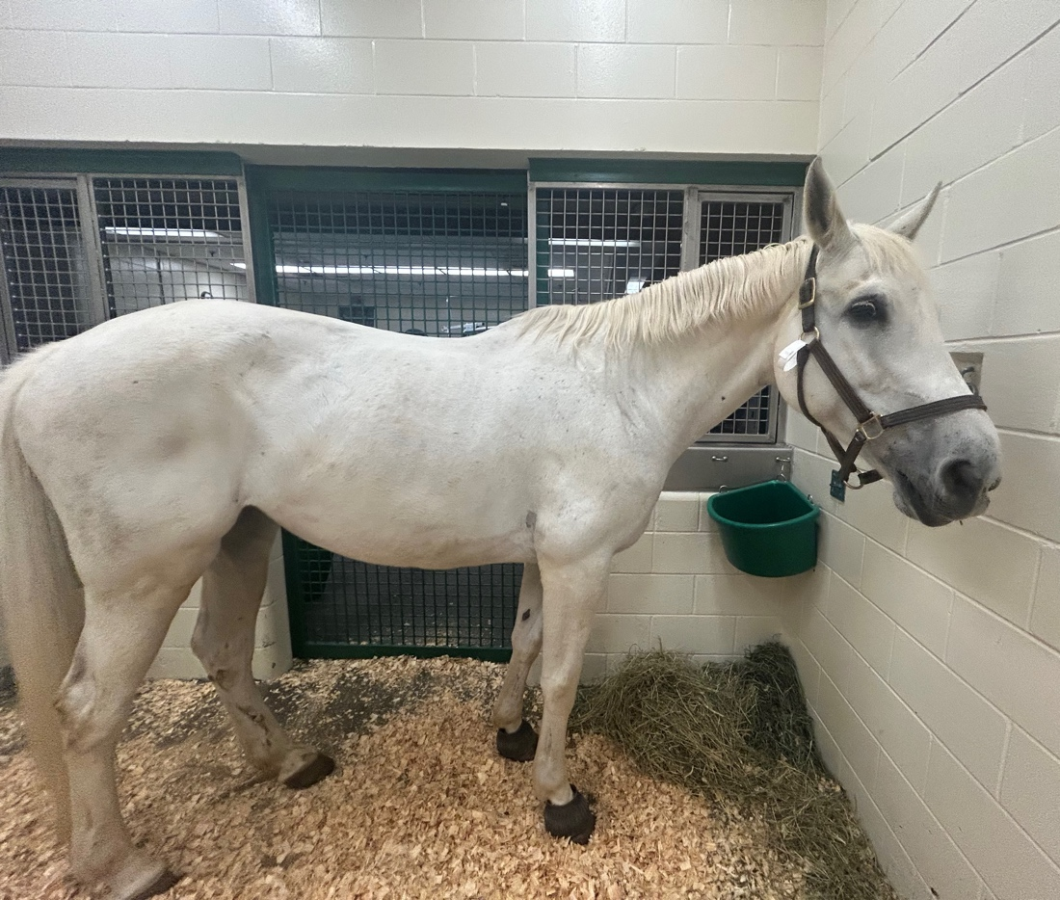

Signalment and History
14-year-old Warmblood mare used for jumping and dressage
Presented to the University of Florida Large Animal Hospital on April 20th, 2026, for evaluation and transvenous electrical cardioversion (TVEC) procedure after an irregular rhythm was noted on a routine wellness evaluation, no exercise intolerance or decrease in performance noted, duration of irregular rhythm unknown
rDVM in Tennessee confirmed presence of atrial fibrillation with a portable echocardiogram
An echocardiogram evaluation was performed at an equine hospital in Tennessee to rule out structural heart disease that would prohibit travel to Florida for procedure – no abnormalities noted
One episode of bilateral epistaxis reported following a jumping competition in Fall 2025
Up to date on all vaccinations and Coggins
Notes:
Certificate of health TN and Coggins in records

Slide 3
Physical Exam Findings
Bright, alert, responsive
599kg, BCS: 5/9
Rectal temperature: 99.8℉
Heart rate: 36 beats per minute
Respiratory: 18 breaths/minute, no crackles or wheezes auscultated
Mucous membranes: pink and moist
Capillary refill time: <2 seconds
Brisk jugular fill
Gastrointestinal, lymphatic, neurologic, and musculoskeletal systems all within normal limits
Integument: ~1.5cm scar dorsal to left eye and a ~2.5cm L-shaped healing abrasion on medial aspect of left mid-metatarsal region
Cardiovascular system:
  Irregularly irregular rhythm auscultated
  Arterial pulse quality strong but irregular
  No murmurs auscultated
  S1, S2, and S3 auscultated (S4 absent)
  No edema (subcutaneous or pleural) or cough noted
Problem List | Differentials
- Irregularly irregular cardiac rhythm | Lone atrial fibrillation (AF) vs AF with structural changes vs multifocal atrial tachycardia vs atrial premature complexes vs wandering atrial pacemaker vs atrial tachycardia with variable AV node conduction vs ventricular premature complexes vs electrolyte imbalances
- Bilateral epistaxis (historic- 2025) | Exercise induced pulmonary hemorrhage (+/- 2nd to AF) vs coagulopathy vs ethmoid hematoma vs foreign body vs guttural pouch mycosis vs neoplasia
Notes:
Cardio focused PE: BCS, HR, heart rhythm, venous distension and refill, eval of abnormal fluid accumulation, auscultation of heart and lungs, arterial blood pressure measure
Associations between postrace atrial fibrillation and measures of performance, racing history and airway disease in horses – paper shows increase incidence of EIPH in horses w AF and explains left atrial pressure is a principal determinant of pulmonary capillary pressure, and AF is both a cause and consequence of increased left atrial pressure, coupled with splenic contraction during exercise -> increase blood volume which contributes to increased L atrial pressure

Slide 4

Diagnostic Plan
Complete blood count (CBC), plasma biochemistry (minimum database)
Evaluation of systemic health, electrolytes, and anesthetic risk
Fractional excretion – electrolytes filtered by kidney
Rule out electrolyte dysfunction as a cause of atrial fibrillation
Cardiac troponin I
Evaluation of myocardial injury
Cardiology service consult – electrocardiogram and echocardiogram
Evaluation of irregularly irregular cardiac rhythm and structural cardiac changes
Additional diagnostics for thorough equine cardiac evaluation – not performed:
Arterial blood pressure
Thoracic radiology to evaluate pleural space, pulmonary parenchyma, lung vascularity, and heart size
Angiocardiography: diagnose abnormal blood flow and evaluate intracardiac/intraabdominal pressures
Measure of RBC potassium levels: low levels can be associated with atrial fibrillation
FE (%) = $\frac{Urine Electrolye x Serum Creatinine}{Serum Electrolyte x Urine Creatinine}$ x 100
Notes:
Arterial blood pressure performed after induction of anesthesia (standard protocol), not typically performed in standing horses unless there is evidence of concurrent pulmonary disease

Slide 5
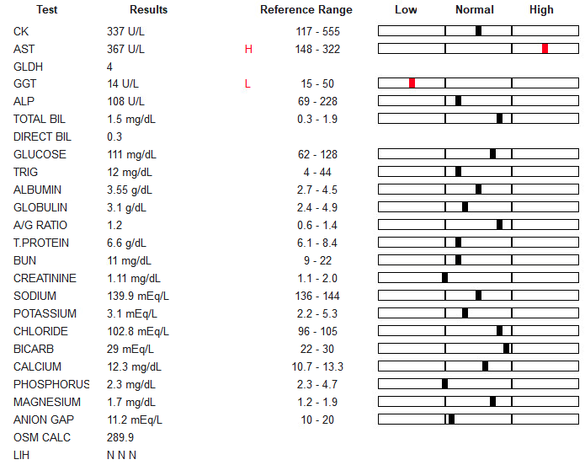
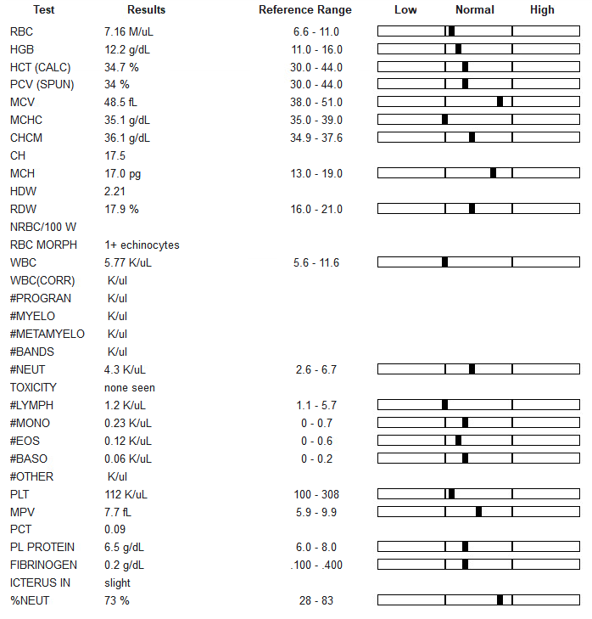
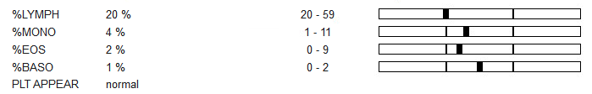
Results – Chemistry / CBC
Interpretation:
Mild elevation in AST (muscle and liver enzyme – clinical significance unknown)
    An increase in AST coupled with lack of elevation in CK can indicate muscle injury (skeletal or cardiac) greater than 48 hours duration
Otherwise within normal limits, including other liver parameters
Notes:
CK peaks 4-12 hours post injury, then returns to normal within 24-48 hours, AST peaks 24-48 hours post injury and stays elevated for 2-3 weeks
Comment on normal kidney values – no evidence of prerenal azotemia secondary to cardiac disease
Bloodwork indicates good anesthesia candidate

Slide 6
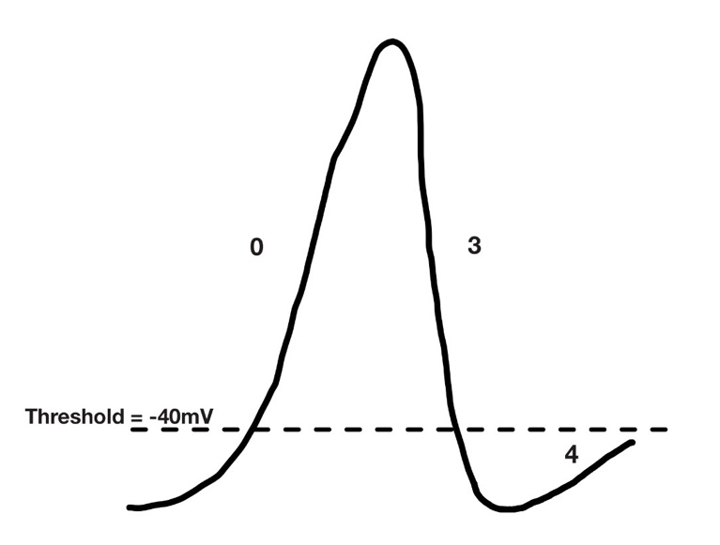

Results – Fractional Excretion / Cardiac Troponin I
Fractional excretion results:
Cardiac Troponin I (cTnI): 4/21/26 = 0.00ng/mL (ref range: 0.00-0.06ng/mL) Indicates no evidence of cardiac muscle damage cTnI = protein biomarker released by cardiac myocytes when injured Average half-life of cTnI in horses is < 1 hour A failure to observe a decline in cTnI over serial measurements is more indicative of ongoing myocardial damage than any singular measurement
Test | Result | Reference Range
Sodium | 0.23% | (0.01% - 1.0%)
Potassium | 36.5% | (15% - 80%)
Magnesium | 32.4% | (15% - 53%)
= $\frac{Urine Electrolye x Serum Creatinine}{Serum Electrolyte x Urine Creatinine}$ x 100
Fractional excretion measures the clearance of electrolytes and minerals compared to clearance of creatinine.
Influx of sodium is responsible for depolarizing cardiac cells and initiating contraction
Hyponatremia: decreased conduction velocity → promotes reentry circuits
Hypokalemia: shortens the heart’s refractory period and increases the resting membrane potential → predisposes the AV node to multiple depolarizations (AF)
Hypomagnesemia: prolongs ventricular repolarization (delays recovery phase of cardiac cycle) and disrupts the sodium/potassium ATPase pump
Action Potential of SA node (pacemaker cells):
Phase 0: depolarization – opening of Ca2+ channels
Phase 3: repolarization – opening of K+ channels
Phase 4: Spontaneous depolarization (decreased K+ permeability, influx of Na+ and Ca2+)
Notes:
Note: calcium is an imp electrolyte in the cardiac cycle as well
AP diagram drawn by me (no permissions needed)
Opening of fast Na+ channels important for depolarization of contractile myocytes

Slide 7
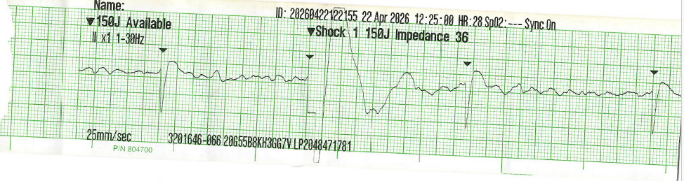
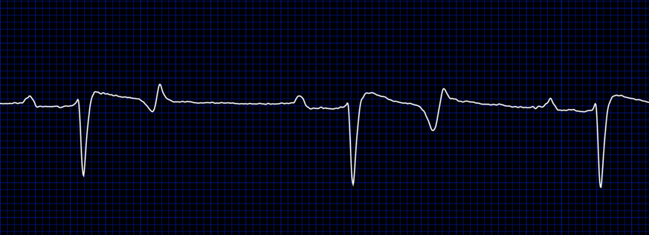
Cardiac Evaluation – ECG
Electrocardiogram:
Normal equine ECG:
Interpretation:
Absence of P waves
Presence of f (fibrillation) waves – baseline undulations
Irregularly spaced QRS complexes
P
R
T
S
Notes:
Normal equine ECG from Televet monitoring system and labeled by self

Slide 8
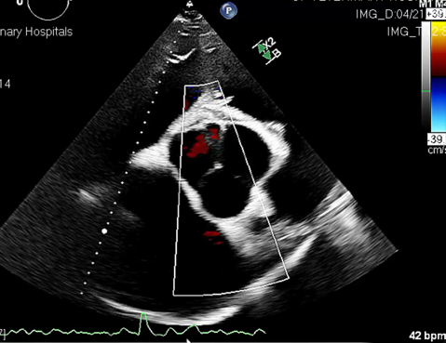
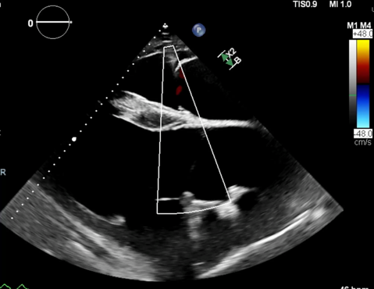
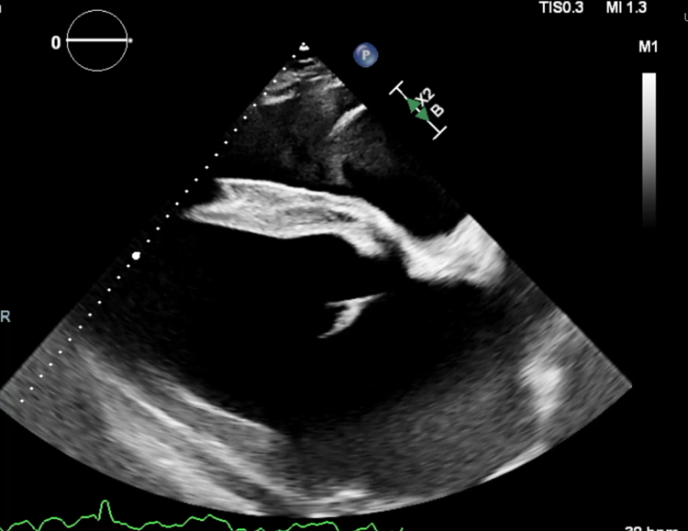
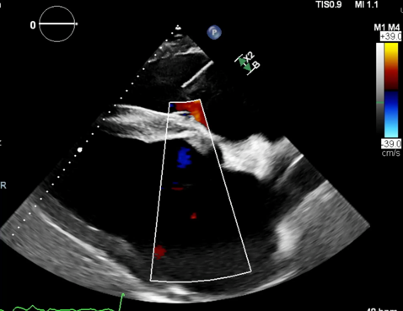
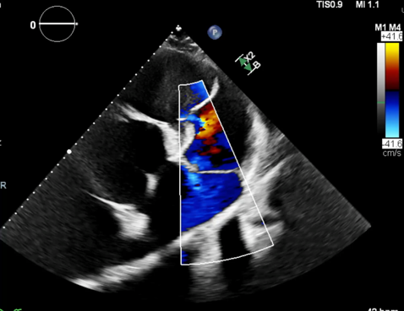
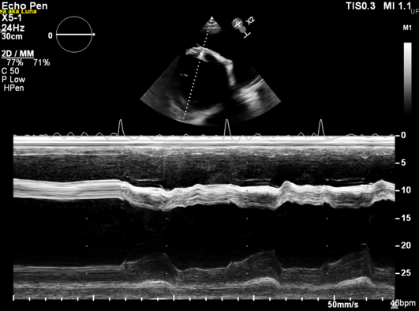
Cardiac Evaluation - Echocardiogram
Aortic valve regurgitation
Tricuspid valve regurgitation (right parasternal long axis 4 chamber view)
Video (above) depicts left ventricle and left atrial throughout diastole and systole
Image (left) depicts M-mode used to obtain left ventricular measurements
Mitral valve regurgitation
Tricuspid valve regurgitation (apical view)

Slide 9
Cardiac Evaluation - Echocardiogram
Echocardiogram measurements and interpretation:
Measurement | Value (mm) | Reference Interval (mm)
LVID_{d} | 125.9 | 99-134
LVID_{s} | 80.1 | 59-92
IVS_{d} | 31.5 | 26-41
IVS_{s} | 41 | 36-52
LV Fractional Shortening | 36.36% | 32-49%
Measurement | Value (mm) | Reference Interval (mm)
A_{o} diameter - systole | 79.3 | 56-79
LA diameter – max, end of systole | 155.8 | 118-136
LA diameter – end of systole | 125.4 | 86-116
LA/A_{o} systole | 1.58 | <1.5
A_{o} annulus diameter | 66.1 | 61-80
Left atrium: Mild – moderate dilatation
Aortic valve: Trace aortic regurgitation, valve appears thickened
Mitral valve: Trace mitral regurgitation, normal structure and function
Tricuspid valve: Mild tricuspid regurgitation, normal structure and function
Remaining heart structures appear normal
No evidence of pericardial effusion
Note: Decreased success rate in horses undergoing TVEC procedure with structural cardiac changes
Notes:
Reference intervals (specific Warmblood values) from Table 9.6 in Chapt 9 of Bayly Equine Internal Medicine textbook (cited in references) and papers cited below
Vernemmen I, Vera L, Van Steenkiste G, van Loon G, Decloedt A. Reference values for 2-dimensional and M-mode echocardiography in Friesian and Warmblood horses. J Vet Intern Med. 2020; 34: 2701–2709. https://doi.org/10.1111/jvim.15938
Huesler IM, Mitchell KJ, Schwarzwald CC. Echocardiographic Assessment of Left Atrial Size and Function in Warmblood Horses: Reference Intervals, Allometric Scaling, and Agreement of Different Echocardiographic Variables. J Vet Intern Med. 2016;30(4):1241-1252. doi:10.1111/jvim.14368

Slide 10
Problem List and Differentials
Problem List | Differentials
- Irregularly irregular cardiac rhythm | AF with structural changes vs lone atrial fibrillation (AF) vs multifocal atrial tachycardia vs atrial premature complexes vs wandering atrial pacemaker vs atrial tachycardia with variable AV node conduction vs ventricular premature complexes vs electrolyte imbalances
- Mild – moderate dilatation of L atrium | 2nd to AF vs 2nd to valvular regurgitation (mitral vs aortic) vs congenital (unlikely)
- Mild valvular regurgitation | 2nd to AF vs degenerative valve disease vs annular dilation vs ruptured chordae tendineae vs bacterial endocarditis (unlikely)
- Mildly elevated AST | Muscle injury greater than 48 hours prior (no increase in CK) vs liver disease (less likely)
- Bilateral epistaxis (one episode 2025) | Exercise induced pulmonary hemorrhage (+/- 2nd to AF) vs coagulopathy vs ethmoid hematoma vs foreign body vs guttural pouch mycosis vs neoplasia

Slide 11
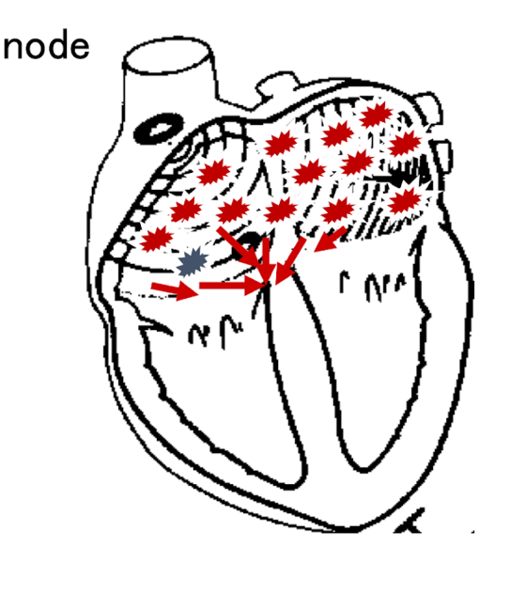
Diagnosis and Pathophysiology
Irregularly irregular cardiac rhythm + ECG loss of P waves and fibrillation baseline → Atrial Fibrillation
Due to presence of structural cardiac changes seen on echocardiogram, lone atrial fibrillation is not an accurate diagnosis
Pathophysiology of equine atrial fibrillation:
Loss of normal electrical conduction within the atria → many random depolarizations to AV node
Lack of normal atrial contraction = loss of P waves on ECG
Horses are predisposed due to large atrial mass and naturally high resting vagal tone
  Large atrial mass allows for multiple disorganized electrical wavelets to develop and be sustained
  High vagal tone shortens the refractory period, which allows for reentry of electrical signals into atria (no coordination)
AF is problematic for horses at peak exercise due to loss of “atrial kick” = final atrial contraction during diastole to eject final blood volume into ventricle prior to systole
  Atrial kick is auscultated as the 4th heart sound (absent in horses with AF)
  Results in decreased stroke volume → decreased cardiac output → exercise intolerance
Notes:
Permission to use image granted by Dr. Adin

Slide 12
Therapeutic Plan
1) Sotalol
2mg/kg PO q12 hours
Classification:
  Class II: beta adrenergic antagonist – non-selective
  Class III: K+ channel blocker
MOA: delay repolarization, antiarrhythmic, prolong action potential duration, slow AV node conduction by increasing AV node refractory period
Continue for at least 30 days post conversion
Adverse effects: bradycardia, negative ionotropic effect, bronchospasm, hypotension, pro-arrhythmic
2) Conversion to normal sinus rhythm
Medically using quinidine vs Transvenous Electrical Cardioversion (TVEC)
Notes:
Neg inotropy = decrease force of contraction
See potential widened QT interval due to K+ channel block (delays repolarization) - > risk of V tach (torsades de pointes)

Slide 13
Therapeutic Plan – alternative medical management
Pharmacological conversion using quinidine:
22mg/kg quinidine sulfate PO q2 hours
a)
c)
b)
Conversion to sinus rhythm
Total of 4 to 6 doses achieved with no changes
Toxic effects noted
Colic, laminitis, nasal edema, nausea, diarrhea, tachycardia, hypotension, negative inotrope, depression
Goal: plasma concentration of 2-5μg/mL
Measure between 3rd and 4th dose
Classification:
  Class 1a antiarrhythmic: sodium channel blocker
MOA: slow conduction velocity by blocking fast Na+ channels that are active during upstroke of action potential. This prolongs the action potential duration, delays repolarization, and depresses conduction
Pros: does not require general anesthesia
Cons: narrow therapeutic index and high risk of adverse effects when using this drug
Contraindicated in patients with bradyarrhythmias, evidence of heart failure, renal or liver disease
Due to the potential adverse effects of medical conversion, and the increased success rate of the TVEC procedure, the owners elected to perform transvenous electrical cardioversion for this patient
Notes:
Kuroda T, Minamijima Y, Kinman CK, Takahashi Y, Ebisuda Y, Inoue K, Ishikawa H, Mita H, Tamura N, Nukada T, Toutain PL, Ohta M. Rational quinidine dosage regimen for atrial fibrillation in Thoroughbred racehorses based on population pharmacokinetics. Front Vet Sci. 2024 Oct 7;11:1454342. doi: 10.3389/fvets.2024.1454342. PMID: 39439824; PMCID: PMC11493839.

Slide 14
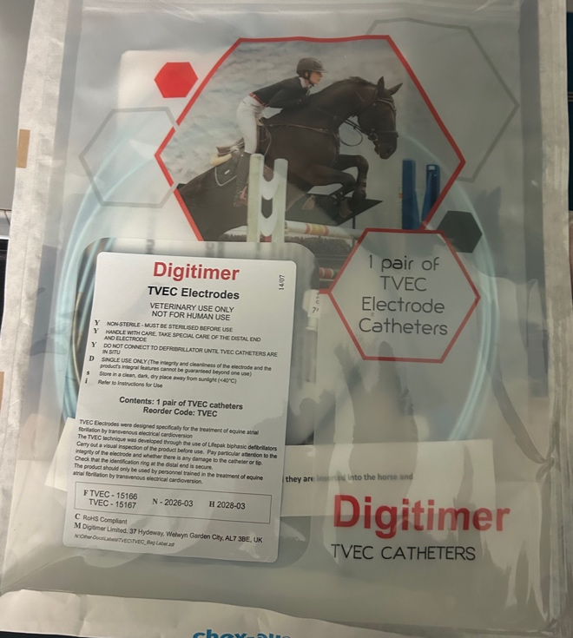
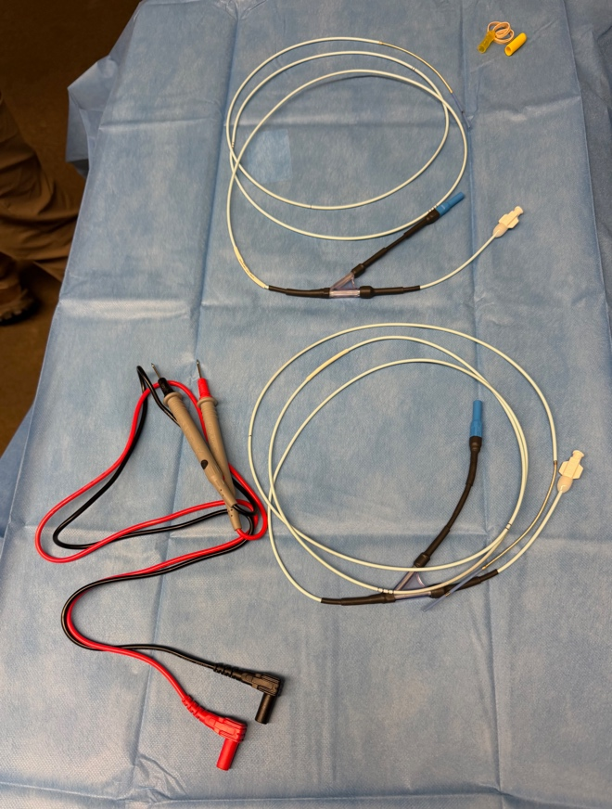
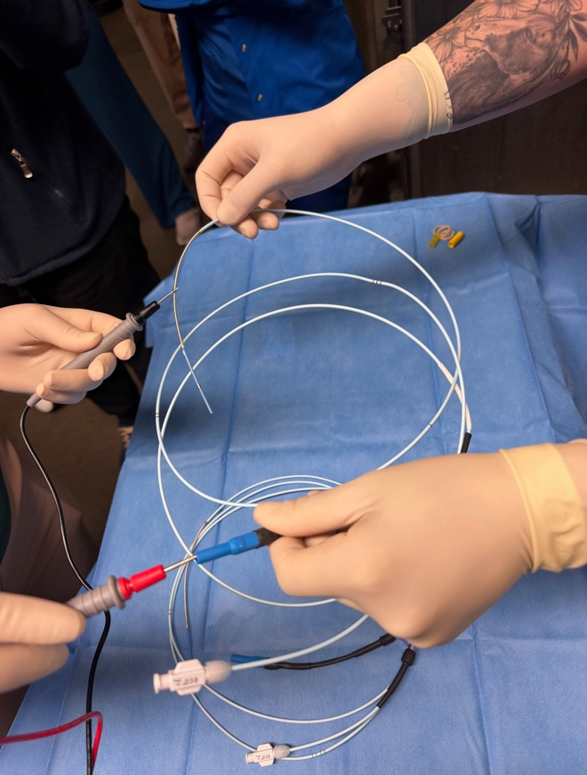
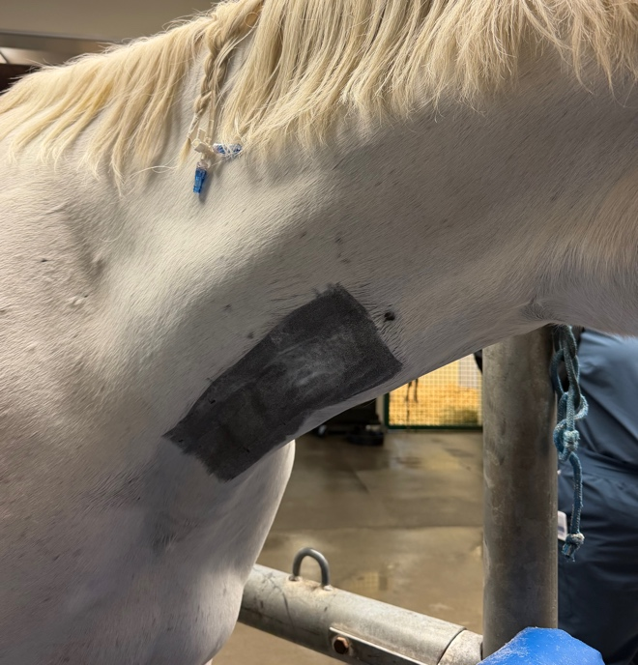
Therapeutic Plan - TVEC Procedure - setup
4/22/2026 – start time 9am
Equipment prep: Electrodes were opened using sterile technique and placed on sterile drape then tested with a digital multimeter to assess flow of electrical current, two 10 French introducer catheters also opened on sterile field
Patient prep: intravenous catheter placed in left jugular vein, ~ 7cm by 25cm area clipped on right side of neck and prepped aseptically with chlorohexidine scrub and alcohol

Slide 15
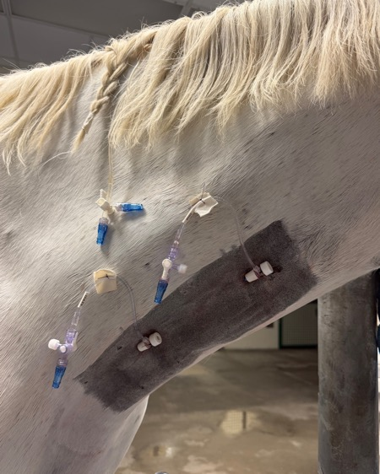
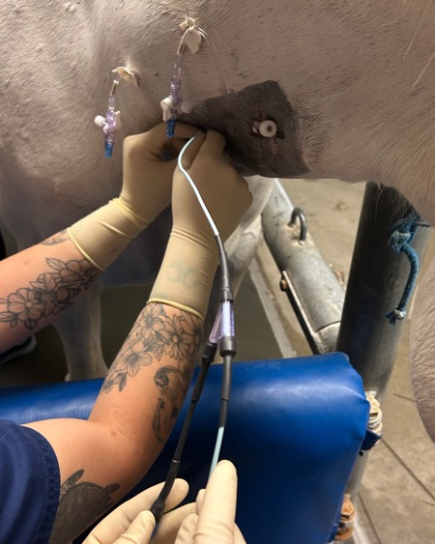
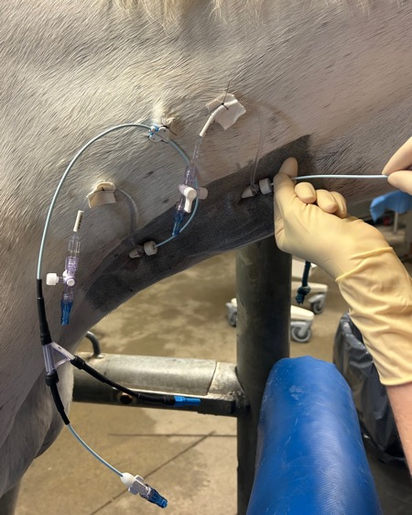
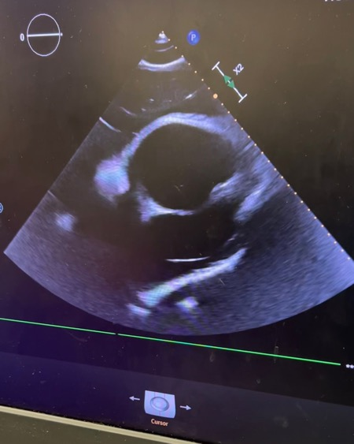
TVEC Procedure – placement of electrodes
Placement of 10 French introducer catheters in R jugular vein
Placement of electrode #1 into right atrium (RA), utilizing caudally placed catheter port
Placement of electrode #2 into left main pulmonary artery (MPA), utilizing cranially placed catheter port
Ultrasound guided placement of electrodes
Arrow pointing to electrode in L MPA

Slide 16
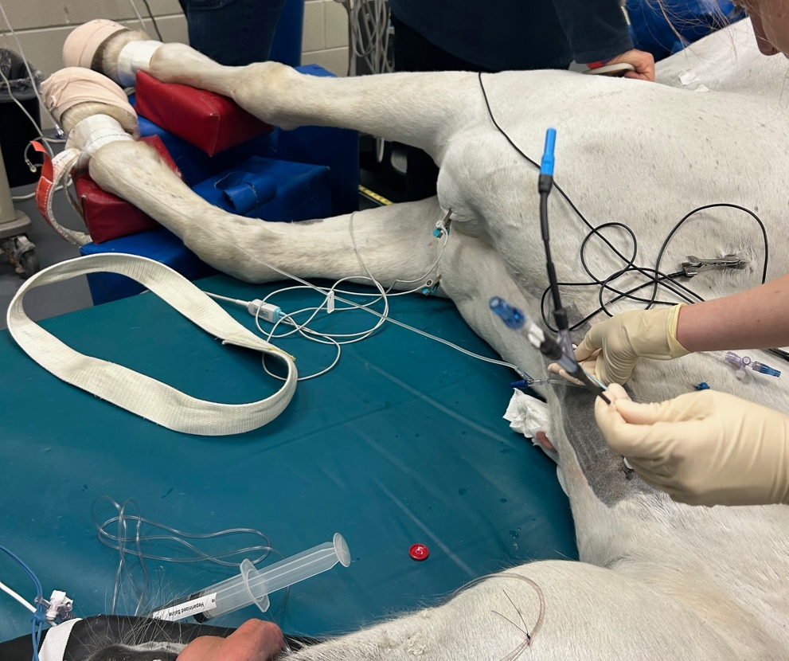
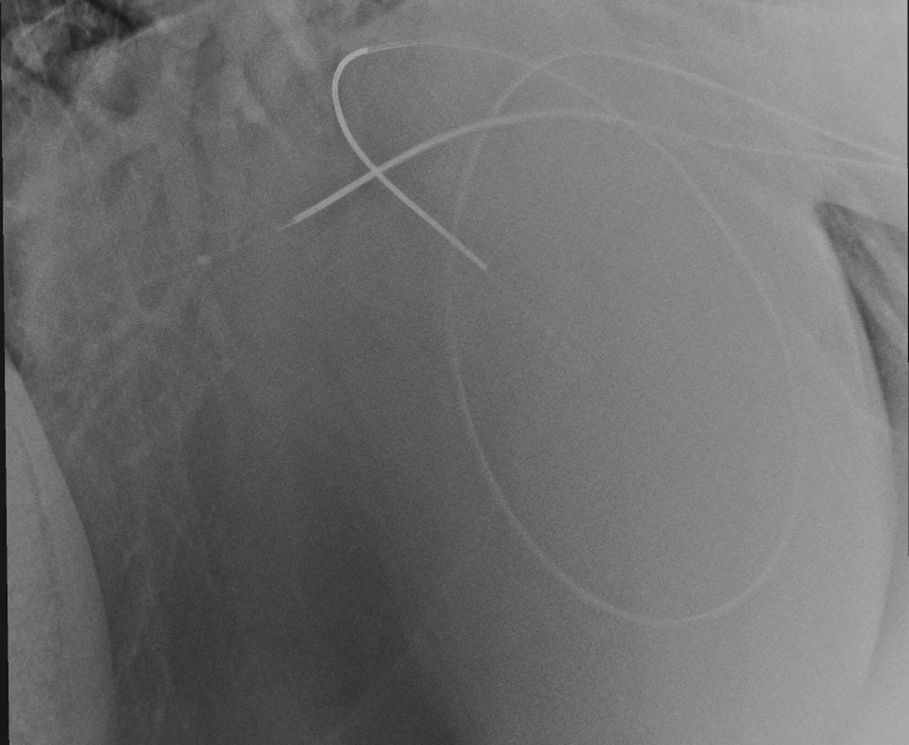
TVEC Procedure – placement of electrodes
After induction of anesthesia and placement on table in radiology suite in L lateral recumbency, thoracic radiographs taken to confirm placement of electrodes
Radiographs revealed electrode in L main pulmonary artery was retroflexed on itself
Multiple attempts were made to straighten catheter, including the placement of a new electrode that also flexed upon entry into the pulmonary artery
Decision was made to proceed with shock delivery despite retroflexion of electrodes

Slide 17
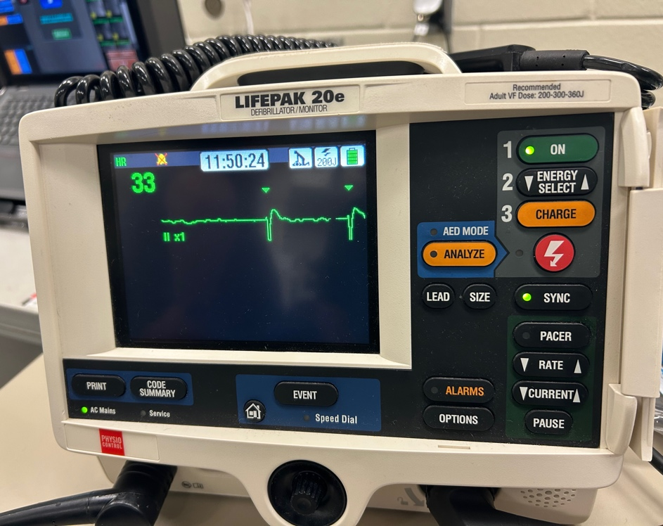
TVEC Procedure - conversion
1) 12:23pm: 150 joules delivered – continuation of atrial fibrillation on ECG
2) 12:25pm: 200 joules delivered – continuation of atrial fibrillation on ECG
3) 12:26pm: 250 joules delivered – conversion to sinus rhythm with 2:1 2nd degree AV block
• AV block resolved within 30 seconds of conversion
Defibrillator used to deliver biphasic shock to heart (150-360 joules)
Shock is synchronized to QRS complex and attempt made to deliver shock on expiration

Slide 18
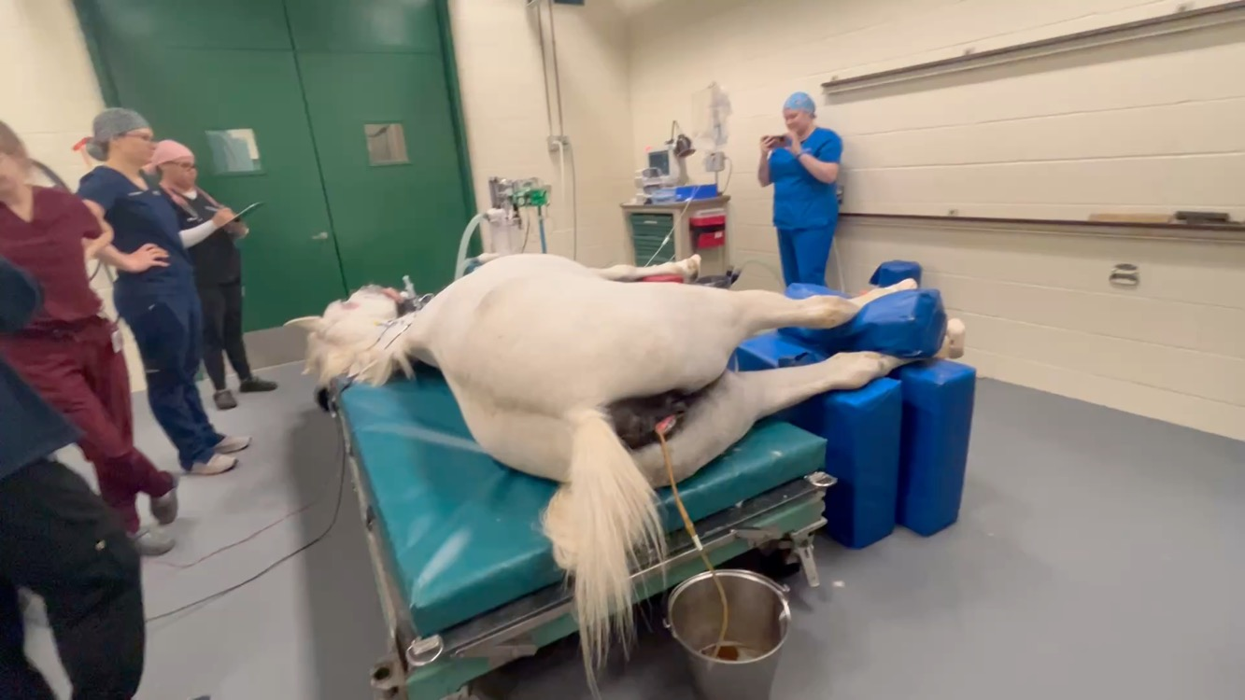
TVEC Procedure - conversion
Successful conversion after 250 joules delivered

Slide 19
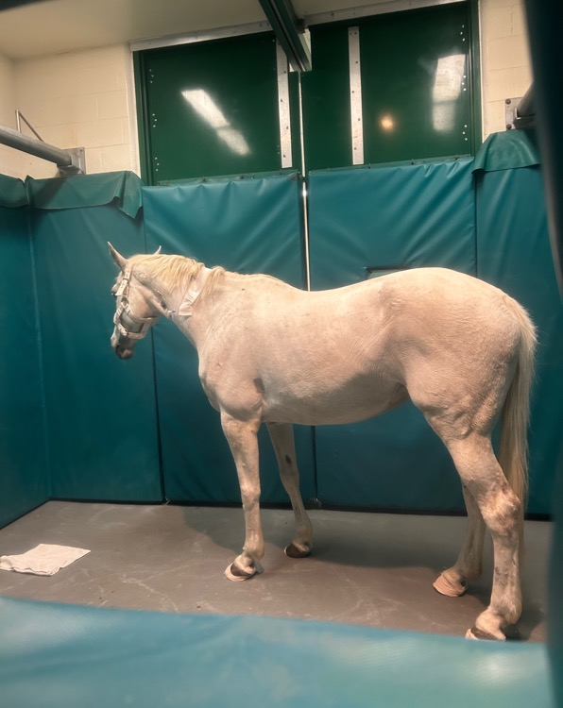
Anesthetic Considerations
Anesthetic induction with ketamine and propofol, maintained on isoflurane inhalant
  Premedicated with 100mg Xylazine IV
  Time under general anesthesia: 10:38am – 12:30pm
  MAP remained between 60 and 90 mmHg throughout procedure
Avoid alpha 2 agonist CRI under general anesthesia for TVEC procedure
  Causes dose dependent hypertension and reflex bradycardia, increase in vagal tone, and risk of AV block, further disrupting electrical conduction of heart
Discontinuation of dobutamine during delivery of electrical shock
  Selective beta-1 agonist used to increase contractility (positive inotrope) and stroke volume
  Minimal impact on heart rate
  Positive inotrope effect can predispose to atrial fibrillation
  Uneventful recovery of anesthesia post TVEC procedure
  Return to stall at 2:20pm
Notes:
Müller TM, Hopster K, Bienert-Zeit A, Rohn K, Kästner SBR. Effect of butorphanol, midazolam or ketamine on romifidine based sedation in horses during standing cheek tooth removal. BMC Vet Res. 2017;13(1):381. Published 2017 Dec 6. doi:10.1186/s12917-017-1299-6

Slide 20
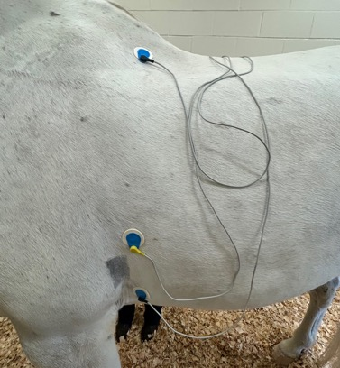
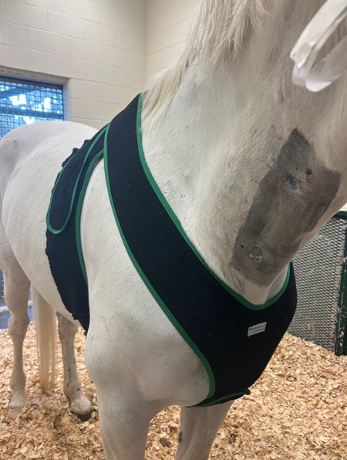
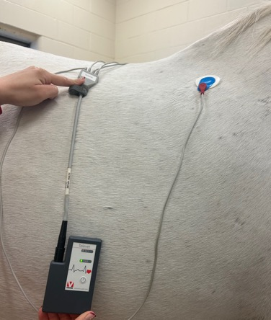
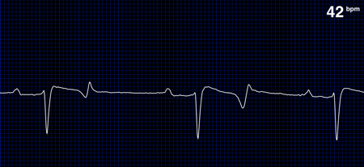
TVEC Procedure – Post conversion procedure
Auscultated heart – confirmed normal sinus rhythm
Placement of Televet continuous ECG monitoring
  Monitor for at least 24 hours post procedure
1% diclofenac sodium gel applied topically q6 hours to R jugular vein catheter sites
Anti-inflammatory therapy with flunixin meglumine for 2 days after procedure
Stall rest for 4 weeks prior to gradual return to work: start with hand walking → tack walking → trot sets
Repeat cardiac troponin I measurements:
  4/23/26 8am: 0.05ng/mL
  4/23/26 8pm: 0.03ng/mL
  Reference range: 0.00ng/mL – 0.06ng/mL
Notes:
Expect mild elevation in cardiac troponin post delivery of shock to cardiac muscle (these values still WNL and decreasing trend is a good prognostic indicator for recovery of cardiac muscle)

Slide 21
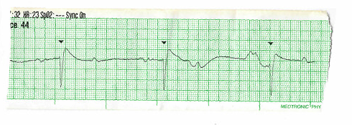
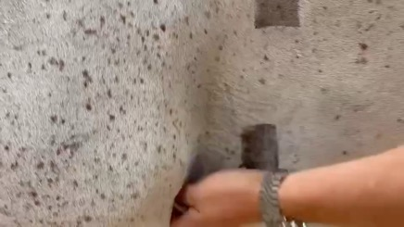
Outcome
Electrocardiogram post-conversion:
Interpretation:
Normal sinus rhythm
Presence of P waves
Successful conversion from atrial fibrillation to normal sinus rhythm after administration of three electrical shocks (150J, 200J, 250J)
Expected full return to athletic performance and competition
  Return to competition requires discontinuation of Sotalol
32% recurrence rate
Suggest at home cardiac monitoring with a device such as KardiaMobile EKG monitor to evaluate for recurrence of atrial fibrillation

Slide 22
References
Bellei MHM, Kerr C, McGurrin MKJ, Kenney DG, Physick-Sheard P. Management and complications of anesthesia for transvenous electrical cardioversion of atrial fibrillation in horses: 62 cases (2002–2006). J Am Vet Med Assoc. 2007;231:1225-1230.
Decloedt A, Van Steenkiste G, Vera L, Buhl R, Van Loon G. Atrial fibrillation in horses part 1: Pathophysiology. Vet J. 2020;263:105521.
McGurrin MK, Physick-Sheard PW, Kenney DG. How to perform transvenous electrical cardioversion in horses with atrial fibrillation. J Vet Cardiol. 2005;7:109-119.
Schwarzwald CC. Disorders of the Cardiovascular System. In: Equine Internal Medicine, 4th ed. Ed: Reed SM, Bayly WM, Sellon DC, Saunders, St. Louis. 2018. Pp. 387-542.
Vernemmen I, Van Steenkiste G, Dufourni A, Decloedt A, Van Loon G. Transvenous electrical cardioversion of atrial fibrillation in horses: Patient and procedural factors correlated with success and recurrence. Equine Vet J. 2021;53(S55):33.

Slide 23
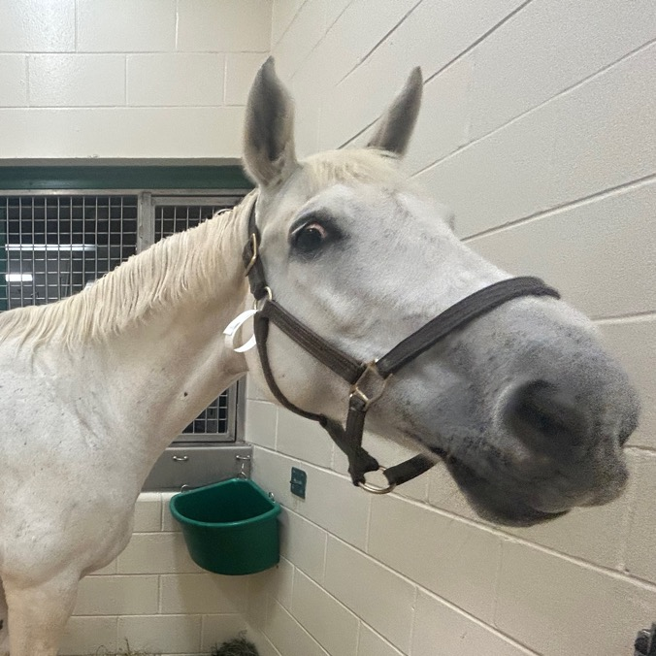
Thank you
Questions?

Slide 24


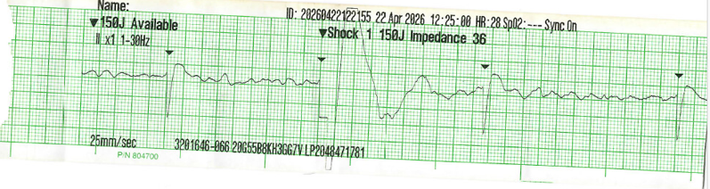
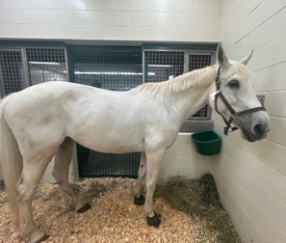
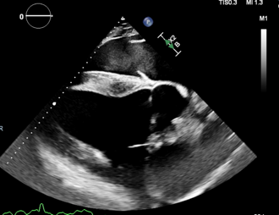
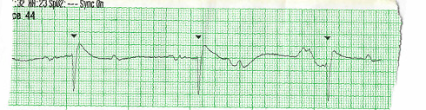
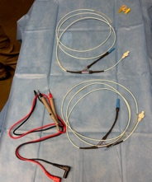
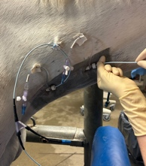
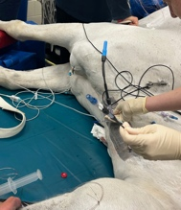
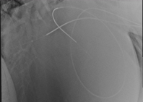
Equine Atrial Fibrillation: Correction with Transvenous Electrical Cardioversion
Jordan Bishman, 2028 - University of Florida College of Veterinary Medicine
Signalment:
14-year-old Warmblood mare used for jumping and dressage
Figure 1. Patient presentation (right)
Presenting Complaint:
Irregularly irregular cardiac rhythm
History:
rDVM auscultated Irregularly irregular cardiac rhythm noted on routine wellness evaluation. Then, referred to an equine hospital in Tennessee for an echocardiogram to evaluate cardiac structure prior to transport to Florida
Clinical Findings:
Bright, alert, and responsive
Rectal temperature: 99.8℉
Heart rate: 36bpm
Respiratory rate: 18bpm (no crackles or wheezes)
Pink and moist mucous membranes, CRT: <2s
On cardiac auscultation, irregularly irregular rhythm auscultated, arterial pulse quality strong but irregular, auscultated no murmurs, S1, S2, and S3 (S4 absent)​
Diagnostics:
Complete blood count: within normal limits (WNL)
Plasma biochemistry: mild elevation in AST
- An increase in AST coupled with lack of elevation in CK can indicate muscle injury (skeletal or cardiac) greater than 48 hours duration​
Fractional excretion (Na+, K+, Mg2+): WNL
Cardiac Troponin I: 0.00ng/mL – no evidence of cardiac muscle damage
Electrocardiogram:
Figure 2. Electrocardiogram of irregularly irregular rhythm
Interpretation:
Absence of P waves​
Presence of f (fibrillation) waves – baseline undulations​
Irregularly spaced QRS complexes​
Echocardiogram:
Figure 3. (below): echo still image (right parasternal four chamber view) focus on left ventricle and left atrium
Interpretation:
Mild – moderate dilatation of left atrium
Trace amount aortic regurgitation with mild valve thickening, trace amount of mitral and tricuspid valve regurgitation, both normal structure and function
Remaining heart structures appear normal
Diagnosis: Atrial fibrillation with LA dilatation
Pathophysiology: Loss of normal electrical conduction within the atria → many random depolarizations to AV node (loss of P waves on ECG) → shortened refractory period → loss of atrial kick → decreased cardiac output
Therapeutic Plan: Transvenous Electrical Cardioversion (TVEC)
Elected to perform TVEC procedure over medical management with 22mg/kg Quinidine Sulfate PO q2 hours due to risk of adverse effects including colic, laminitis, and nasal edema
Note: decreased success of TVEC procedure with structural cardiac changes
Start Sotalol (antiarrhythmic) 2mg/kg PO q12 hours to slow AV node conduction
Materials:
Intravenous catheter (L jugular vein)
Digitimer TVEC Electrodes
Multimeter (to assess functionality of electrodes
2 - 10 French introducer catheters
Defibrillator
Figure 4. (top left): electrodes and introducer catheters prior to placement
Figure 5. (top middle): placement of electrode in L MPA
Figure 6. (top right): patient after induction of anesthesia prior to conversion
Figure 7. (right): left lateral
thoracic radiograph taken to
confirm electrode placement
Procedure:
Placement of introducer catheters and electrodes into right atrium (RA) and left main pulmonary artery (L MPA)
Induction under general anesthesia
Thoracic radiographs taken to confirm electrode placement in RA and L MPA
Biphasic shock delivery via electrodes using defibrillator (150-360 joules): shock is synchronized to QRS complex
12:23pm: 150 joules delivered – AF
12:25pm: 200 joules delivered – AF
12:26pm: 250 joules delivered – conversion to sinus rhythm with 2:1 2nd degree AV block
      AV block resolved within 30 seconds
Outcome:
Figure 8: recheck electrocardiogram post TVEC procedure
Interpretation:
Normal sinus rhythm
Presence of P waves
Continue ECG monitoring post-procedure
Stall rest with gradual return to exercise
Continue Sotalol 2mg/kg q12hr PO x 30 days
Successful correction of atrial fibrillation
2026 Student and New Graduate Case Study Competition

