Slide 1

Pemphigus Foliaceus in a 23-year-old Appendix Quarter Horse Gelding
Megan Fahey
Cornell University, Class of 2027
Dr. Gillian Perkins, Dr. Jeanine Peters-Kennedy, Dr. Jamie Lemus, Dr. Ana Sofia Bariga

Slide 2
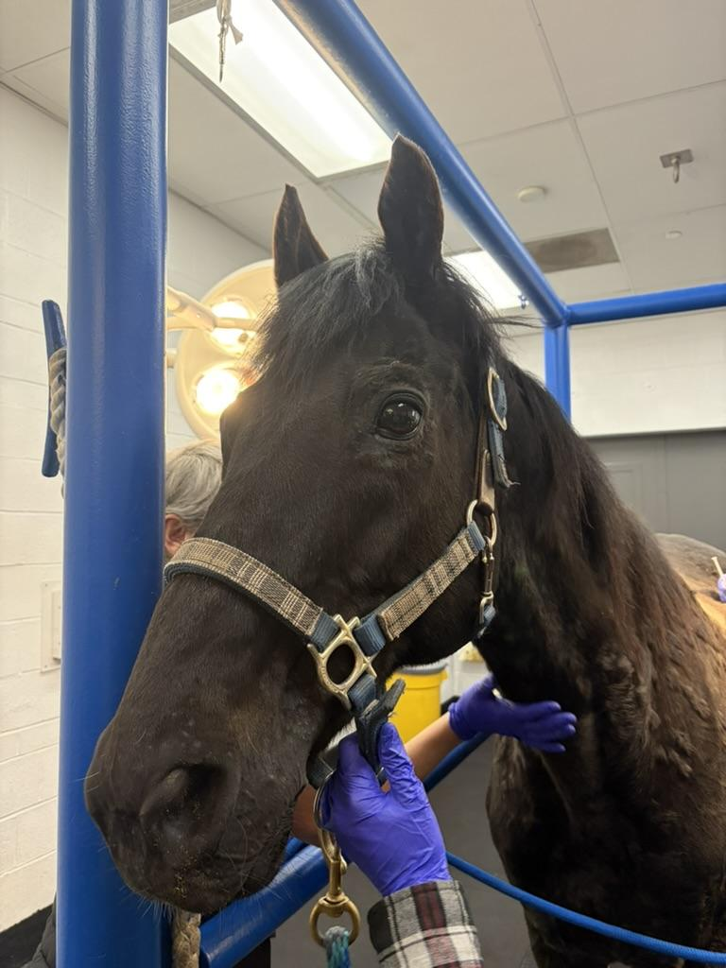
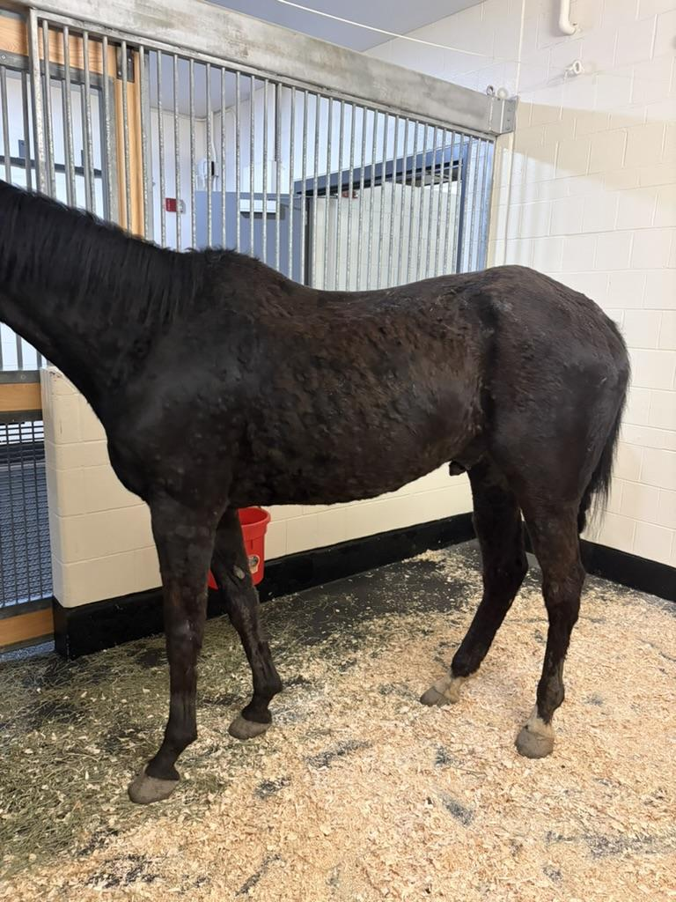

Signalment
23-year-old Appendix Quarter Horse Gelding
Trail horse located in NY
Presenting Complaint:
flaky/crusty skin, unresolved cellulitis

Slide 3
History
Spring 2024
Acute onset of suspected distal limb cellulitis, treated with Excede
Over the next month → generalized urticaria, crusting, and alopecia
  marked pruritus and reluctance to move
  responded to dexamethasone treatment
Spring 2025
PCR-positive for Strangles
  mild cough without lymph node abscessation
No dermatologic disease
Spring 2026
decreased appetite, stiffness
referring DVM reported edema of hind limbs and sheath, generalized crusting and severe pruritus
  partial improvement on dexamethasone, recurrence during taper
  referral to Cornell Large Animal Internal Medicine Service for further evaluation

Slide 4
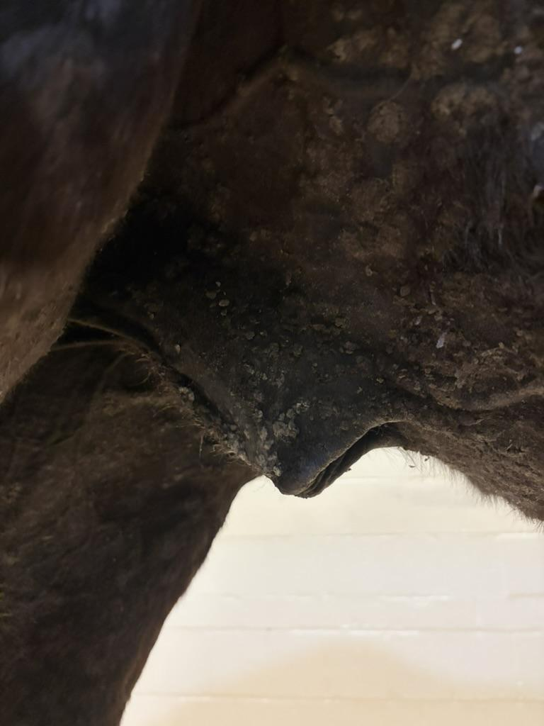
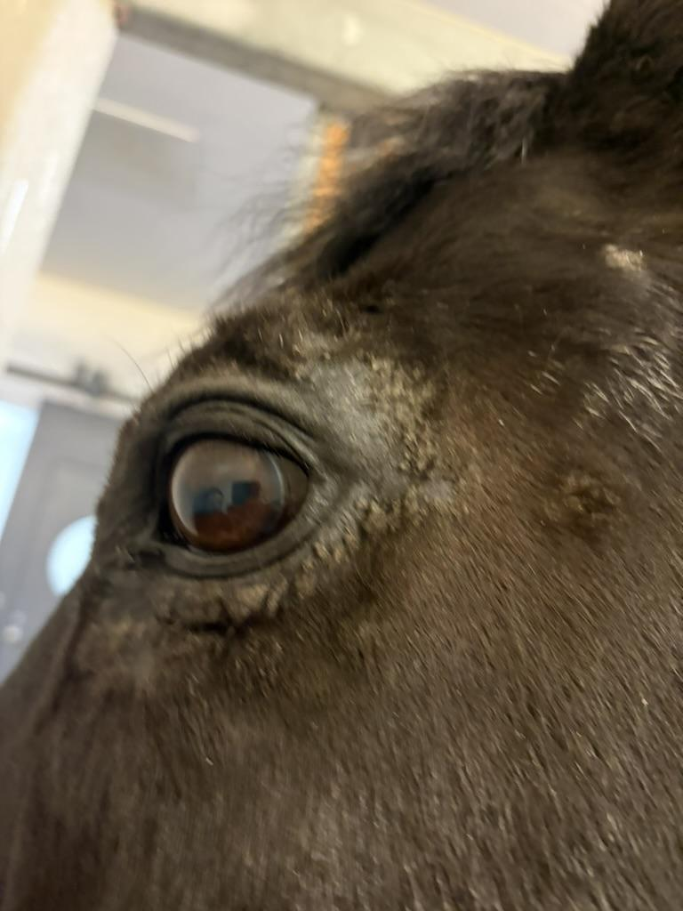
Clinical Findings
General
Bright and alert
CV, respiratory, GI within normal limits
mild enlargement of mandibular lymph nodes
No lameness appreciated at the walk
Dermatologic Findings
Severe generalized pruritus
Marked cutaneous hyperesthesia
Diffuse urticaria
Thick crusting of the periocular region, pinnae, neck, trunk, ventrum, distal limbs, and sheath

Slide 5
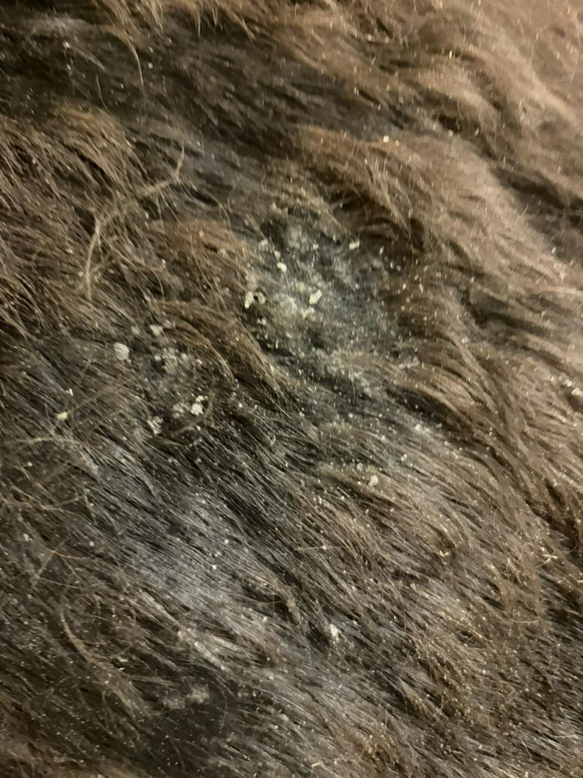
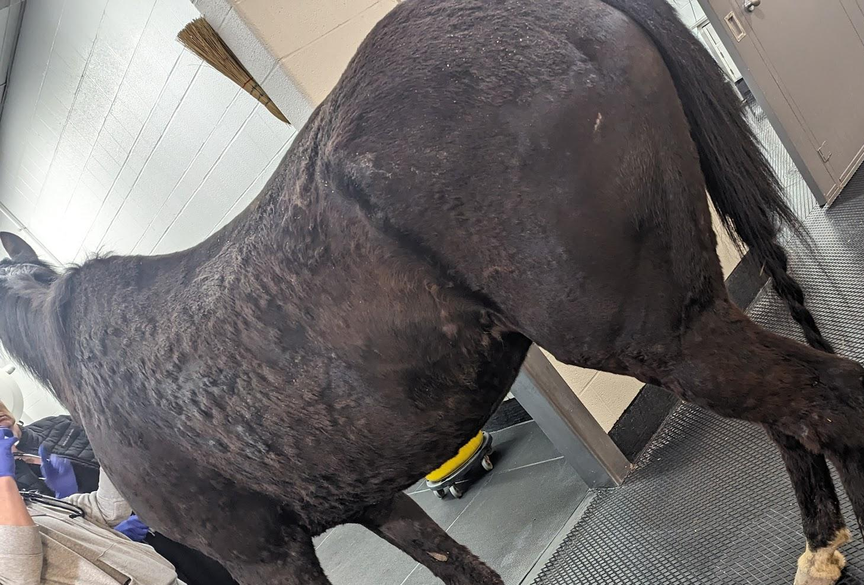
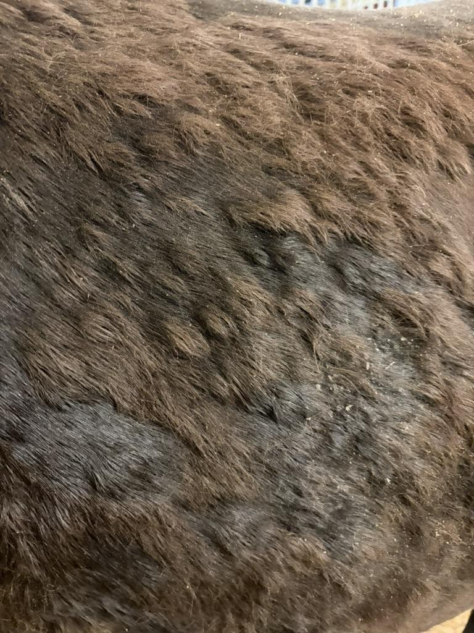
Clinical Findings
Thorax
Neck

Slide 6
Assessment
Prioritized Problems:
1. Severe generalized crusting dermatitis
2. Marked generalized pruritus
3. Distal limb and sheath edema
4. Bacterial skin infection
5. Decreased appetite
6. Stiffness/reluctance to move
Inflammatory dermatologic disease?
seasonally recurrent? responded to dexamethasone in Spring 2024, only partial response Spring 2026
suspect secondary to above

Slide 7
Assessment
Prioritized Problems:
1. Severe generalized crusting dermatitis
2. Marked generalized pruritus
3. Distal limb and sheath edema
4. Bacterial skin infection
5. Decreased appetite
6. Stiffness/reluctance to move
Differential Diagnoses:
Pemphigus foliaceus (prioritized)
Dermatophytosis
Primary bacterial folliculitis
Insect bite hypersensitivity
suspect secondary to above

Slide 8
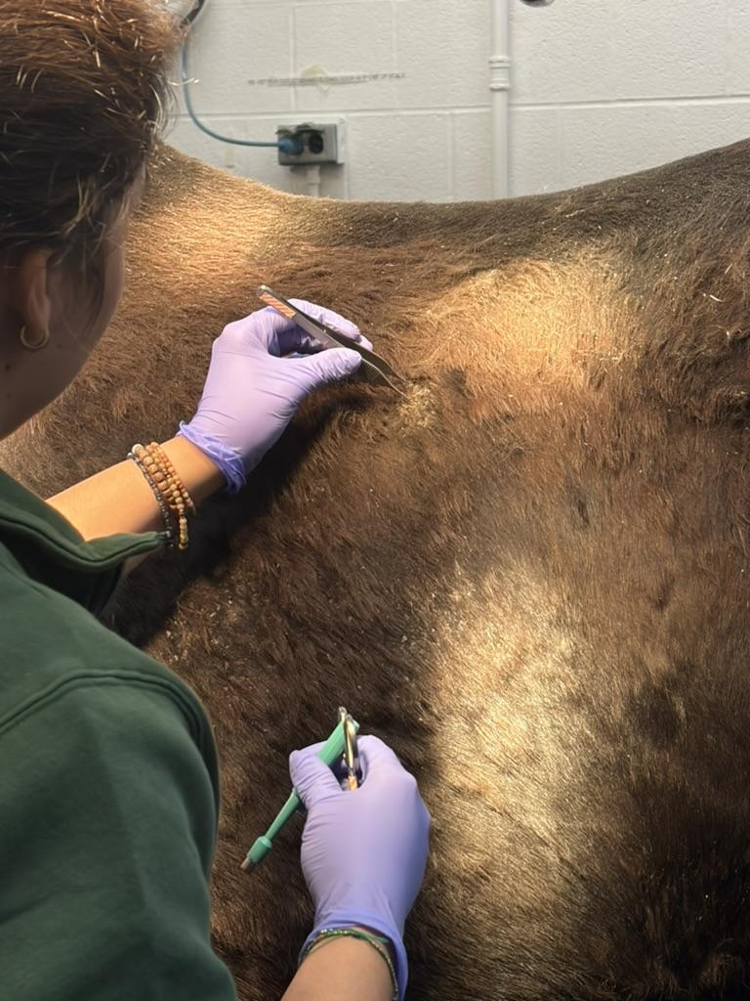
Plan
Consult with Dermatology:
full dermatologic exam
impression cytology from crusts
punch biopsies for histopathology
aerobic bacterial culture and sensitivity
  Staphylococcus species, susceptible to enrofloxacin
dermatophyte culture
  negative

Slide 9
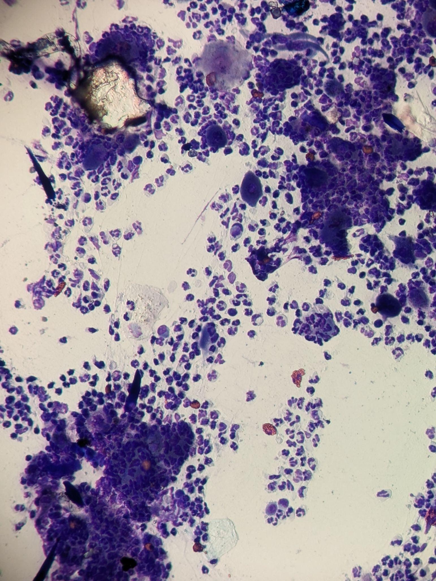
Cytology
Impression smear of crusted lesions:
numerous non-degenerate neutrophils
moderate acantholytic keratinocytes (arrows)
moderate eosinophilic inflammation
mild nuclear streaming
extracellular cocci present

Slide 10
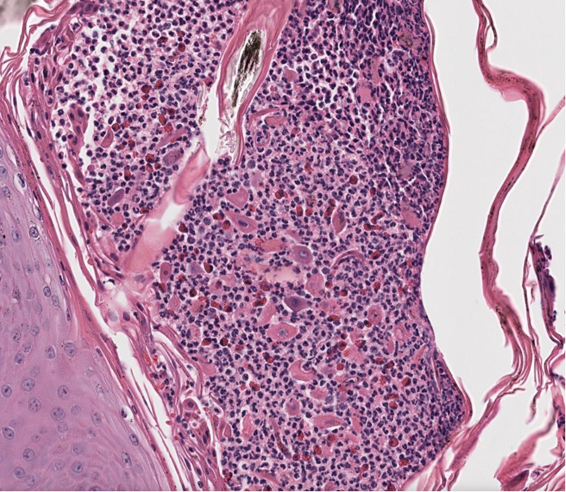
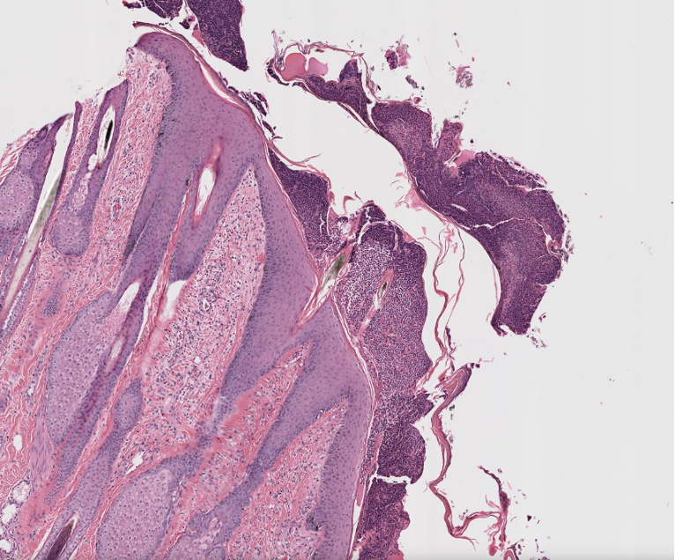
Histopathology
Histologic diagnosis:
moderate, diffuse, crusting and pustular dermatitis with acantholytic keratinocytes (arrows)
Comment:
consistent with the diagnosis of pemphigus foliaceus and secondary bacterial folliculitis

Slide 11
Treatment
Initial Treatment:
Switched from dexamethasone to prednisolone (1 mg/kg by mouth once daily)
  *increased to 2 mg/kg once biopsy results came back confirming pemphigus
Continue enrofloxacin (7.5 mg/kg by mouth once daily)
Vetericyn spray twice daily on crusts
Zymox shampoo and conditioner for bathing every few weeks
Additional Considerations:
Steroid-sparing drugs: pentoxifylline, azothioprine
Off-label oclacitinib (Apoquel)
Address underlying cause: insect control, reduced sun exposure

Slide 12
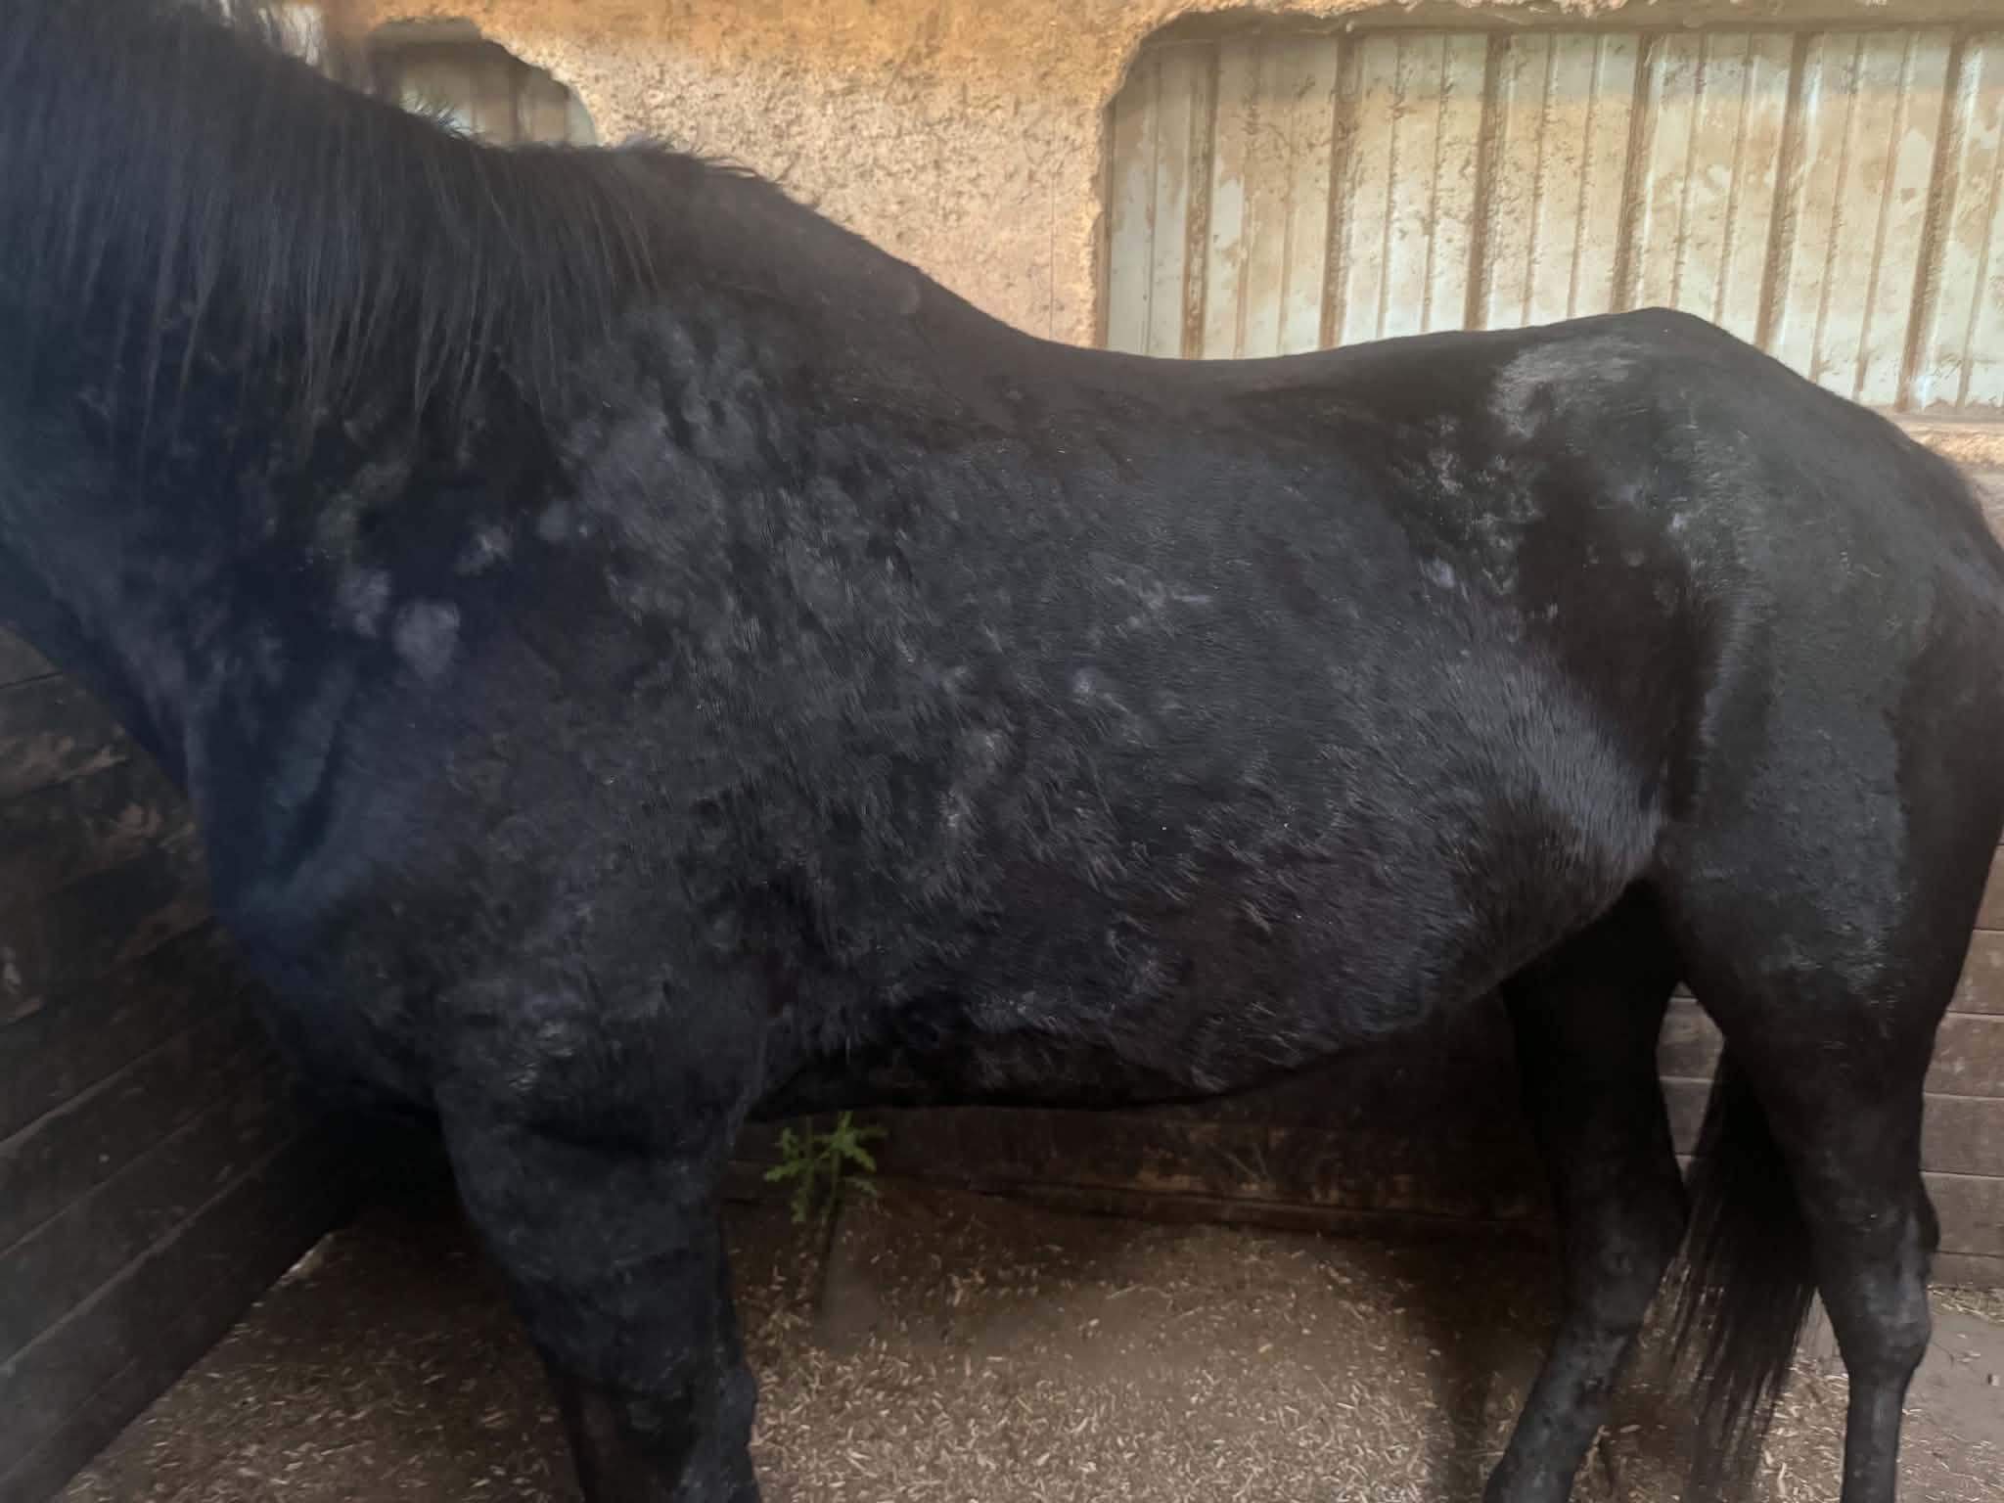
Response to Treatment
Mild to moderate improvement in crusting dermatitis and pruritus
presentation
12 days later

Slide 13
Outcome
8-week follow-up with Dermatology Service:
Stable clinical disease with no new lesions, normal appetite and energy, and ongoing multimodal management
  steroid taper attempt at ~1 month resulted in a flare-up, returned to prednisolone 2 mg/kg then transitioned to dexamethasone at 75% dose reduction equivalency → significant improvement compared to prednisolone
  added pentoxifylline 1 mg/kg, steroid taper planned for 2-3 weeks later
Long term: monitor for flare-ups, secondary skin infections, and continue environmental management to avoid potential “triggers” (sunlight, insects, etc.)

Slide 14

Pemphigus Foliaceus in a 23-year-old Appendix Quarter Horse Gelding
Megan Fahey, Class of 2027 – Cornell University
SIGNALMENT & HISTORY
ASSESSMENT & DIAGNOSTICS
TREATMENT & OUTCOME
Presentation 12 days later
Prednisolone (up to 2 mg/kg PO q24h after biopsy confirmed diagnosis) plus enrofloxacin; topical Vetericyn and Zymox bathing
Mild-to-moderate improvement in crusting and pruritus by 12-day recheck
8-week recheck: stable on multimodal therapy; steroid taper triggered a flare, transitioned to dexamethasone with improved control; pentoxifylline added
Long-term plan: gradual steroid taper, monitor for flares/secondary infection, minimize sun and insect exposure
23-year-old Appendix Quarter Horse gelding; trail horse located in NY
Presented for flaky/crusty skin and unresolved cellulitis
Recurrent crusting, urticaria, and pruritus since spring 2024; partial response to dexamethasone, recurrence on taper
PCR-positive Strangles in 2025 (mild cough, no dermatologic disease that spring)
Cytology: acantholytic keratinocytes with neutrophilic/eosinophilic inflammation and extracellular cocci
Aerobic culture: Staphylococcus spp., susceptible to enrofloxacin; dermatophyte culture negative
Histopathology: diffuse crusting, pustular dermatitis with acantholytic keratinocytes
Diagnosis: Pemphigus foliaceus with secondary bacterial folliculitis
2026 Student and New Graduate Case Study Competition

