Slide 1


Successful Control of Metastatic Nasal Squamous Cell Carcinoma in a 20-year-old Stock Horse Through Multimodal Therapy
Giuliana LaMarca
University College Dublin, 2025
Gaby van Galen, DVM, PhD, Dipl ECEIM, Dipl ECVECC

Slide 2
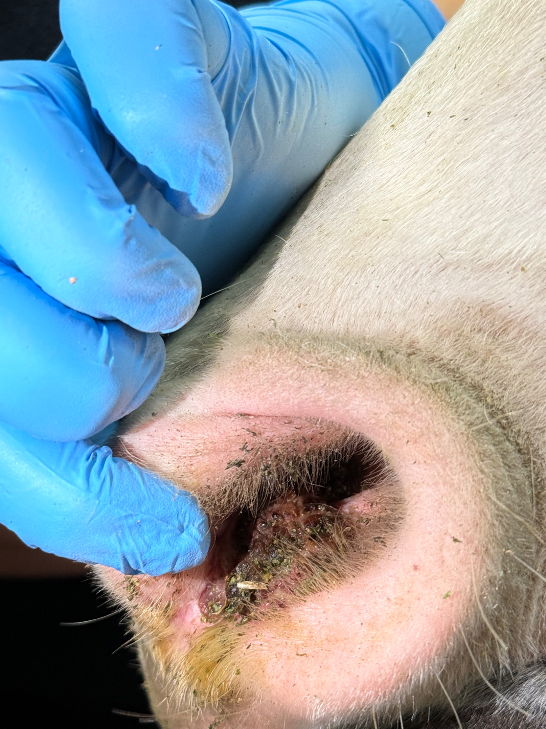

Signalment & Presentation
Signalment & History
Presentation
20-year-old Australian Stock Horse Gelding
Initial presentation in April 2025 in Victoria, Australia
Painful lesion in left nostril noted approx. 12 months prior to presentation
Refractory to multiple treatments at another hospital
  Electrocauterization
  Cryotherapy
  Effudix (topical 5% fluorouracil)
  Surgical excision (was not sent for histopathology)
Initial physical examination
  BAR, HR 40, RR 20, Temp 37.6ºC (99.7ºF)
Initial skin examination
  Thick left submandibular lymph node, hard on palpation
  Ulcerated, crusty lesion in the left ventral nostril, with serohemorrhagic secretions and irregular borders

Slide 3
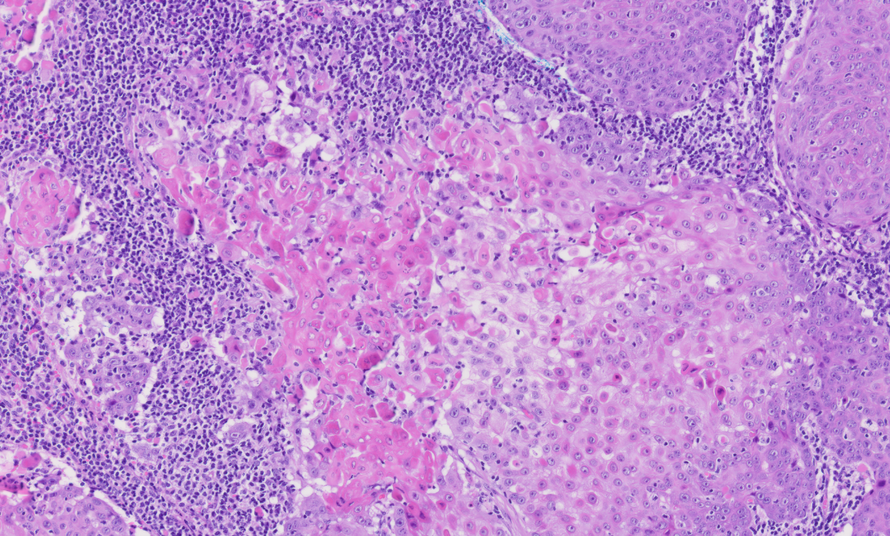
Investigation: Day 1
Problem List
Diagnostics
Painful lesion/mass in left nostril
Left submandibular lymphadenopathy
Left nostril mass → incisional biopsy
Result: histologic findings consistent with a squamous cell carcinoma
Left submandibular lymph node → fine needle aspirate
Result: findings reflected non-specific inflammation and no evidence of a metastasis, though it cannot be excluded on cytology alone.
Differential Diagnoses
Left Nostril Mass
Infection (i.e. abscess)
Cyst
Immune-mediated process
Neoplasia
Left Submandibular Lymphadenopathy
Reactive
  Infectious
  Non-infectious (immune-mediated)
Neoplasia

Slide 4
Diagnosis & Initial Treatment Plan
Diagnosis
Squamous cell carcinoma with unknown metastasis
Initial Treatment Plan
Piroxicam tablets (80 mg PO SID)
Chemotherapy: 4 times local infiltration with slow release 5-fluorouracil (every 5 days) followed by 4 times local infiltration with slow-release carboplatin (every 5 days)
Cryotherapy: after the initial and final chemotherapy infiltrations
Flunixin as needed as it is likely the lesion will worsen initially
After the initial 35 days of treatment, → period of 2 weeks without treatment (only ongoing piroxicam).
Then, an assessment will be made to see if the treatment was successful or if additional treatment is needed.

Slide 5
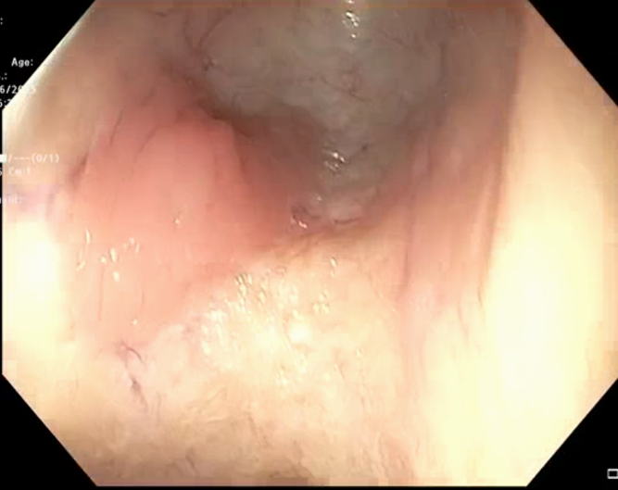
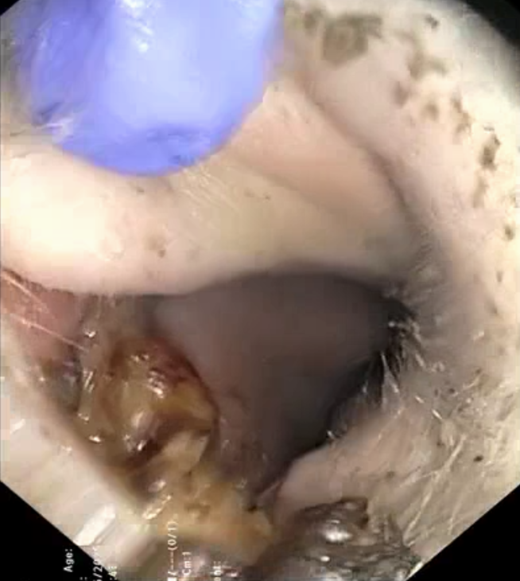
Case Progression: Treatment #1
Day 61 – weight: 480kg
Two masses in left nostril present
Regrowth from biopsy site
Junction between ventral nostril & septum
Full blood work
SAA = 27
Mild lymphopenia – 1.29 x 10⁹/L (RI 1.5-7.7)
No other abnormalities
Endoscopy of the Upper Respiratory Tract
Swelling in pharyngeal recess → biopsied
Result: lymphocyte rich tissue → no evidence of neoplasia
Surgical Excision of Left Submandibular Lymph Node
Result: squamous cell carcinoma
Treatment Plan
Original treatment plan continued → 1st chemotherapy injection with fluorouracil
First round of cryotherapy performed on nasal mass
Updated Diagnosis: metastatic squamous cell carcinoma

Slide 6
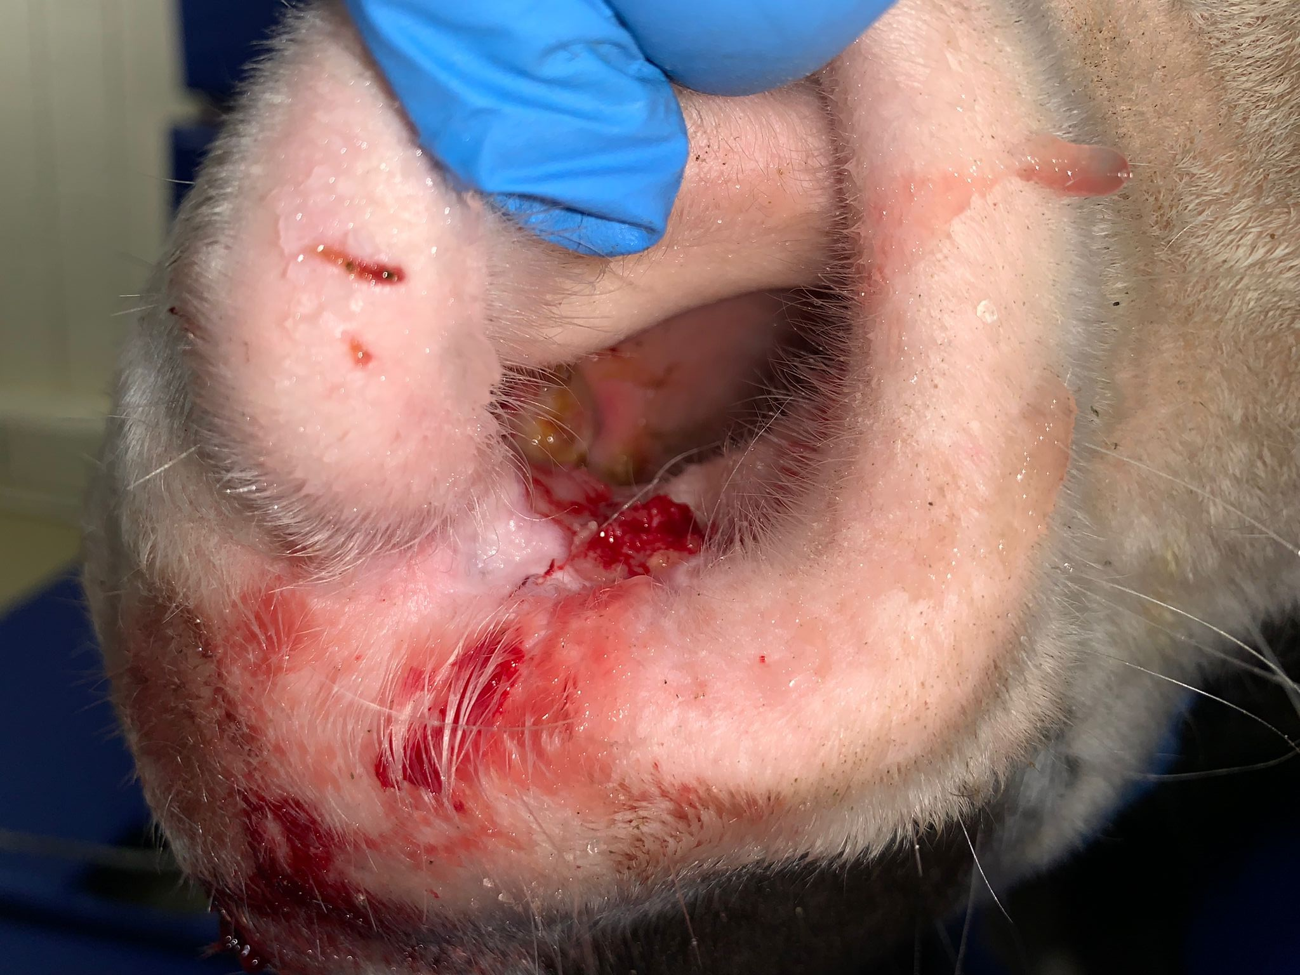
Case Progression: Treatment #2
Day 67 – weight: 480kg
Chemotherapy #2 – Fluorouracil
Maxillary nerve block attempted but unsuccessful due to intense hyperreactivity to needle placement
Ring block is attempted around the nostril but was unsuccessful for the same reasons
Induction and TIVA maintenance required for injection of chemotherapy

Slide 7
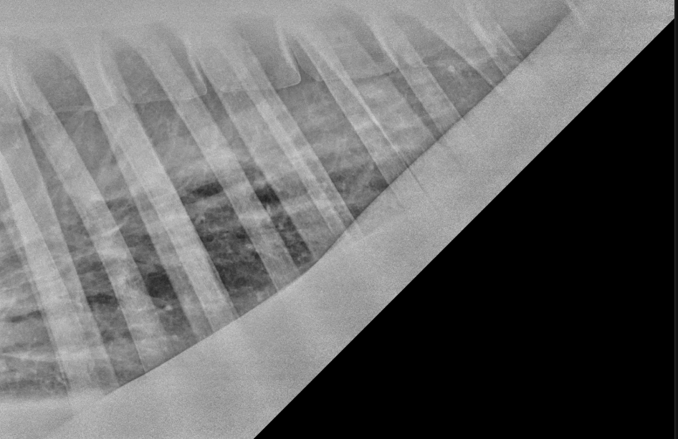
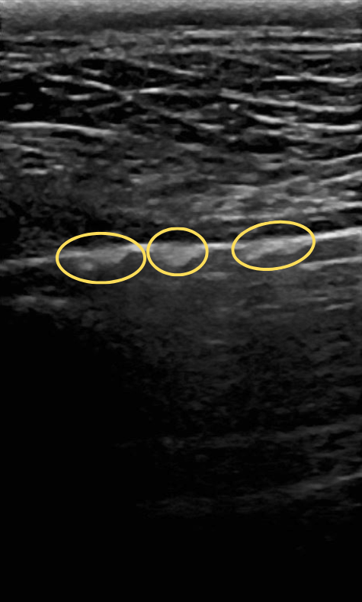
Case Progression: Treatment #3
Day 70 – weight: 451kg
Chemotherapy #3 – Fluorouracil
Lung auscultation revealed harsh lung
sounds craniodorsally.
Ultrasound thorax
  Presence of multiple pleural
nodules visible mainly on the
caudal half of the lungs.
Overall irregular pleura.
Thoracic ultrasound
  Ill-defined radiopaque circular
lesions caudally.
Systemic cyclophosphamide was recommended after discovery of pulmonary metastasis, but declined by owner. With no changes to treatment plan, proceeded with Fluorouracil injection under TIVA.

Slide 8
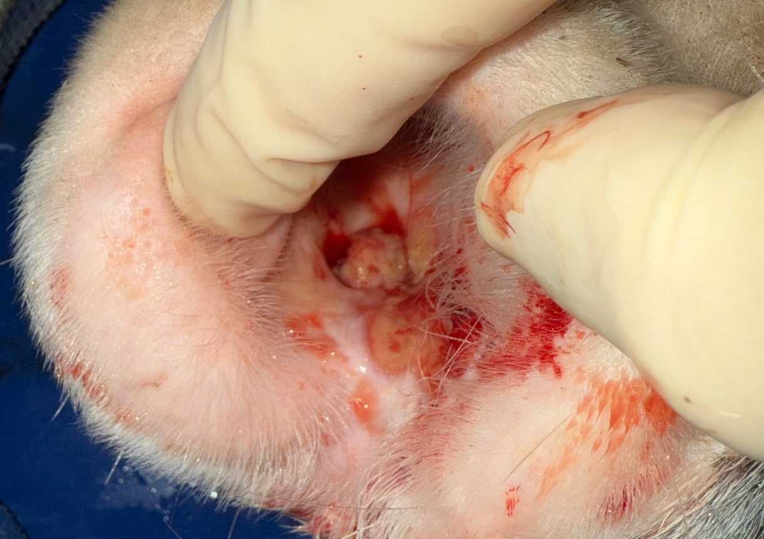
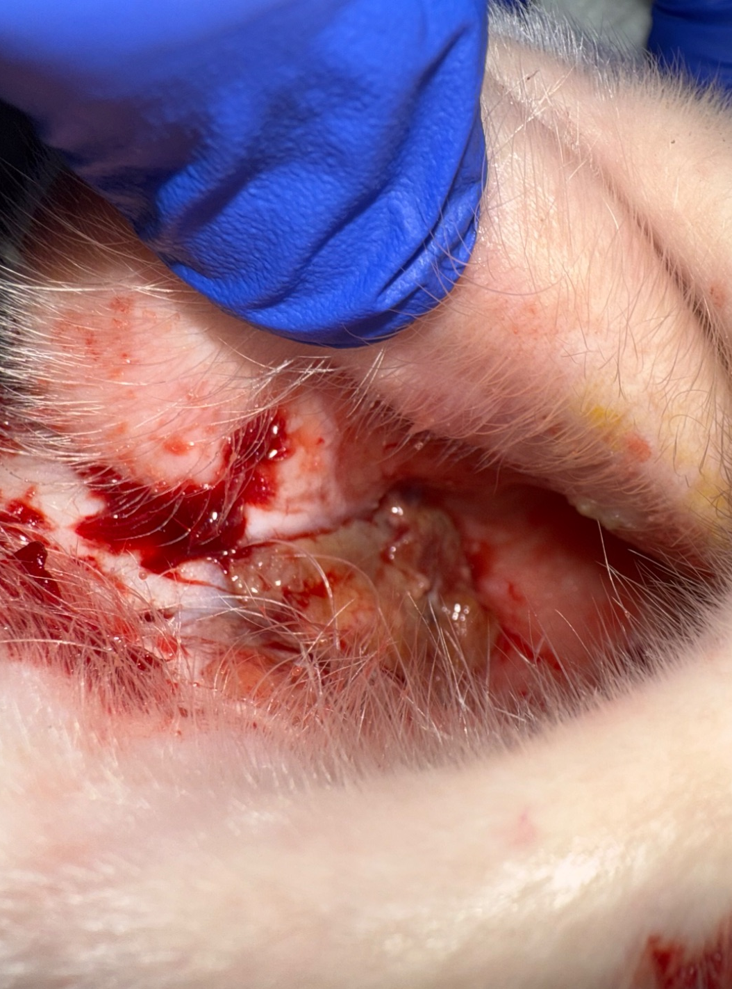
Case Progression: Treatment #4-6
Day 75 – weight: 442kg
Chemotherapy #4 – Fluorouracil
TIVA + local blocks required to inject
Day 80 – weight: 438kg
Chemotherapy #5 – Carboplatin
TIVA + local blocks required to inject
July 9
Day 85 – weight: 437kg
Chemotherapy #6 – Carboplatin
TIVA + local blocks required to inject
Pre-loading 12 topical applications of Effudix overnight followed by BID Effudix application until cryotherapy on day 95
July 18

Slide 9
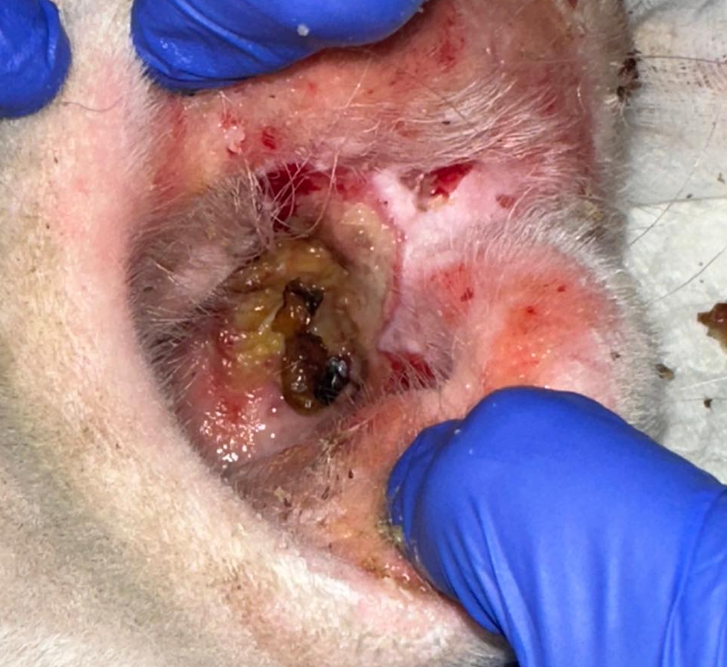
Case Progression: Treatment #7-8
Day 90 – weight: 437kg
Chemotherapy #7 – Carboplatin
TIVA + local blocks required to inject
Ongoing BID Effudix application
Day 95 – weight: 437kg
Chemotherapy #8 – Carboplatin
TIVA + local blocks required to inject
Post-chemotherapy cryotherapy with liquid nitrogen
July 23

Slide 10
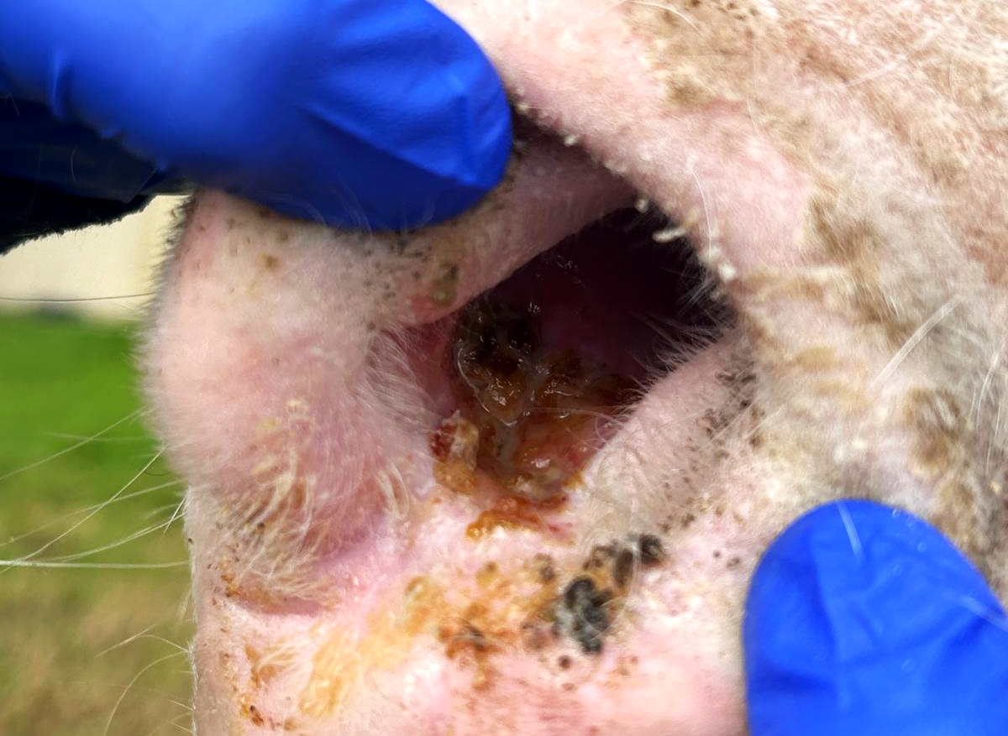
Case Progression: 2 Week Control Check
Day 110 – weight: 435kg
Ongoing daily piroxicam treatment with last chemotherapy injection 16 days prior
Skin around his nostril healed
Mass in the nostril is still visible — flat and crusted
Clinically BAR, normal vitals, no further weight loss, good appetite

Slide 11
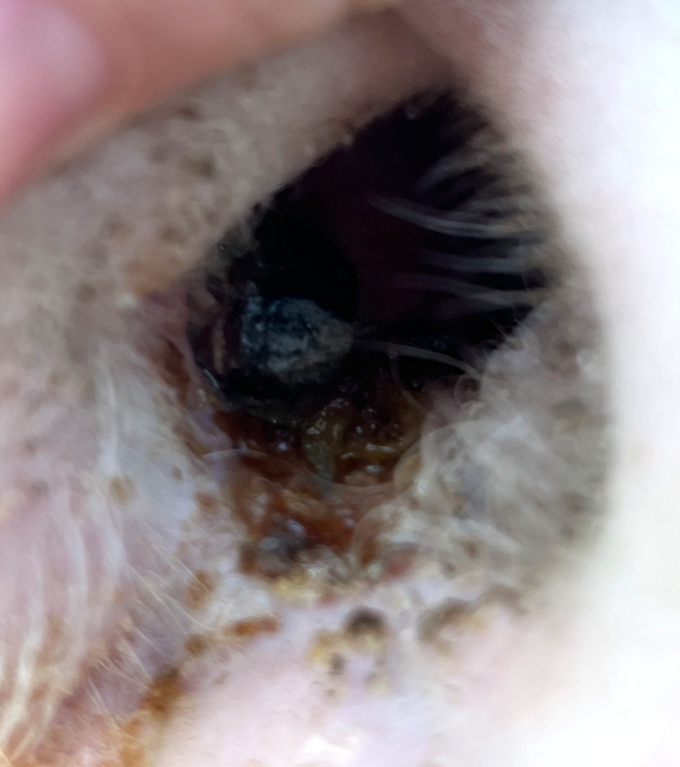
Case Progression: Surgical Removal
Day 130 – weight: 454kg
Ongoing daily piroxicam treatment since last chemotherapy injection on 7/28
Lung auscultation: mild crackles
Mass regrowth → mushroom shape approx 1 cm depth and 1-1.5cm in diameter
Normal SAA, hematology, and biochemistry
Thoracic US: very few and small lesions, though improved
Left submandibular lymph node regrowing into hard mass

Slide 12
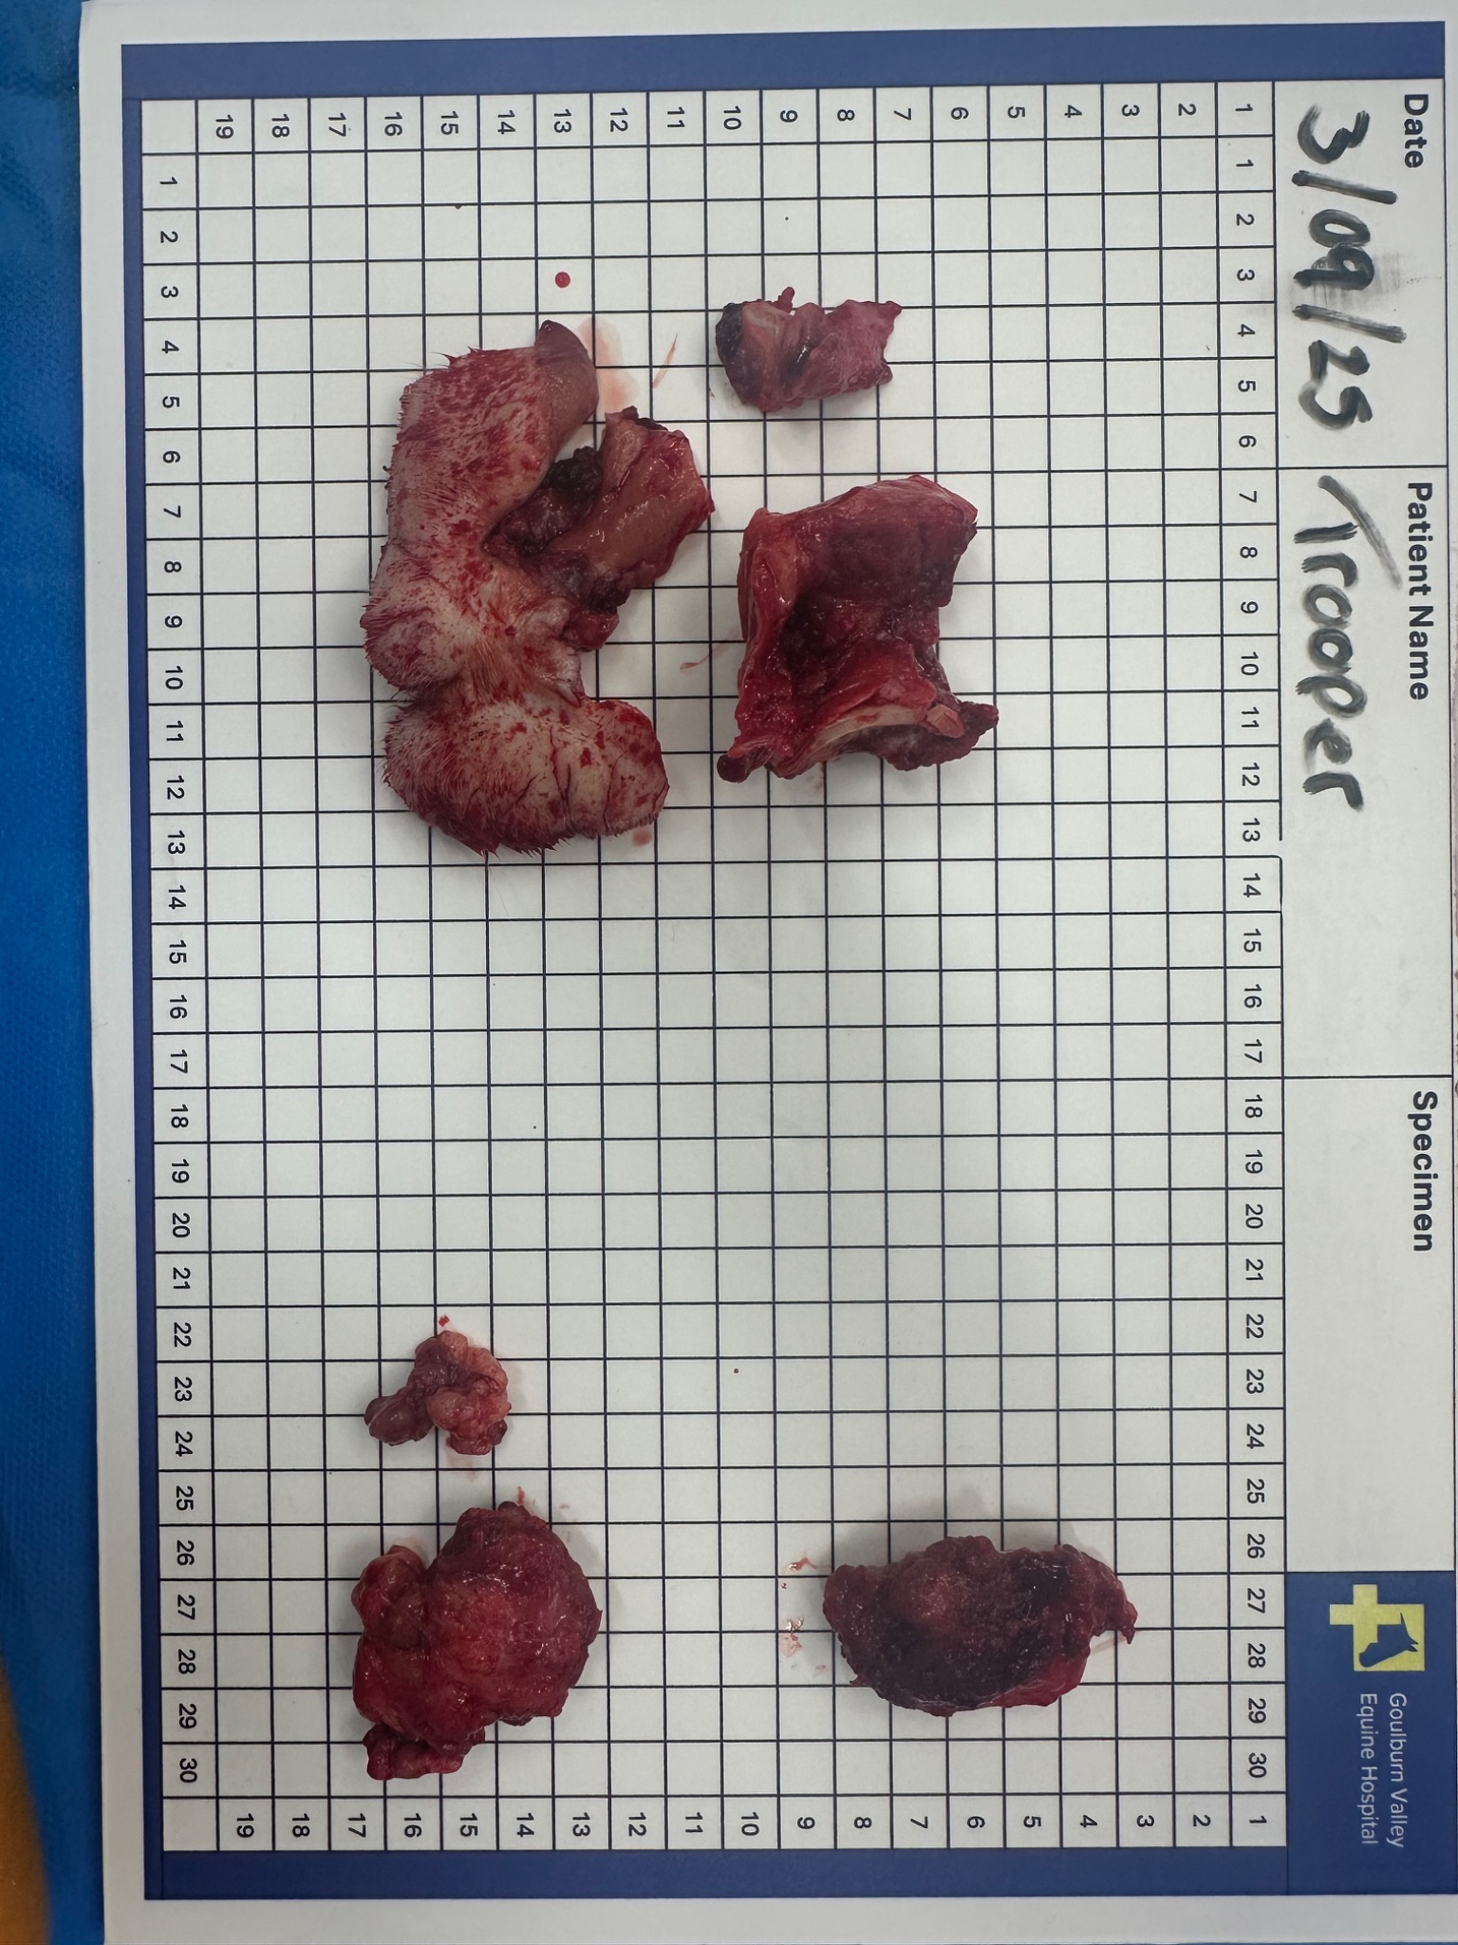
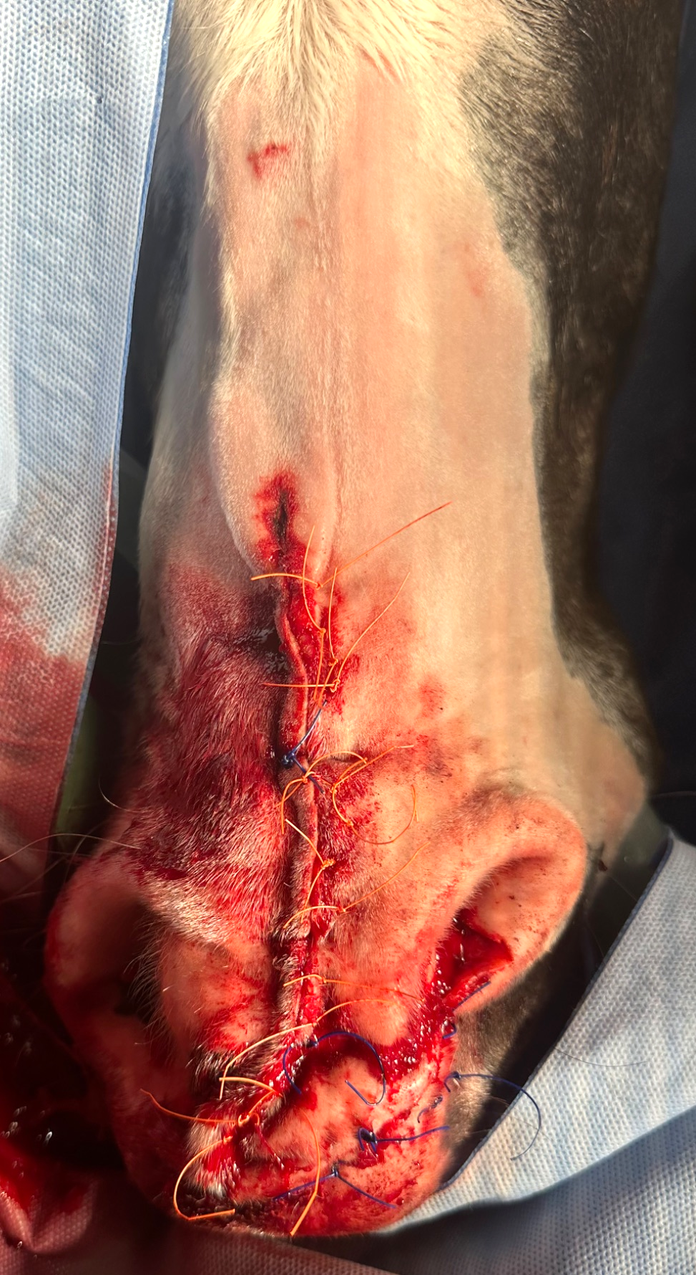
Case Progression: Surgical Removal
Day 131
Extensive surgical removal of the nasal mass together with partial nasal septum removal and reconstruction
Enlarged submandibular lymph node mass excised in total
Histology confirmed presence of SCC and its infiltration into the nasal septum
Injection of carboplatin in nose and submandibular area every
five days for three treatments followed surgery
Ongoing oral piroxicam continued

Slide 13
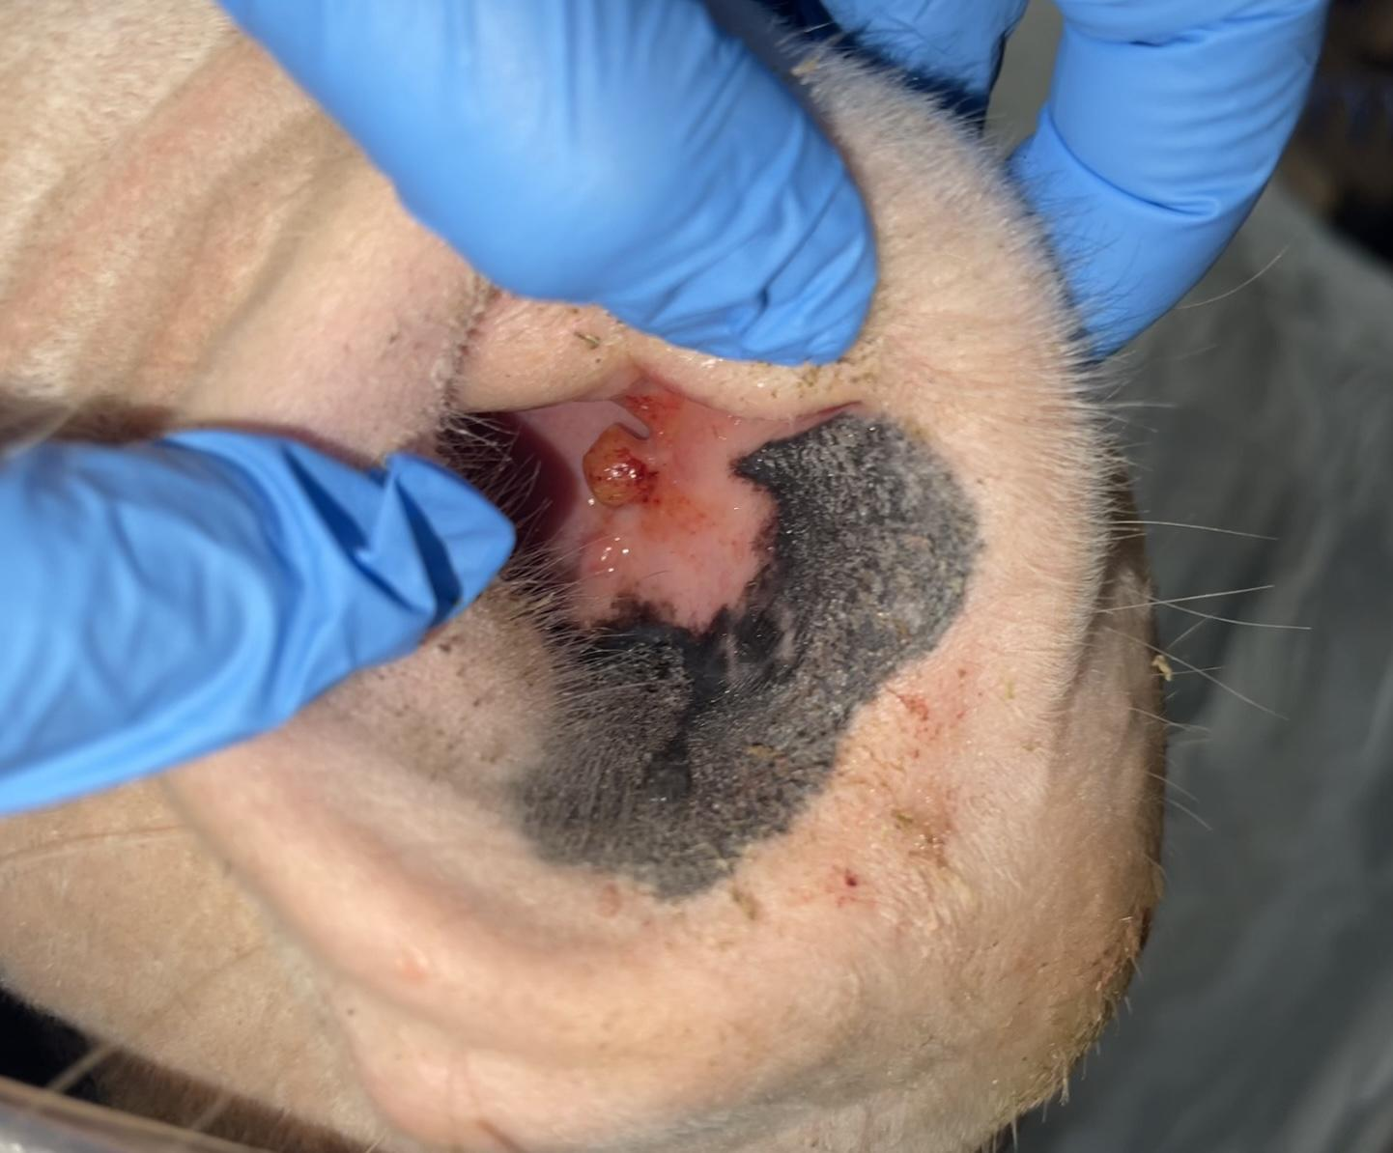
Case Progression: Post-op to Remission
Day 146 – weight: 420kg
Chemotherapy #3 – Carboplatin
Thoracic XR: no major nodules seen, improvement from previous radiographs
Thoracic US: no nodules seen but pleural irregularities present, improvement still
Day 171 – weight: 465kg
No evidence of regrowth of nostril/lymph node mass
Day 200 – weight: 492kg
Thoracic XR: few small radiopaque lesions noted
Thoracic US: single nodule seen with pleural irregularities, improvement still
Right nostril had small cauliflower growth → biopsied
  Result: inflammatory tissue, no evidence of SCC
Right Nostril 11/11

Slide 14
Case Outcome
Day 242 – weight: 496kg
Right nostril mass still present
No abnormalities on clinical exam
Day 305 – weight: 495kg
Right nostril mass no longer present & no abnormalities on clinical exam
Thoracic XR/US showed overall improvements, mild pleural irregularities
Piroxicam reduced to two weeks on & two weeks off for 3 months
Day 390 – weight: 500kg
Thoracic US: mild pleural irregularities, overall improved
Thoracic XR: similar to previous images, no evidence of new/progressive nodular lesions
Piroxicam discontinued, with a recheck scheduled in two months

Slide 15
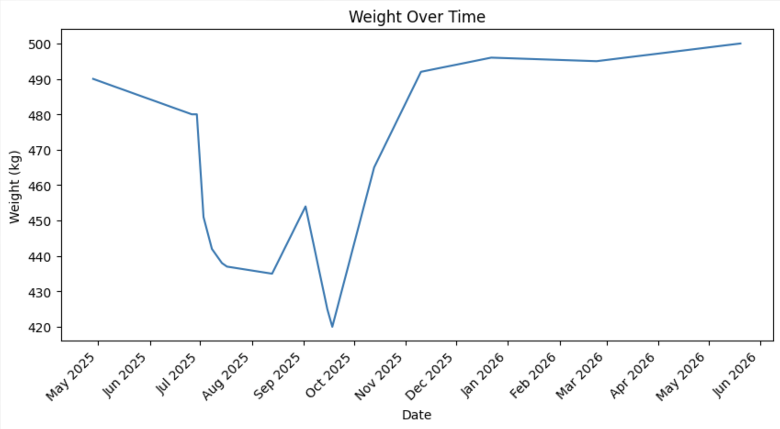
Case Outcome
Day 451 – weight: 486kg
Off Piroxicam since day 388 (2 months ago)
Hematology, biochemistry, SAA within normal limits
Thoracic radiographs and ultrasound showed no change from previous visit
No evidence of recurrence of squamous cell carcinoma within the left nostril, left submandibular lymph node or lungs
In this case, notable weight loss occurred leading up to and just after the surgical procedure to remove the primary SCC mass. This is associated with the metastatic nature of the neoplasia as well as intensive chemotherapy treatments.

Slide 16
Case Outcome and Implications for Clinical Practice
Nasal squamous cell carcinoma (SCC) is an uncommon presentation site in the horse. The metastatic rate has been reported at 10-19%.¹
Treatment of a local lesion is not synonymous with control of metastatic spread.²
There is limited data that supports piroxicam as a less invasive yet successful treatment modality to help control spread.³
This case achieved remission following a comprehensive multimodal treatment plan. Early, aggressive, multimodal treatment combined with persistence was required to control local tumor development. Oral piroxicam was an inexpensive yet effective addition to control the metastatic SCC in this case. Piroxicam is well documented in humans and dogs for treatment of metastatic SCC⁴ and has been used successfully in few equine case reports.⁵

Slide 17
Case Outcome and Implications for Clinical Practice
In some cases, FNA’s can be inconclusive and not representative of a masses true cell population. Diagnostic biopsies in this case were a valuable tool to determine the metastatic nature of this neoplasia and to formulate an effective treatment plan as previous treatment attempts were done without a diagnosis.
In cases refractory to single treatments, a multimodal approach is often done in human and small animal medicine. This case is an example that tailoring multiple treatments to a single patient based on its clinical picture and it can be successful. The plan in this case was consistently re-evaluated and initially surgical removal was declined, but revisited as the metastasis was confirmed and chemotherapy alone did not control the neoplasia.
Piroxicam is effective in this case as in some other documented cases. It is easy to administer, with minimal side effects and financial burden to the client. This is a great way to improve owner compliance.
Cyclophosphamide was a viable treatment option available but not performed due to its side effects.
Oncological cases in equine medicine can be successfully treated as in human and small animal medicine if the owner is committed to a prolonged treatment plan.

Slide 18
References/Acknowledgements
Acknowledgements
Case Involvement: GVEH veterinarians - Dr. Gaby van Galen DVM, PhD, Dipl ECEIM, Dipl ECVECC; Dr. Denis Verwilghen DVM, MSc, PhD, DES, Dipl ECVS, Dipl EVDC(eq); Dr. Marie Vandecandeare, DVM, ECEIM Resident; Dr. Chiara di Donato DVM, ECVECC Resident
Oncology Consult: Prof Derek Knottenbelt BVM&S, DVM&S, DipECEIM, MRCVS; Emma Alsop Cert EM (IntMed) MRCVS (Equine Medical Solutions)
¹Taylor, S. and Haldorson, G. (2012) ‘A review of equine mucocutaneous squamous cell carcinoma’, Equine Veterinary Education, 25(7), pp. 374–378. doi:10.1111/j.2042-3292.2012.00457.x.
²Elce, Y.A. et al. (2011) ‘Metastasis or delayed local extension of ocular squamous cell carcinoma in four horses’, Equine Veterinary Education, 23(10), pp. 496–499. doi:10.1111/j.2042-3292.2010.00211.x.
³Elce, Y.A., Orsini, J.A. and Blikslager, A.T. (2006) ‘Expression of cyclooxygenase-1 and -2 in naturally occurring squamous cell carcinomas in horses’, American Journal of Veterinary Research, 68(1), pp. 76–80. doi:10.2460/ajvr.68.1.76.
⁴Schmidt, B.R. et al. (2001) ‘Evaluation of piroxicam for the treatment of oral squamous cell carcinoma in dogs’, Journal of the American Veterinary Medical Association, 218(11), pp. 1783–1786. doi:10.2460/javma.2001.218.1783.
⁵Moore, A.S. et al. (2003) ‘Long‐term control of mucocutaneous squamous cell carcinoma and metastases in a horse using piroxicam’, Equine Veterinary Journal, 35(7), pp. 715–718. doi:10.2746/042516403775696320.

Slide 19

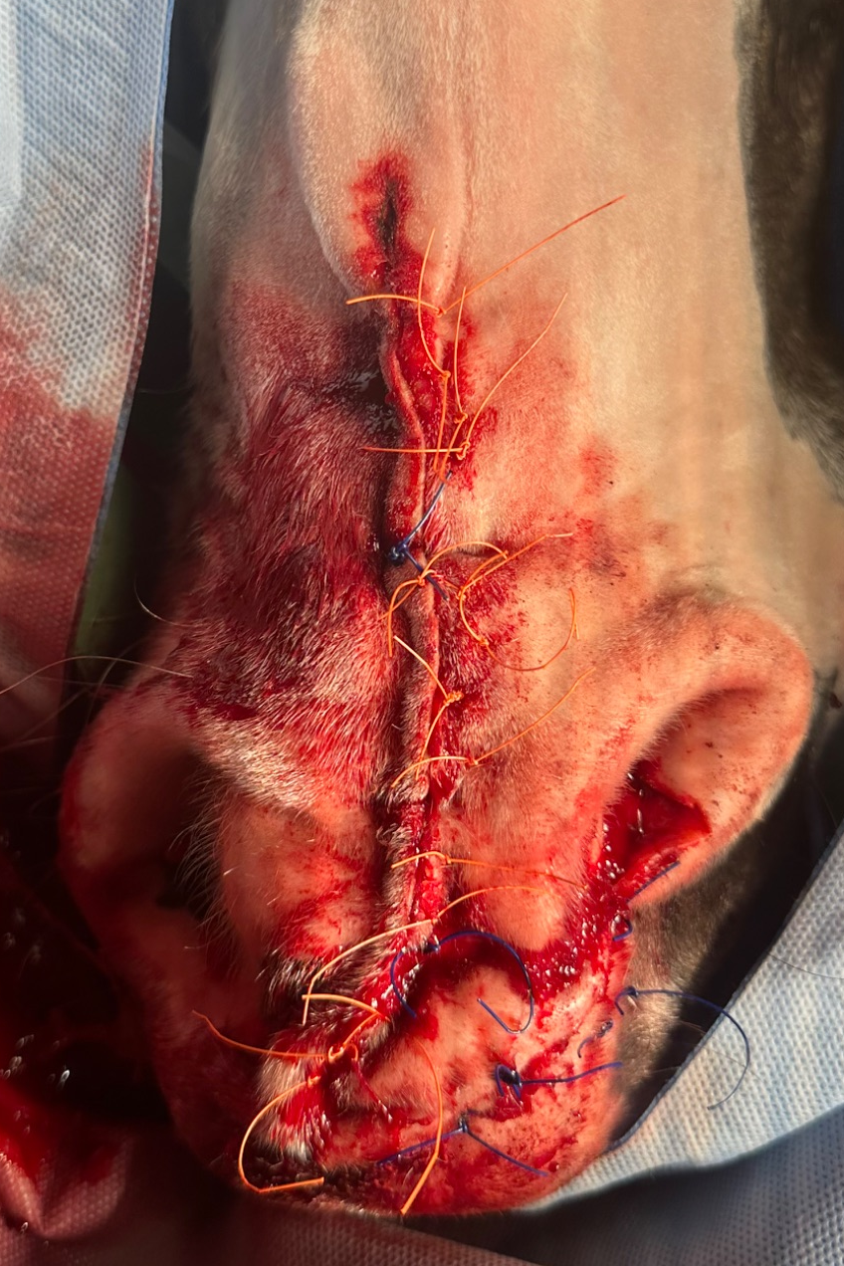
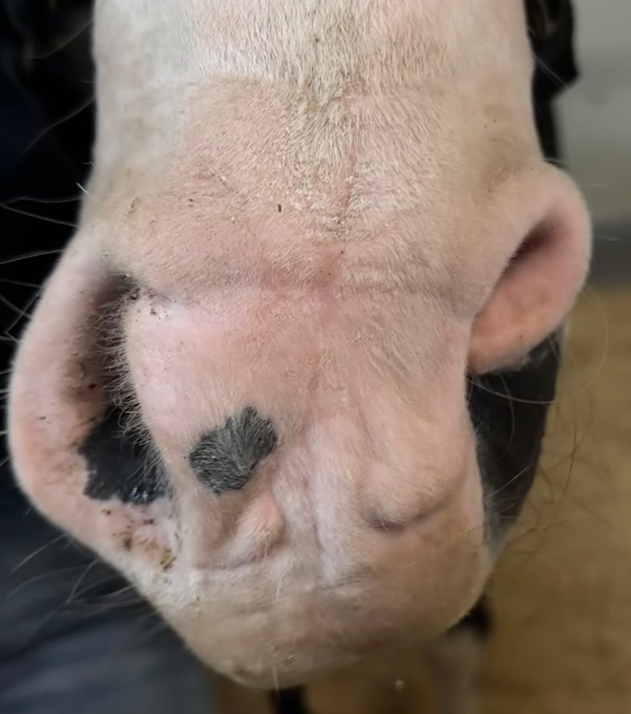
Successful Control of Metastatic Nasal Squamous Cell Carcinoma in a 20-year-old Stock Horse Through Multimodal Therapy
Giuliana LaMarca — University College Dublin, 2025
Signalment & History
A 20-year-old Stock Horse Gelding presented in April 2025 with a mass in the left nostril refractory to several treatment attempts at a different hospital (electrocauterization, cryotherapy, effudix, and surgical excision).
Treatment Plan Cont.
3. Cryotherapy after the first and last injection.
4. Flunixin as needed
Day 130
- Extensive surgical removal of the nasal mass together
- Left submandibular lymph node mass excised in total
- Three slow-release carboplatin injections one-week post-op administered at 5-day intervals
Day 61: Chemotherapy #1
- Nasal mass had regrown
- Left submandibular LN still enlarged → excised and histopathology confirmed SCC
- Cryotherapy performed
- Chemotherapy injections in the nasal mass/lymph node resection area started
Day 146-390
- Left nostril showed no evidence of SCC
- Right nostril developed a small growth → no evidence of
SCC on histopathology
- Thoracic US/XR showed further improvement at rechecks
every 2 months
- Ongoing daily piroxicam until May → weaned off before cessation
Presentation: Day 1
BAR and clinical exam within normal limits
- Left submandibular LN enlarged/hard
- Irregular ulcerated, crusty lesion in left ventral nostril with serohemorrhagic secretions & necrotic smell.
Day 70: Chemotherapy #3
- Clinical exam identified harsh lung sounds bilaterally
- Imaging: abnormal nodules, both notable on ultrasound and radiographs
Diagnosis
Metastatic SCC
Diagnostics
- Incisional biopsy of nasal mass confirmed SCC
- FNA of lymph node inconclusive at that time
- Final chemotherapy injection on day 95
- Cryotherapy after the final injection with preloaded Effudix
Conclusion
- Nasal SCC is an uncommon presentation site in horses
- Metastatic rate has been reported at 10-19%
- There is limited data that supports piroxicam to help control spread
- This case achieved remission following a comprehensive multimodal treatment plan
- Piroxicam was an inexpensive yet effective addition to control the metastatic SCC in this case
Initial 5-week Multimodal Treatment Plan
1. Continuous piroxicam (q24H PO)
2. Local chemotherapy—4 injections of slow release 5-fluorouracil (5-FU) followed by 4 injections of slow-release carboplatin (injections 5 days apart). Local anesthesia and general anesthetic required due to hyperreactivity.
Day 110
- Recheck after treatment pause (except ongoing piroxicam).
- Nasal/left submandibular lymph node mass regrowth
- Mild crackles on lung auscultation. Thoracic US showed few small lesions but clear improvement
2026 Student and New Graduate Case Study Competition

