Slide 1

GUIDED BY PURPOSE:
A Workshop to Define Core Values and Build a Meaningful Practice Mission Statement
Notes:
Today's workshop is designed to help us intentionally define the values that guide our work. We will then use those values to create or refine a meaningful mission statement for our practice.
This workshop is not about creating words for a website or a document that sits on a shelf. It is about building alignment, strengthening our culture, and creating a shared sense of purpose that can help us to guide decisions, behaviors, and the future direction of the practice.
By the end of today's session, we will have identified the core values that matter most to us. Next time, we will create or refine a mission statement that reflects who our practice strives to be.

Slide 2
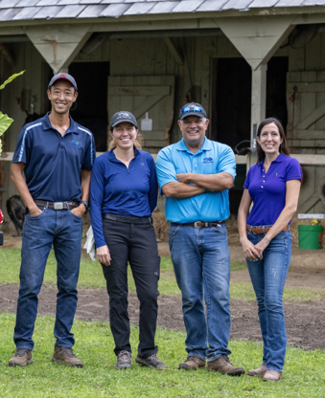
GUIDED BY PURPOSE:
Part 1:
A Workshop to Define Core Values
  Setting the Foundation:
    Why values and mission matter
    Risks of operating without them
  Defining your Core Values:
    Identify the values that guide our practice
    Build alignment across the team
INSERT PHOTO
Notes:
This workshop follows a progression. We will first discuss why values and mission matter and the impact they have on culture, engagement, and practice success. We will then work together to identify the core values that define our practice. Once those values are clear, we will use them as the foundation for creating or refining a mission statement for our practice. Finally, we will discuss how to integrate values and mission into everyday decisions, hiring, leadership, and team culture.

Slide 3
WHY VALUES AND MISSION MATTER
THE GOOD (by design)
  Align decision-making across the practice
  Strengthen culture and team retention
  Increase engagement and ownership
  Build client trust and consistency
THE BAD (by default)
  Fragmented culture and inconsistent behavior
  Decision fatigue and conflict
  Reduced engagement and accountability
  Loss of strategic focus
  Erosion of trust
Notes:
Values and mission provide a shared framework for how a practice operates. When clearly defined, they help guide decisions, strengthen culture, improve engagement, and create a more consistent experience for both team members and clients.
Without clearly defined values and a shared mission, we risk operating based on individual interpretations of what matters most. This lack of alignment can lead to confusion, conflict, and disengagement, making it harder for us to make decisions together as a team.
The goal of today's workshop is not simply to create words on a page. The goal is to create clarity, alignment, and intentional culture within our practice.

Slide 4
Without clearly defined values and mission, practice culture develops by default rather than by design.
Notes:
Every practice possesses an inherent culture; our objective is to ensure ours is developed with intentionality and purpose. Values and mission provide an opportunity to intentionally shape the culture of a practice by defining what matters most, how decisions are made, and how the team will work together.

Slide 5


DEFINING OUR CORE VALUES
Notes:
Now that we've discussed why values and mission matter and the impact of leaving them undefined, let's focus on the foundation of the entire process: core values. Before a mission statement can be meaningful, we must first understand what matters most to YOU - the people who make up this practice.

Slide 6
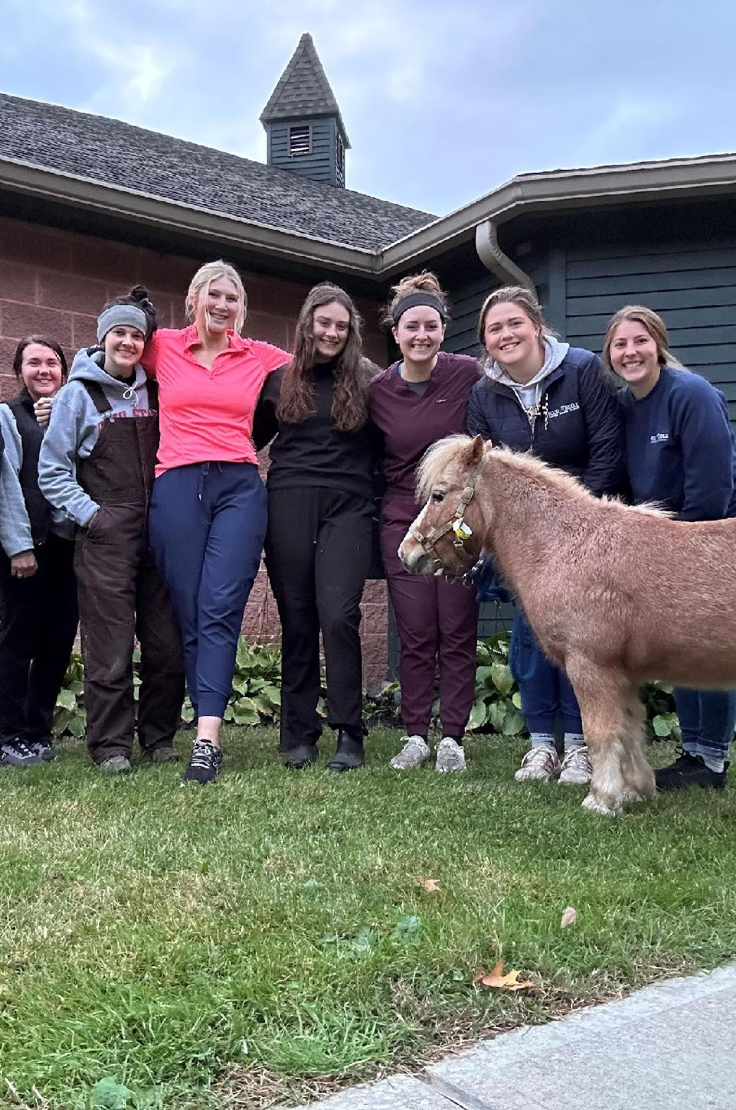
CORE VALUES
Core Values are the principles that guide the actions, decisions, and culture of a practice.
They define the behaviors and standards that team members use to interact with one another, serve clients, and care for patients.
When clearly defined and consistently demonstrated, core values create alignment, strengthen culture, and provide a foundation for a meaningful mission statement.
Notes:
Before we identify our own values, let's establish a common understanding of what core values are. Core values represent the beliefs and principles that guide how a practice operates and ultimately how clients and patients experience the practice. Core values are not aspirational slogans or words chosen because they sound good. They represent the principles that guide behavior, influence decisions, and shape the culture of a practice. When values are clearly defined and consistently demonstrated, they help create alignment across the team and provide the foundation upon which a meaningful mission statement can be built.

Slide 7
STEPS TO DEFINING PRACTICE CORE VALUES
Step One: Brainstorm all potential guiding words.
What is important when treating our patients, clients, and one another?
Step Two: Group similar responses into larger groups
Do we see any themes emerging?
Step Three: Narrow and prioritize down to 5 core values that represent our practice
What is non-negotiable?
Notes:
Let’s identify the values that best reflect our practice and the culture we aspire to build. We’ll follow a three-step process, starting with a broad exploration and gradually narrowing our focus to our core values. You should select values that best represent both the current strengths of the practice and the culture the team wants to create moving forward.

Slide 8
STEP 1
• Review the complete values list provided in the toolkit
• Identify values that best represent our practice
Honesty | Competent | Fair | Friendly | Dedicated | Passionate | Compassionate
Empathetic | Trustworthy | Dependable | Helpful | Respectful | Outstanding | Consistent
Loyal | Knowledgeable | Experts | Service Excellence | Committed | Energetic | Professional
Accountable | Integrity | Teamwork | Supportive | Principled | Responsive | Productive
Collaborative | Sincere | Positive | Sensitive | Creative | Community Oriented | Enthusiastic
Notes:
Now for the fun part. The words shown on this slide are examples only and are intended to help us begin thinking about the values that are most important to us and to our practice. The complete list of values is in the toolkit so let’s open it up and take a look. Review the full list and identify the values that resonate most strongly with how you believe our practice should operate, serve clients, care for patients, and support one another as a team. The goal is not to immediately narrow the list but to identify the values that feel most meaningful and representative of the desired culture.
Step 1: Select broadly at first, maybe 20 or more.
If you asked participants to do this ahead of time, you may skip to Step 2.
https://brenebrown.com/resources/dare-to-lead-list-of-values/ (Dare to Lead list of values_Brene Brown)

Slide 9
STEP 2
Discuss common themes and priorities as a group
Group similar values together in order to narrow the list
Work toward 5–7 core values
Be prepared to share your group's final selections and rationale to support.
Notes:
Step 2: Now that we’ve looked at all the words and chosen the ones that best fit what we think aligns well with our culture and team, we will now narrow that list to a handful of values before developing our top tier. Let’s aim for 7-10ish values and then we’ll come back together to share how we’ve narrowed our lists down.

Slide 10
STEP 3
Discuss themes as a full team
Prioritize the most meaningful values
Narrow the list to about 5 core values that best represent the practice
Notes:
Step 3 is to finalize our core values into a concise and descriptive list. The goal is to narrow the list to approximately 5 core values that are meaningful, memorable, and actionable.

Slide 11
GUIDED BY PURPOSE
What is one action you will take in the next 30 days to bring our values to life?
Notes:
Now that we have our practice’s values, what is one action you will take in the next month to demonstrate our values?

Slide 12
TAKE A BREAK!

Slide 13
GUIDED BY PURPOSE
Part Two:
A Workshop to Build a Meaningful Practice Mission
Examples of Mission Statements
  Developing Our Mission Statement:
    Translate values into purpose
    Create or refine our mission statement
  Bringing it to Life:
    Use values and mission to guide hiring, decision-making, and enriching our culture
Notes:
Welcome to Part Two. Now that we have identified the core values that define our practice and the culture we want to create, the next step is translating those values into a clear mission statement. In this exercise, we will explore the components of an effective mission statement, review examples from veterinary and non-veterinary organizations, and begin developing a mission statement that reflects the values identified by this team. We will be using our core values as the foundation for creating or refining our mission statement.

Slide 14
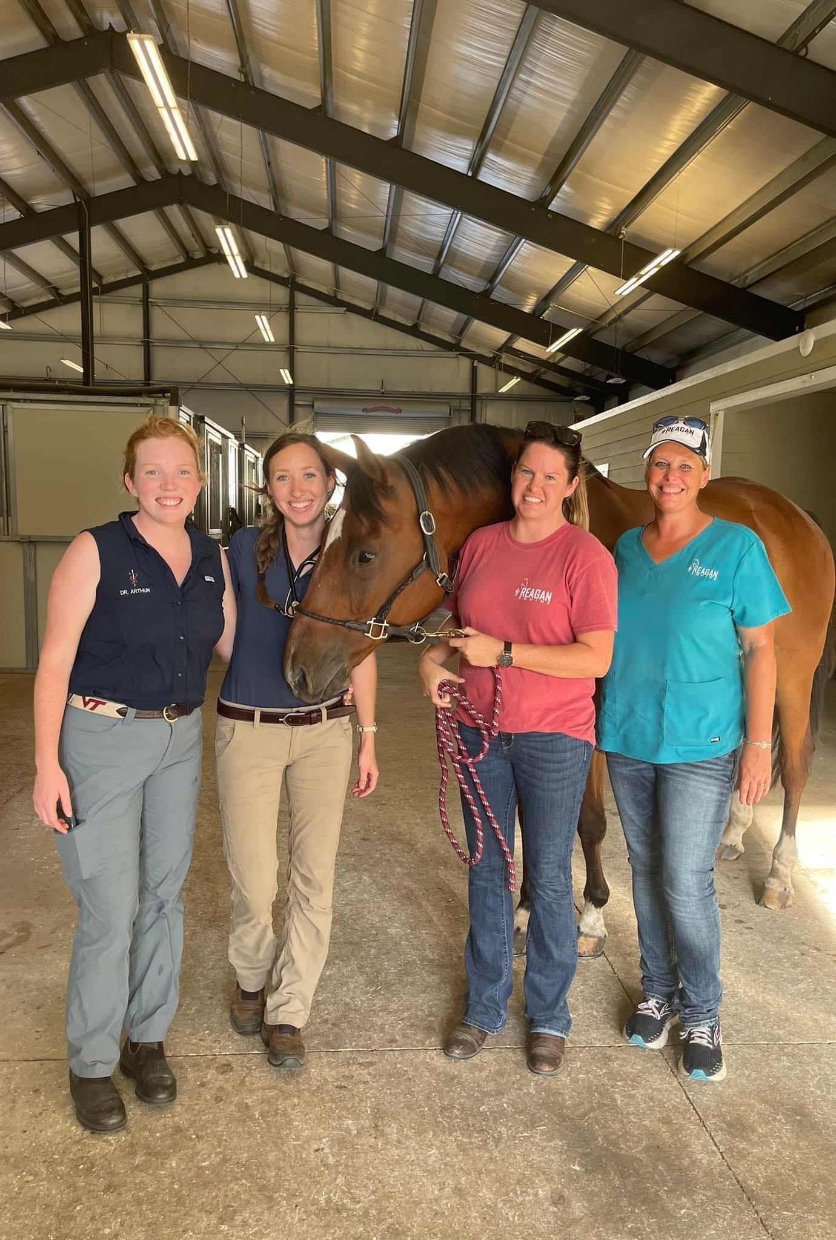
WHAT IS A MISSION STATEMENT?
A mission statement defines a business's purpose and reason for being.
It guides our day-to-day operations while communicating to stakeholders (clients and practice team) the core services our practice provides.
Our mission should motivate the team toward a common goal and help them focus on what is most important.
Notes:
While values describe what we believe and how we behave, a mission statement explains why we exist, who we serve, and the impact we aim to make. A mission statement answers an important question: Why does this practice exist? It defines our purpose and the impact we aim to have on our patients, clients, team members, and community.It serves as a reminder of what is most important and provides direction as our practice grows and evolves.

Slide 15

EXAMPLE MISSION STATEMENTS
Starbucks
With every cup, with every conversation, with every community - we nurture the limitless possibilities of human connection.
Google
To organize the world's information and make it universally accessible and useful.
AAEP
To improve the health and welfare of the horse, further the
professional development of its members, and provide resources and leadership for the benefit of the equine industry.
Notes:
Before drafting our mission statement, it can be helpful to review examples from a variety of organizations. Notice that each statement is concise, memorable, and focused on purpose. While the wording and style differ, all mission statements answer similar questions: Why do we exist? Who do we serve? What impact do we hope to make?
Try not to focus on the specific wording, but instead focus on the structure and intent of the statements. The goal is not to copy another organization's mission statement, but to identify characteristics that may be helpful when developing a mission statement for our practice.

Slide 16
EXAMPLES OF EQUINE PRACTICE
MISSION STATEMENTS
Fairfield Equine
Our Mission is to provide excellence in the health care of the horse,
deliver high quality customer care and advance veterinary education.
Pacific Crest Equine Veterinary Services
Our mission is to provide the highest quality medical care available for our equine patients, and support to their owners in all areas of their horse’s lives. We aim to be a support center for the horse community and an integral part of the health care team for our equine patients and their owners.
Notes:
These examples come from actual equine veterinary practices and illustrate different approaches to communicating purpose and impact. Notice that while the wording differs, both statements clearly describe who they serve, what they provide, and the difference they hope to make for their patients, clients, and community.
Looking at these examples, which elements resonate most strongly with our practice? Again, we don’t want to copy theirs, but identify themes and approaches that may help inform the development of our own.

Slide 17

DEVELOPING A
MISSION STATEMENT
Notes:
As we begin developing a mission statement, think about the unique role our practice plays, who we serve, and the difference we hope to make through our work. A mission statement does not need to be long or complicated.
Most effective mission statements answer four simple questions:
Why do we exist?
Who do we serve?
What do we provide?
How do we do it?
Let's focus on capturing our core ideas and themes for now rather than getting the wording perfect. We're just building the foundation of our mission statement; we can polish the phrasing later. Right now, let’s prioritize clarity and purpose. Try writing one on your own!

Slide 18
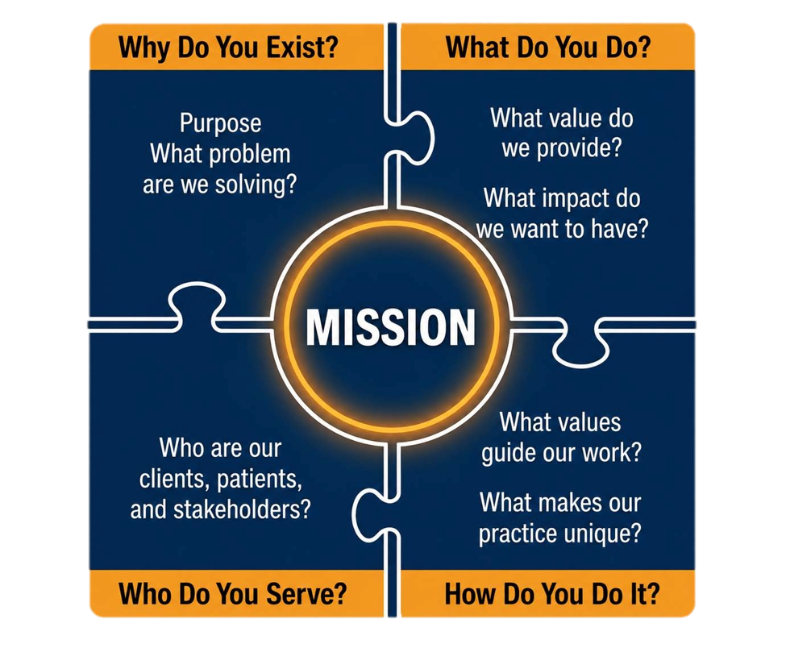
CREATING YOUR MISSION STATEMENT
Notes:
Let’s use the four mission statement prompts and identify the ideas that are most important to the purpose of our practice. It is often easier to identify the core ideas and then build a concise mission statement around them.

Slide 19
CREATING YOUR MISSION STATEMENT
As a small group:
• Discuss each of the four mission statement prompts
• Identify key themes and ideas
• Draft one or more mission statement options
• Refine the wording together
• Select a final statement that best reflects your purpose and values
Be prepared to share your group's mission statement with the larger group.
Notes:
The goal is to develop a mission statement that is clear, authentic, memorable, and meaningful to the entire team.

Slide 20
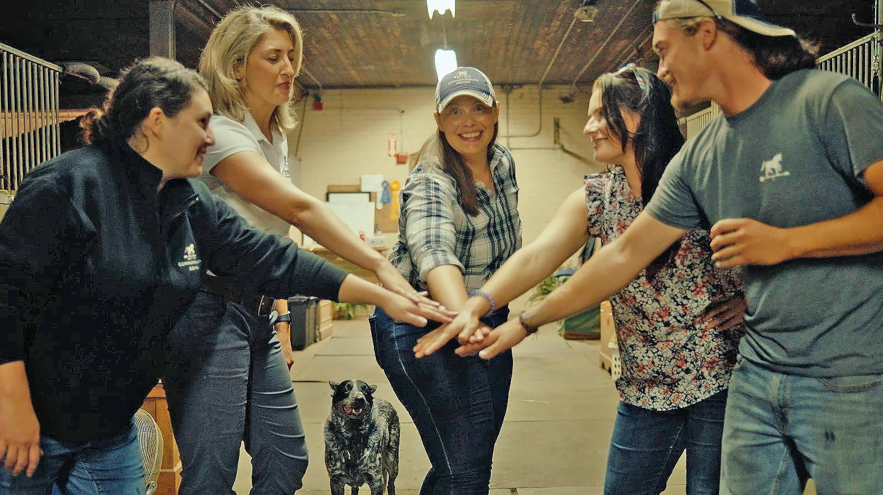
REAL LIFE INTEGRATION
Notes:
Now that we have identified our core values and drafted a mission statement, the next step is putting them into practice. Values and mission statements only create impact when they are reflected in everyday decisions, behaviors, and interactions. If they remain words on a wall, they do little to influence culture or performance. The goal is to create alignment between what our practice says is important and what we as team members experience every day.

Slide 21
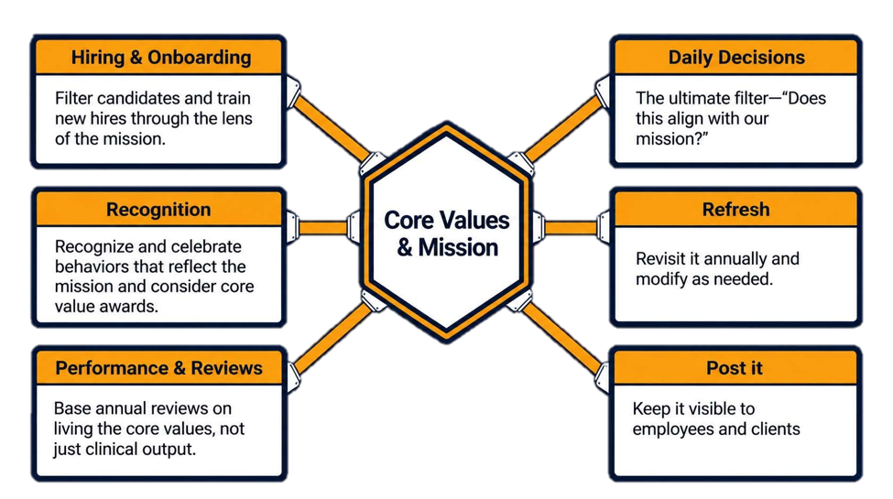
LIVING THE MISSION, EVERY DAY
Notes:
A mission statement only has value if we use it. Our next step is to make it part of how we work every day. That means using it to guide our decisions, how we hire and onboard new team members, how we recognize one another, and how we approach challenges as a practice.
Our mission shouldn't only be something we read on a website or hang on a wall. It should show up in our conversations, our priorities, and the way we care for our clients, patients, and each other.
One way to keep our mission alive is to ask simple questions like:
Does this decision reflect our mission?
Are we recognizing behaviors that support our mission?
How can we better demonstrate our mission in the way we work together?
When our actions consistently reflect our mission, we build trust, strengthen our culture, and create a practice where people know what we stand for—not because we've told them, but because they experience it every day.
Ask participants:
"What are some ways our practice could keep its mission visible and relevant throughout the year?"

Slide 22
GUIDED BY PURPOSE
What is one action you will take in the next 30 days to bring your practice mission to life?
Notes:
As we wrap up, remember that values and mission statements only create impact when they influence daily behavior. These workshops weren’t really about creating a document. They were about creating alignment. The words matter, but our conversations and commitments behind these choices matter even more.
Values define who we are. Mission defines why we exist. Together, they provide a framework for decision-making, culture, and long-term success.
Let’s take a moment to reflect:
What is one action you will take in the next 30 days to bring our values and mission to life? It could be recognizing a team member who demonstrated it, discussing it during a staff meeting, or using it to guide a decision. Small, consistent actions are what turn a mission statement into our practice culture.

Slide 23
Notes:
Thank you all for your engagement and involvement. Remember, positive practice culture is not created by a statement or a few words. It is created by the actions we take every day. Alignment happens by design, not by accident.

