Slide 1
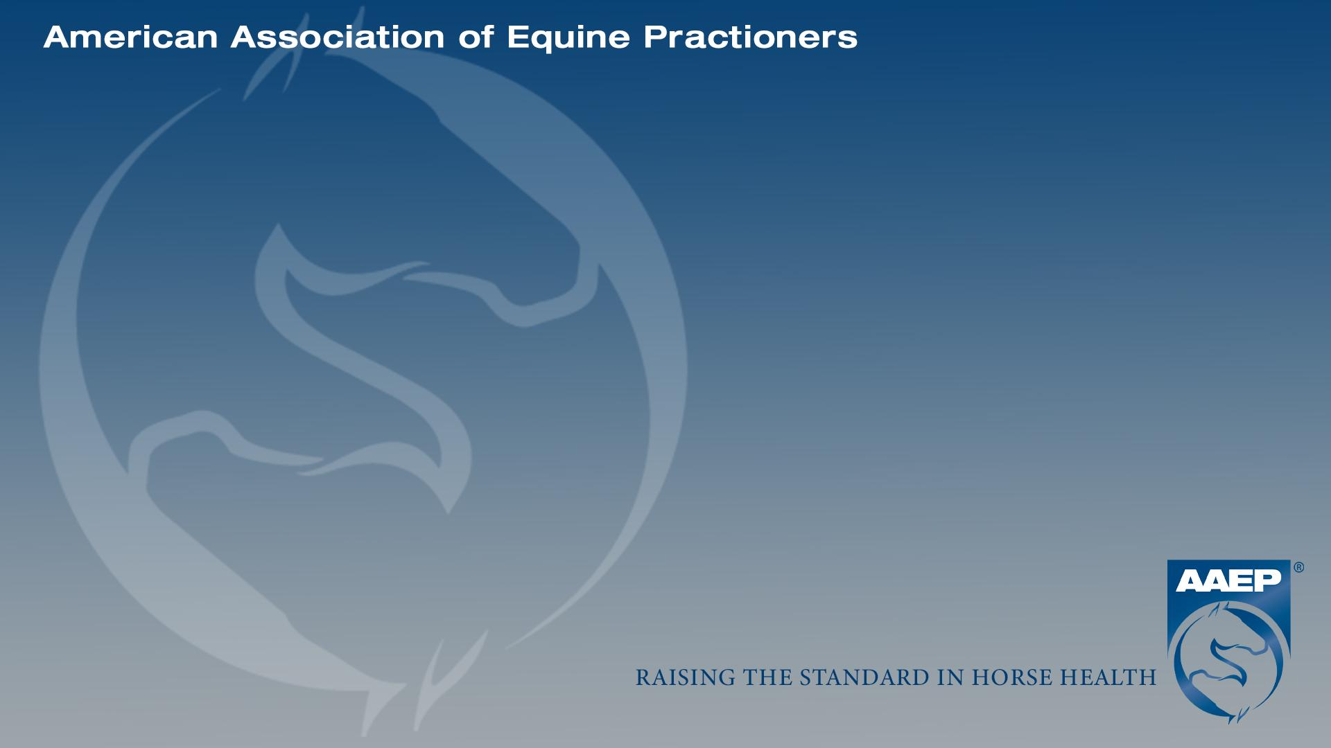

Triple the problem: Case Report of a Tripartite Navicular Bone
Madison Gray
Washington State University College of Veterinary Medicine, 2026
Mentor: Solomon Benarroch, DVM
Equine Sports Medicine PC

Slide 2
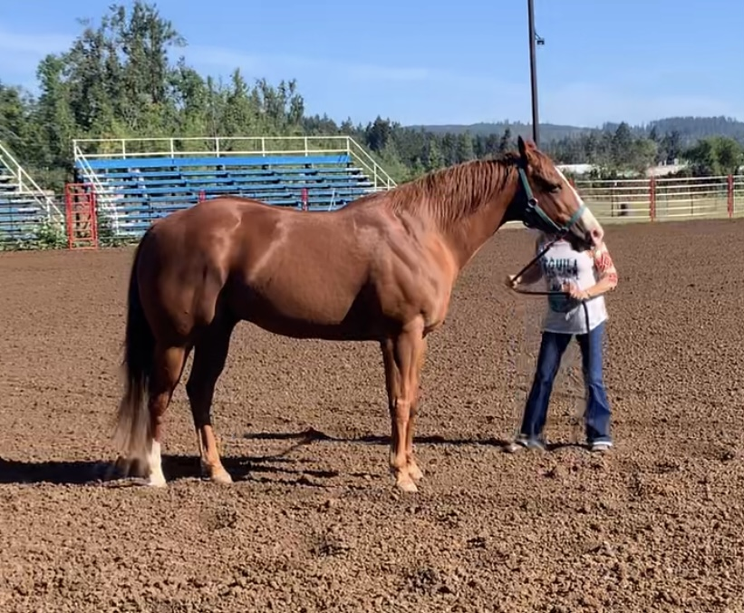

Signalment and History
11-year-old sorrel QH gelding: Rascal
2013 Quarter horse gelding used for barrel racing
Osphos administered in January 2024 for suspected navicular bone pain, no radiographs taken at this time
June 5, 2024: lameness workup, injected bilateral forelimb distal interphalangeal joints
June 19, 2024: Returned for recheck with improved but unresolved left forelimb lameness and pointing of left front (LF) limb
Owner reported horse appeared sound on oral 1-gram phenylbutazone AM and 1-gram phenylbutazone PM

Slide 3
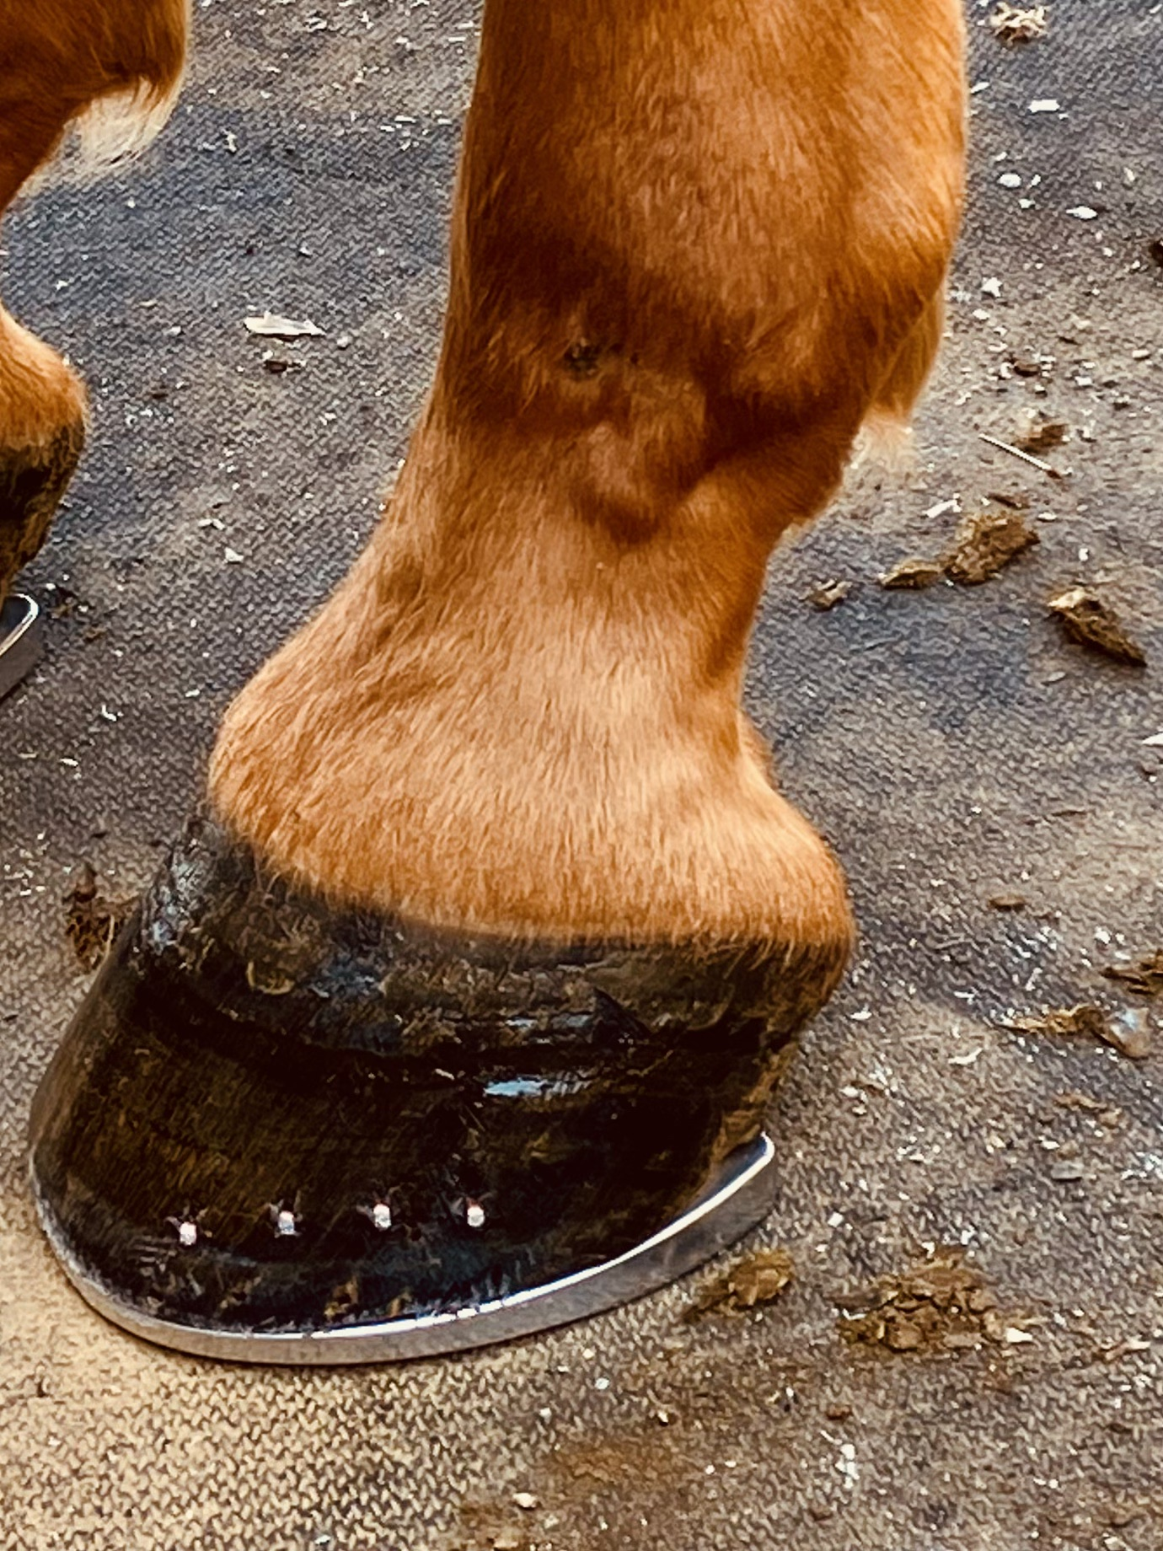
Clinical Findings
On exam 6/19/24
Vitals WNL
Horse repeatedly presented posturing with LF limb pointing forward
No heat or digital pulses
Shod in 3-degree wedge LF/RF
Straight line trot hard surface: 2.5/5 LF
  Lunge left hard surface: 3/5 LF
  Lunge right hard surface: 2.5/5 LF
  Hoof testers LF and RF:
      Concussion: WNL
          Sole pressure: WNL
          Frog quarters: WNL
      Across the heel: WNL

Slide 4
Clinical Findings
On exam 6/19/24
      Static flexions:
      Positive to left carpus
      All other front limb flexions WNL
      All hind limb flexions WNL
      Stress flexions:
      Left carpus 30-second stress flexion: 3/5 LF lameness with poor recovery

Slide 5
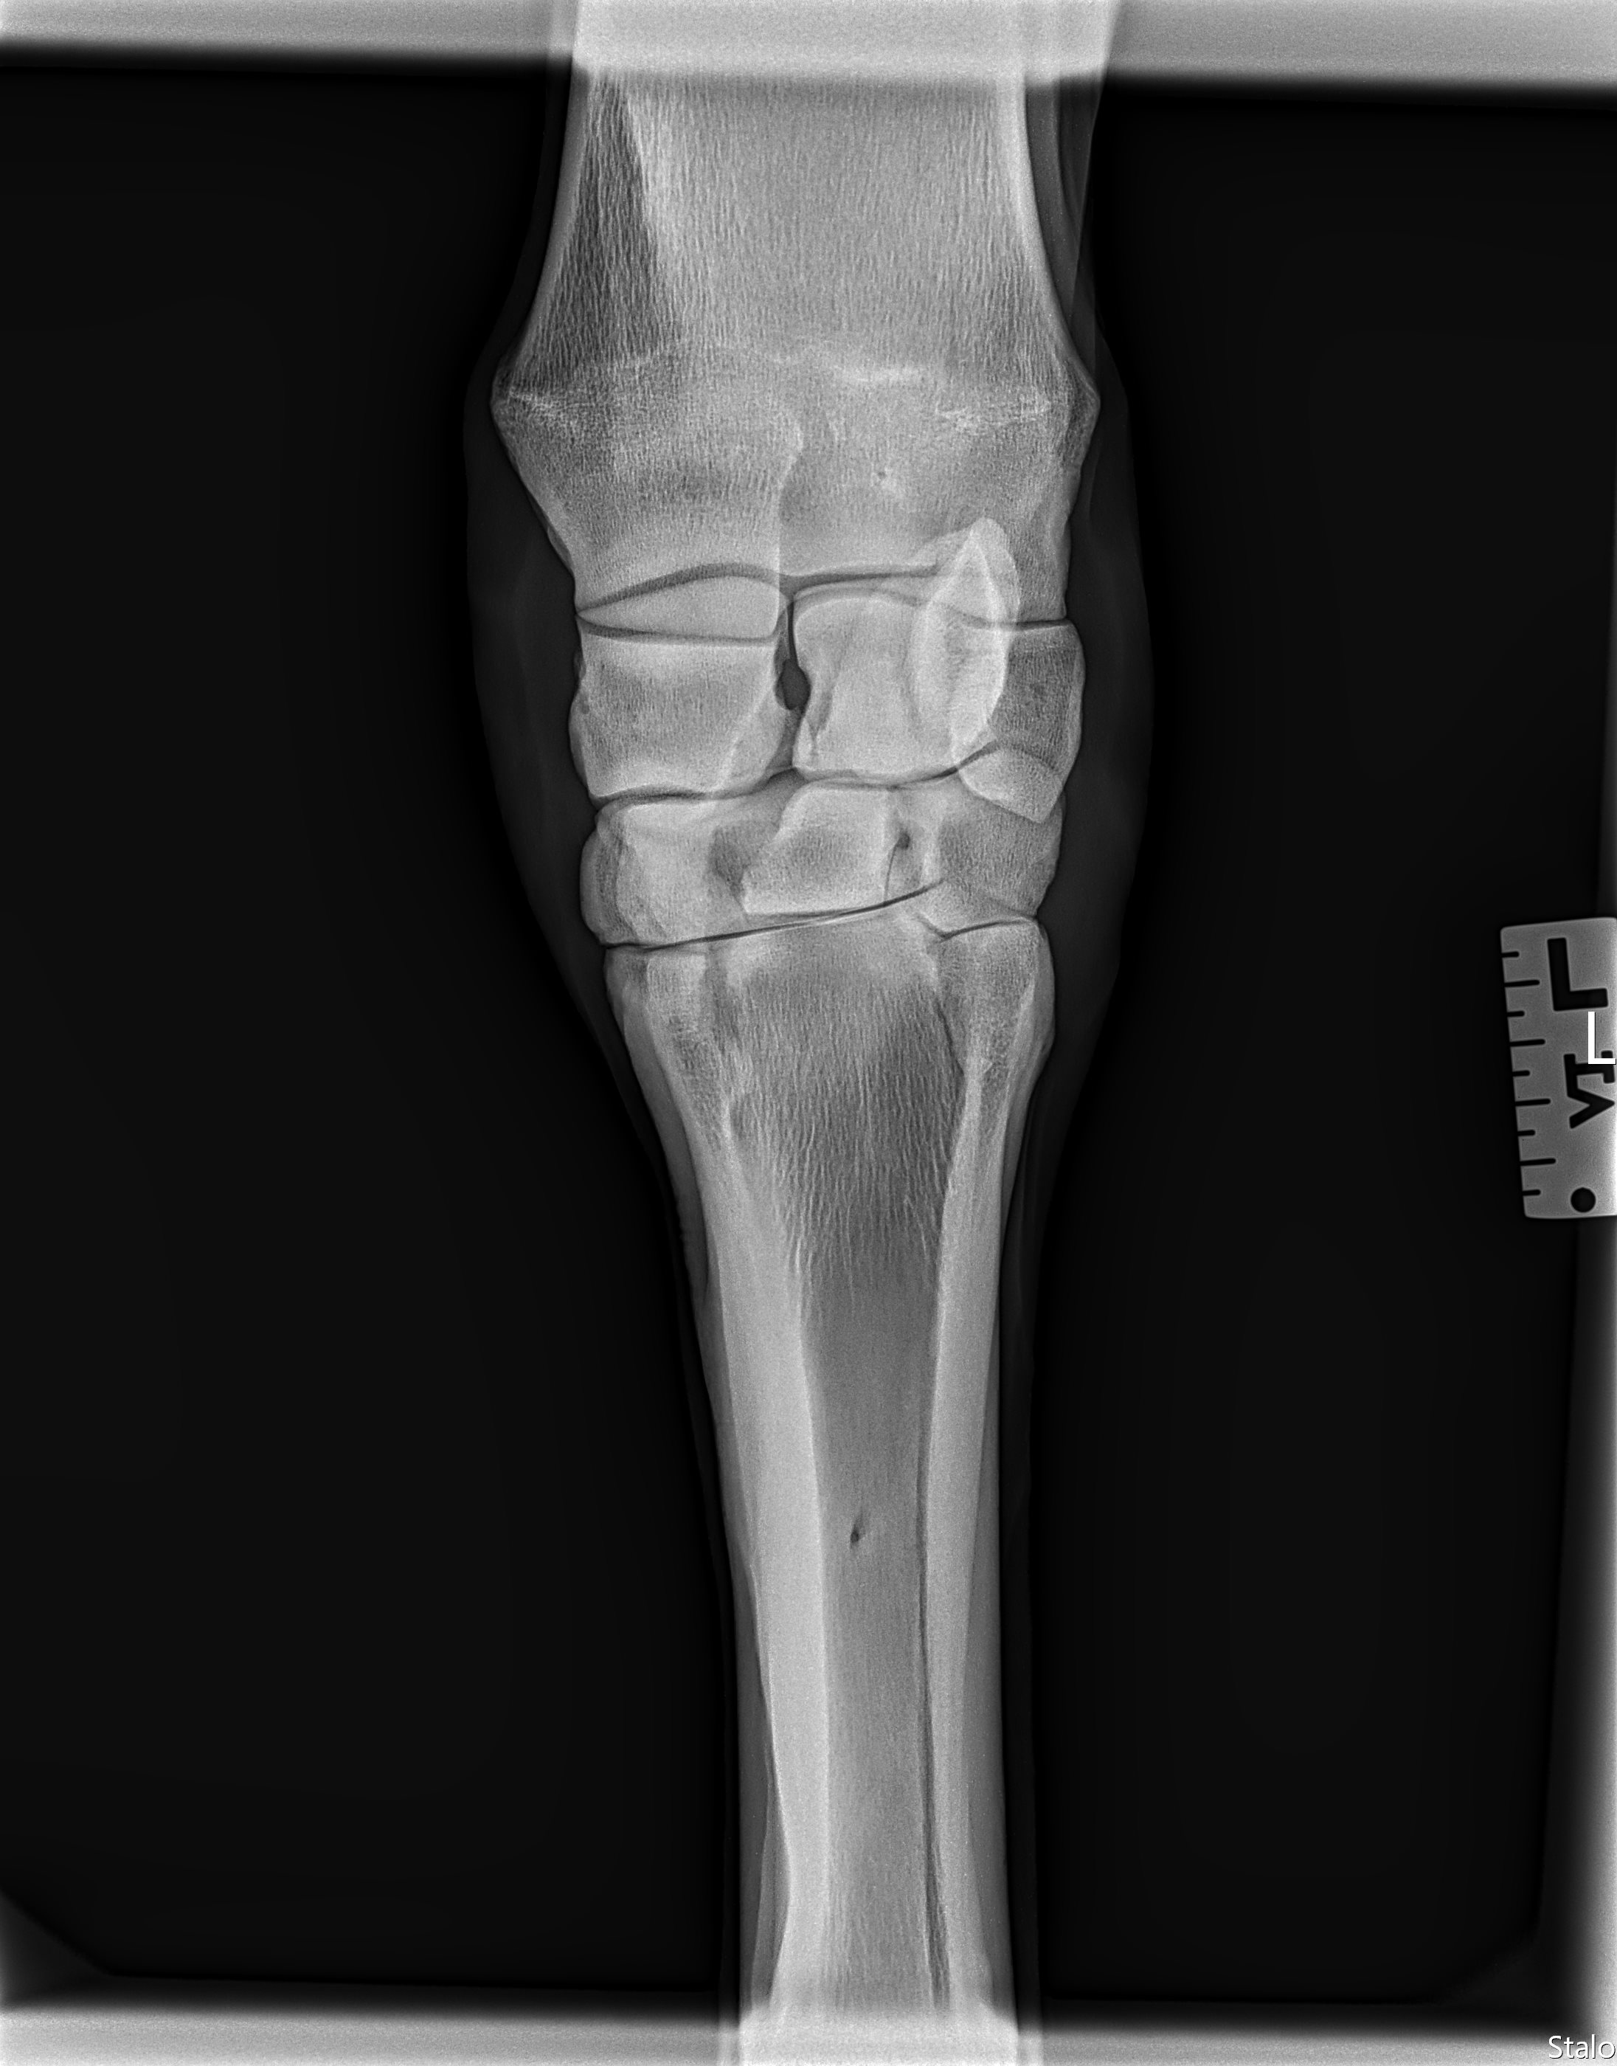
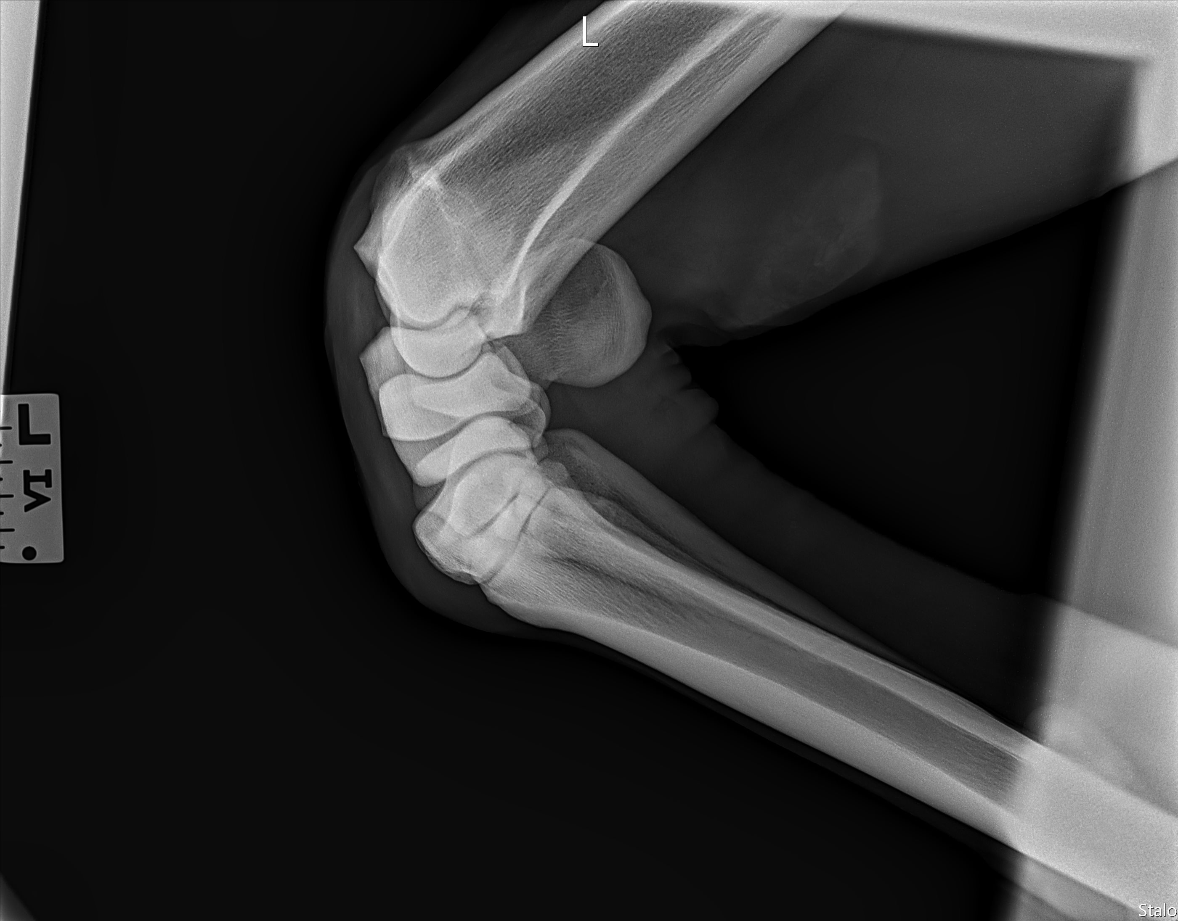
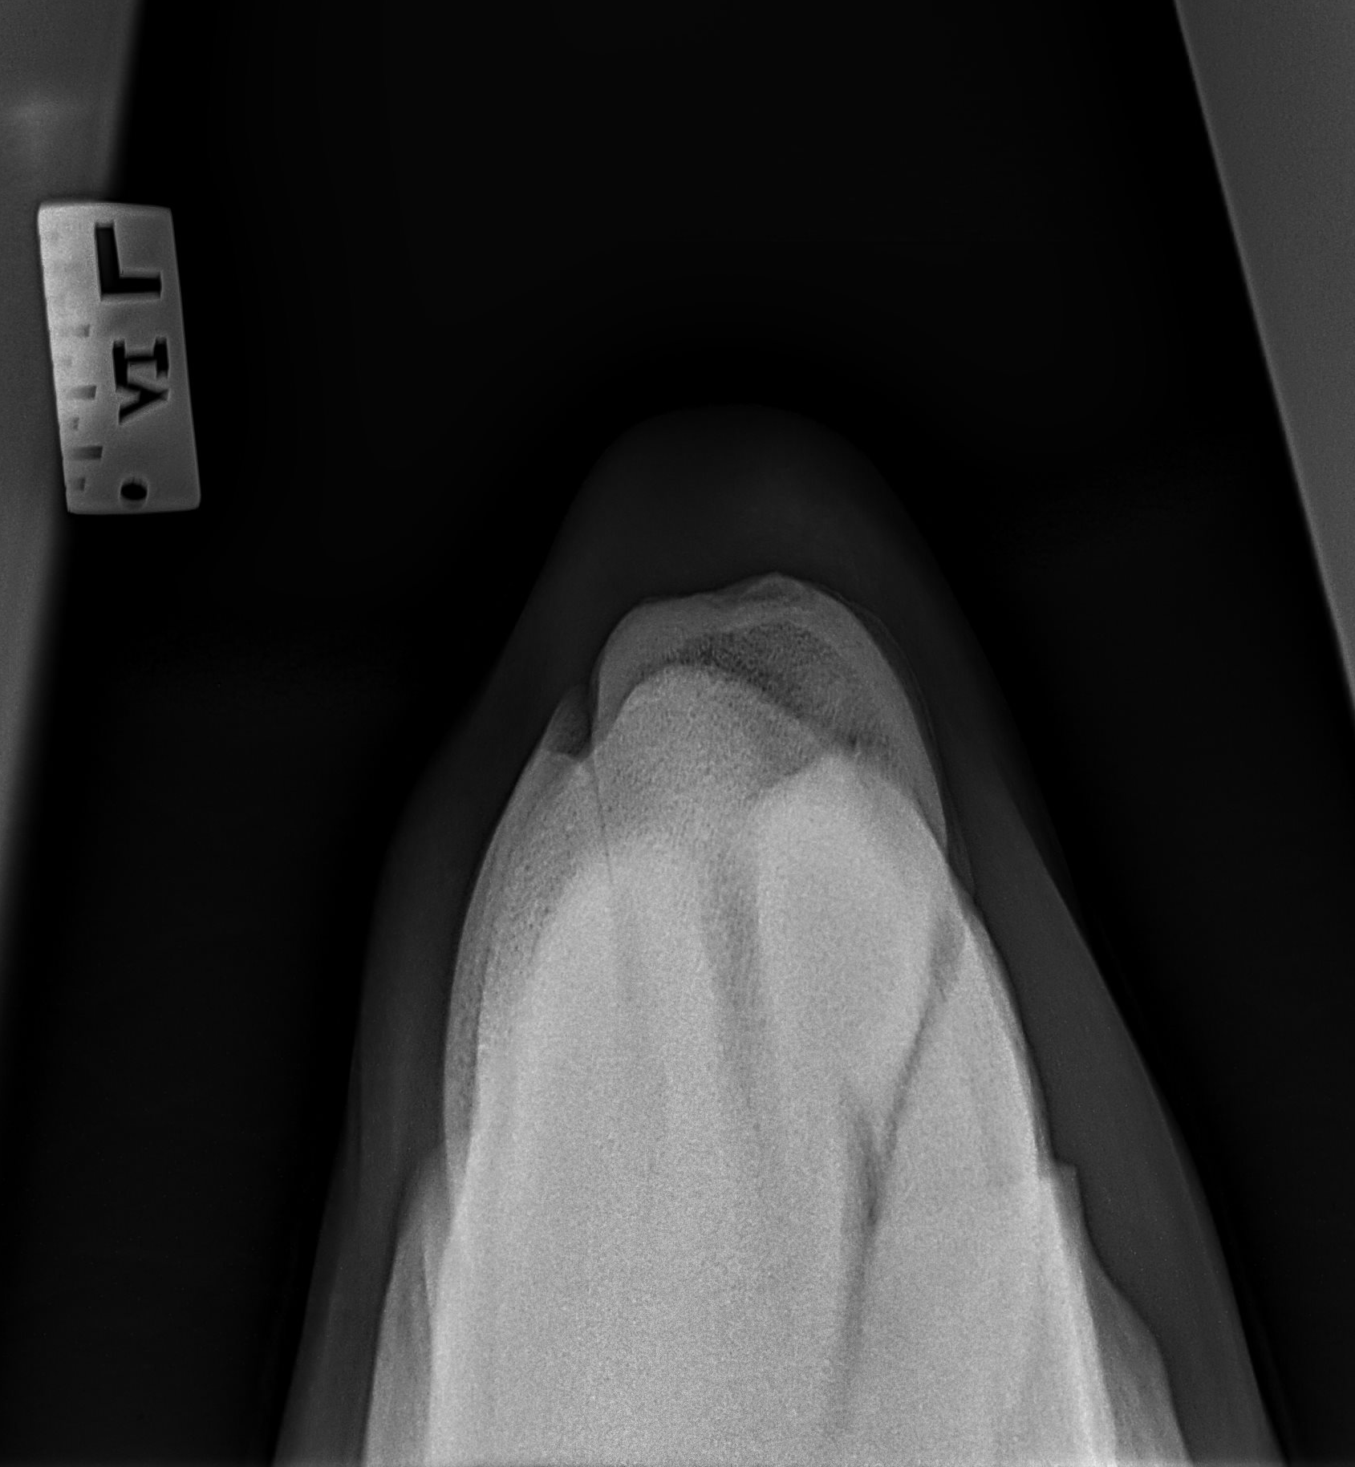
Clinical Findings
6/19/24 Exam Continued
      Radiographs of the left carpus: DP, lateral oblique, flexed lateral, skyline
      Showed minimal radiographic changes

Slide 6
Clinical Findings
6/19/24 Exam Continued
      Radiographic changes to the carpus not significant enough for the degree of lameness
      Proceeded with LF PDN lidocaine block.
      10 mins post lidocaine block:
        Straight line trot hard surface: 1/5 RF
        Lunge left hard surface: 1.5/5 RF
        Lunge right hard surface: 2 RF
        Conclusion: Left forelimb lameness was localized to distal limb, lameness switched to the right forelimb, indicating a bilateral forelimb lameness that is dominantly left forelimb.

Slide 7
Problem List and Differentials
Problem list
Differentials
Chronic LF limb pointing
Chronic LF limb lameness
Positive left carpus flexion
Bilateral forelimb lameness, significantly greater on LF
Common sources of pain in the distal equine limb:
Bone – higher differential due to improvement on phenylbutazone and history of improvement with Osphos
Joint/bursa – possible navicular bursitis due to history of temporary improvement from distal interphalangeal joint injections
Soft tissue (tendon/ligament) – possible, but bilateral soft tissue injuries are more rare than unilateral.
Sole bruise/hoof abscess – unlikely due to hoof testers being normal and the lack of digital pulses/heat

Slide 8
Differentials Continued
LF PDN block localized pain to palmar 2/3 of the LF limb – isolated structures:
Bone:
Navicular bone
Pedal bone (P3)
Possibly part of the middle phalanx (P2)
Joint/bursa:
Navicular bursa
Distal interphalangeal joint
Possibly part of the proximal interphalangeal joint
Soft tissue:
Distal portion of DDFT
Impar ligament
Suspensory ligaments of the navicular bone
Distal sesamoidian ligaments (straight and oblique)
Collateral ligaments of the distal interphalangeal joint
Possibly collateral ligaments of the proximal interphalangeal joint
Other:
Sole
Palmar hoof wall/heel bulb
Notes:
Even though hoof testers were WNL across the heel, the navicular bone could still be causing pain that we cannot recreate. Secondly, the history of temporary improvement with coffin injections and reoccurring lameness fits the pattern of bursa pain (receiving temporary relief due to close proximity of coffin joint and navicular bursa in the foot). Also, not all bursas ffex positive to lower limb.

Slide 9
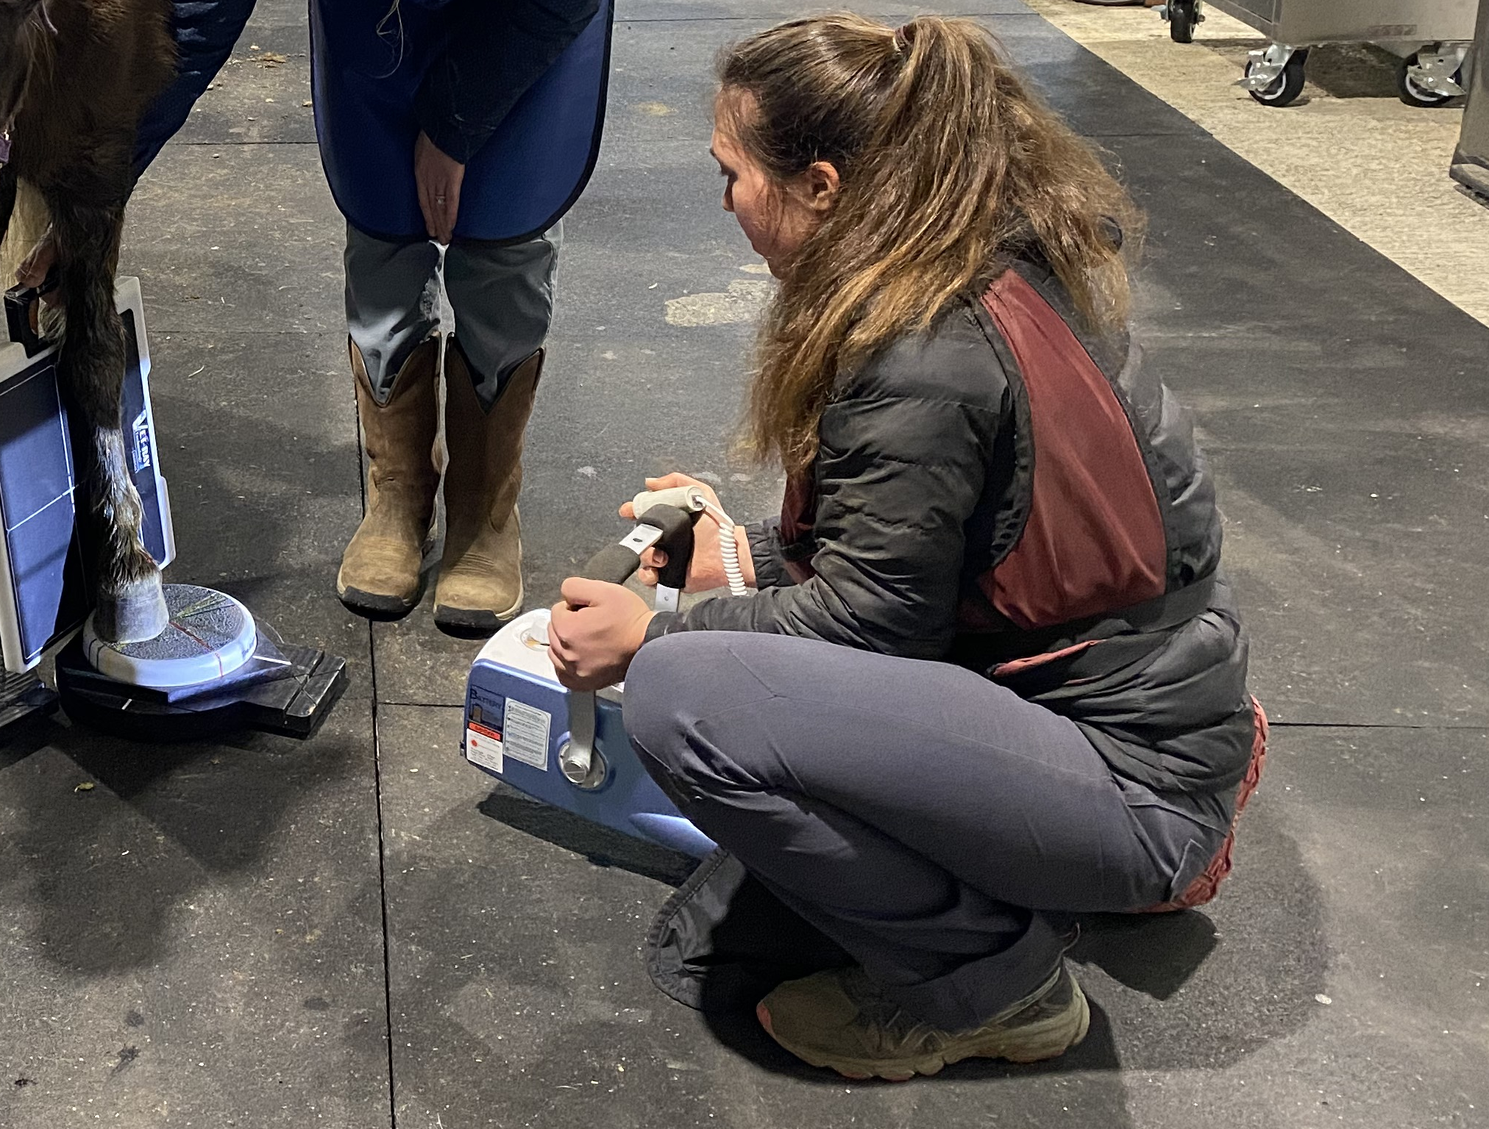
Diagnostic Plan
To evaluate causes of LF foot pain
Start with radiographs of the left front distal limb to evaluate possible sources of bone pain
Depending on findings, other diagnostics include ultrasound, CT, MRI to look for bursa and soft tissue structure involvement
Radiographic images taken:
Left fore foot: lateral, dorsopalmar, 65 dorsopalmar, navicular skyline
Right fore foot: navicular skyline

Slide 10
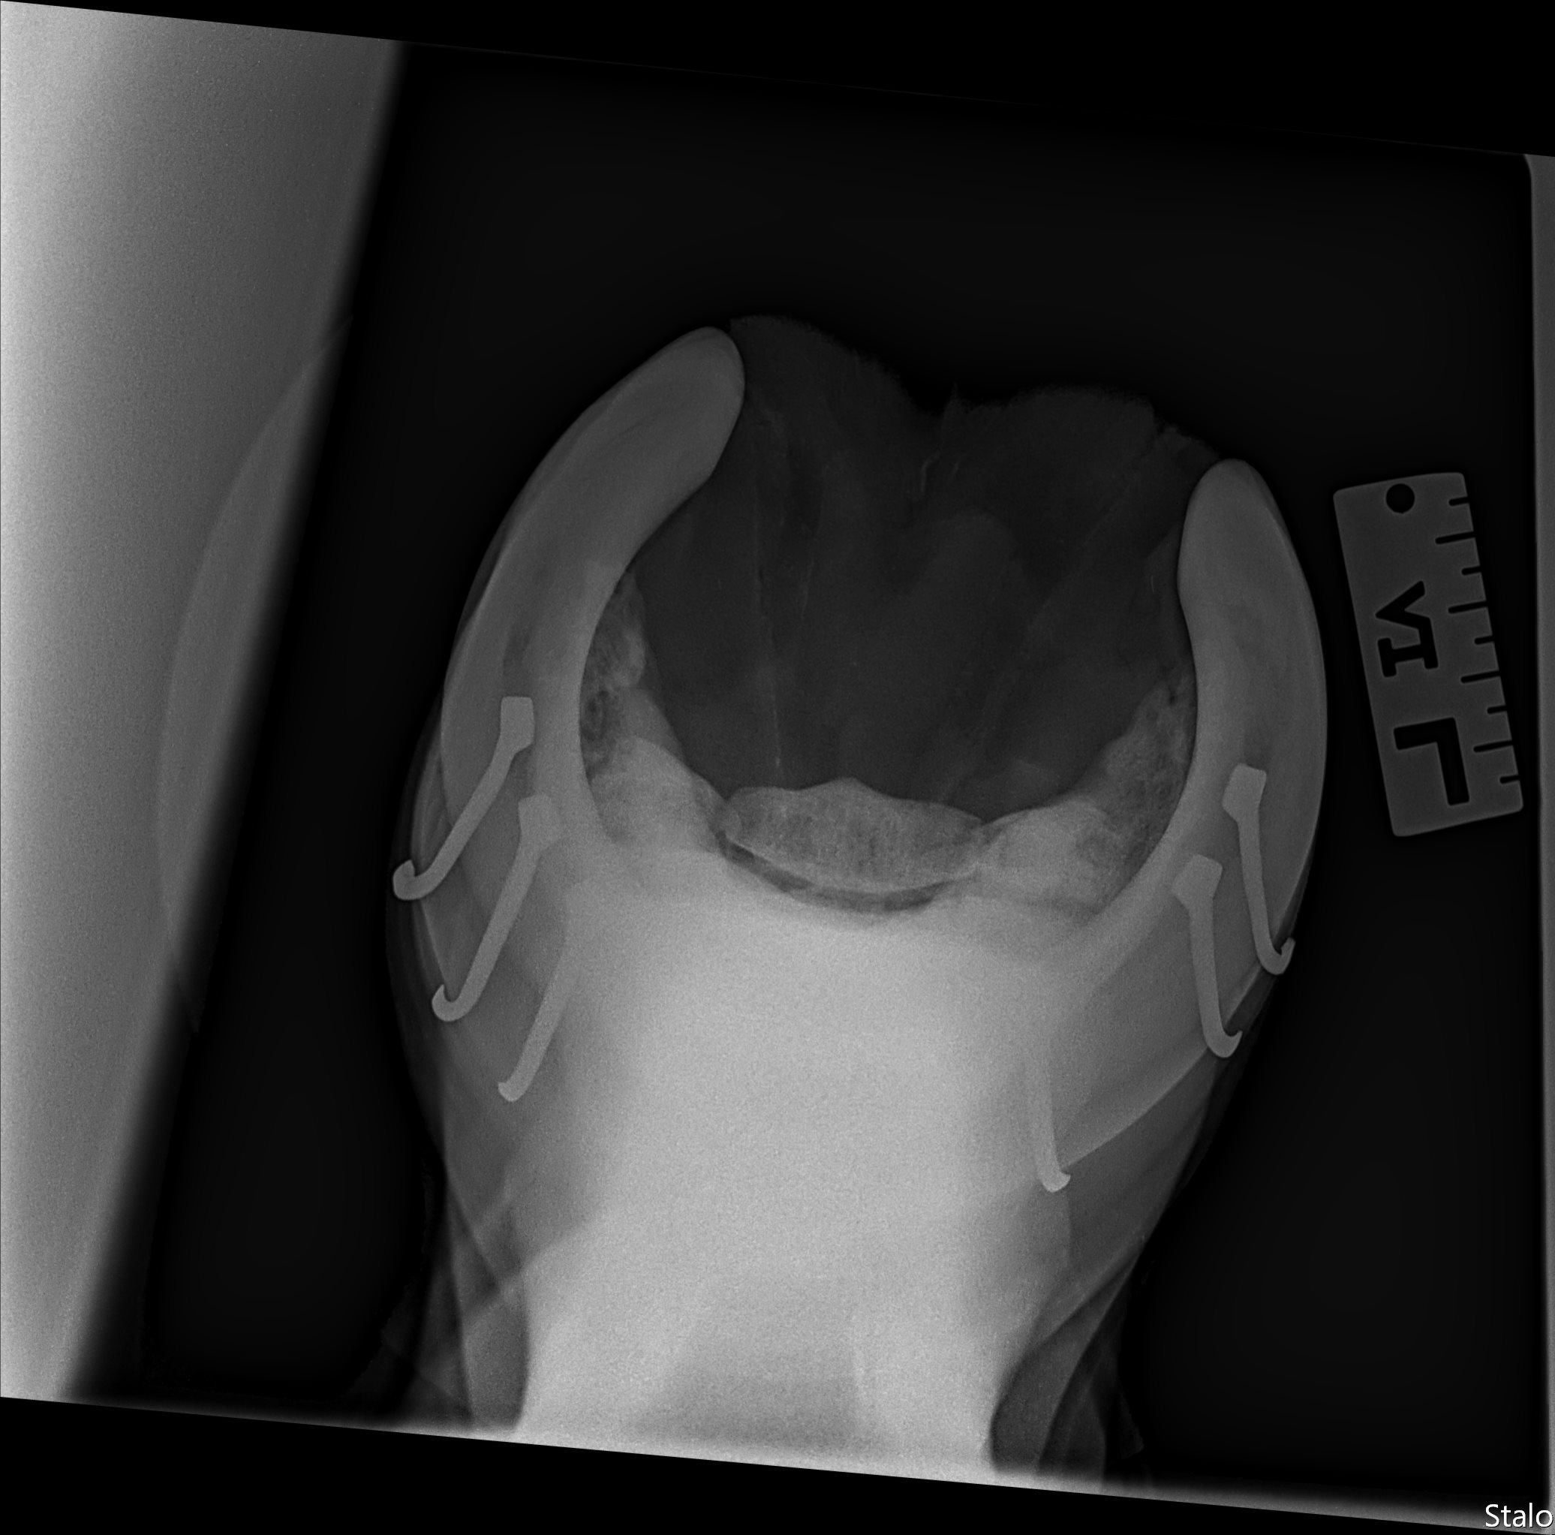
Diagnosis
Navicular Skyline
On LF radiographs, found a tripartite navicular bone.

Slide 11
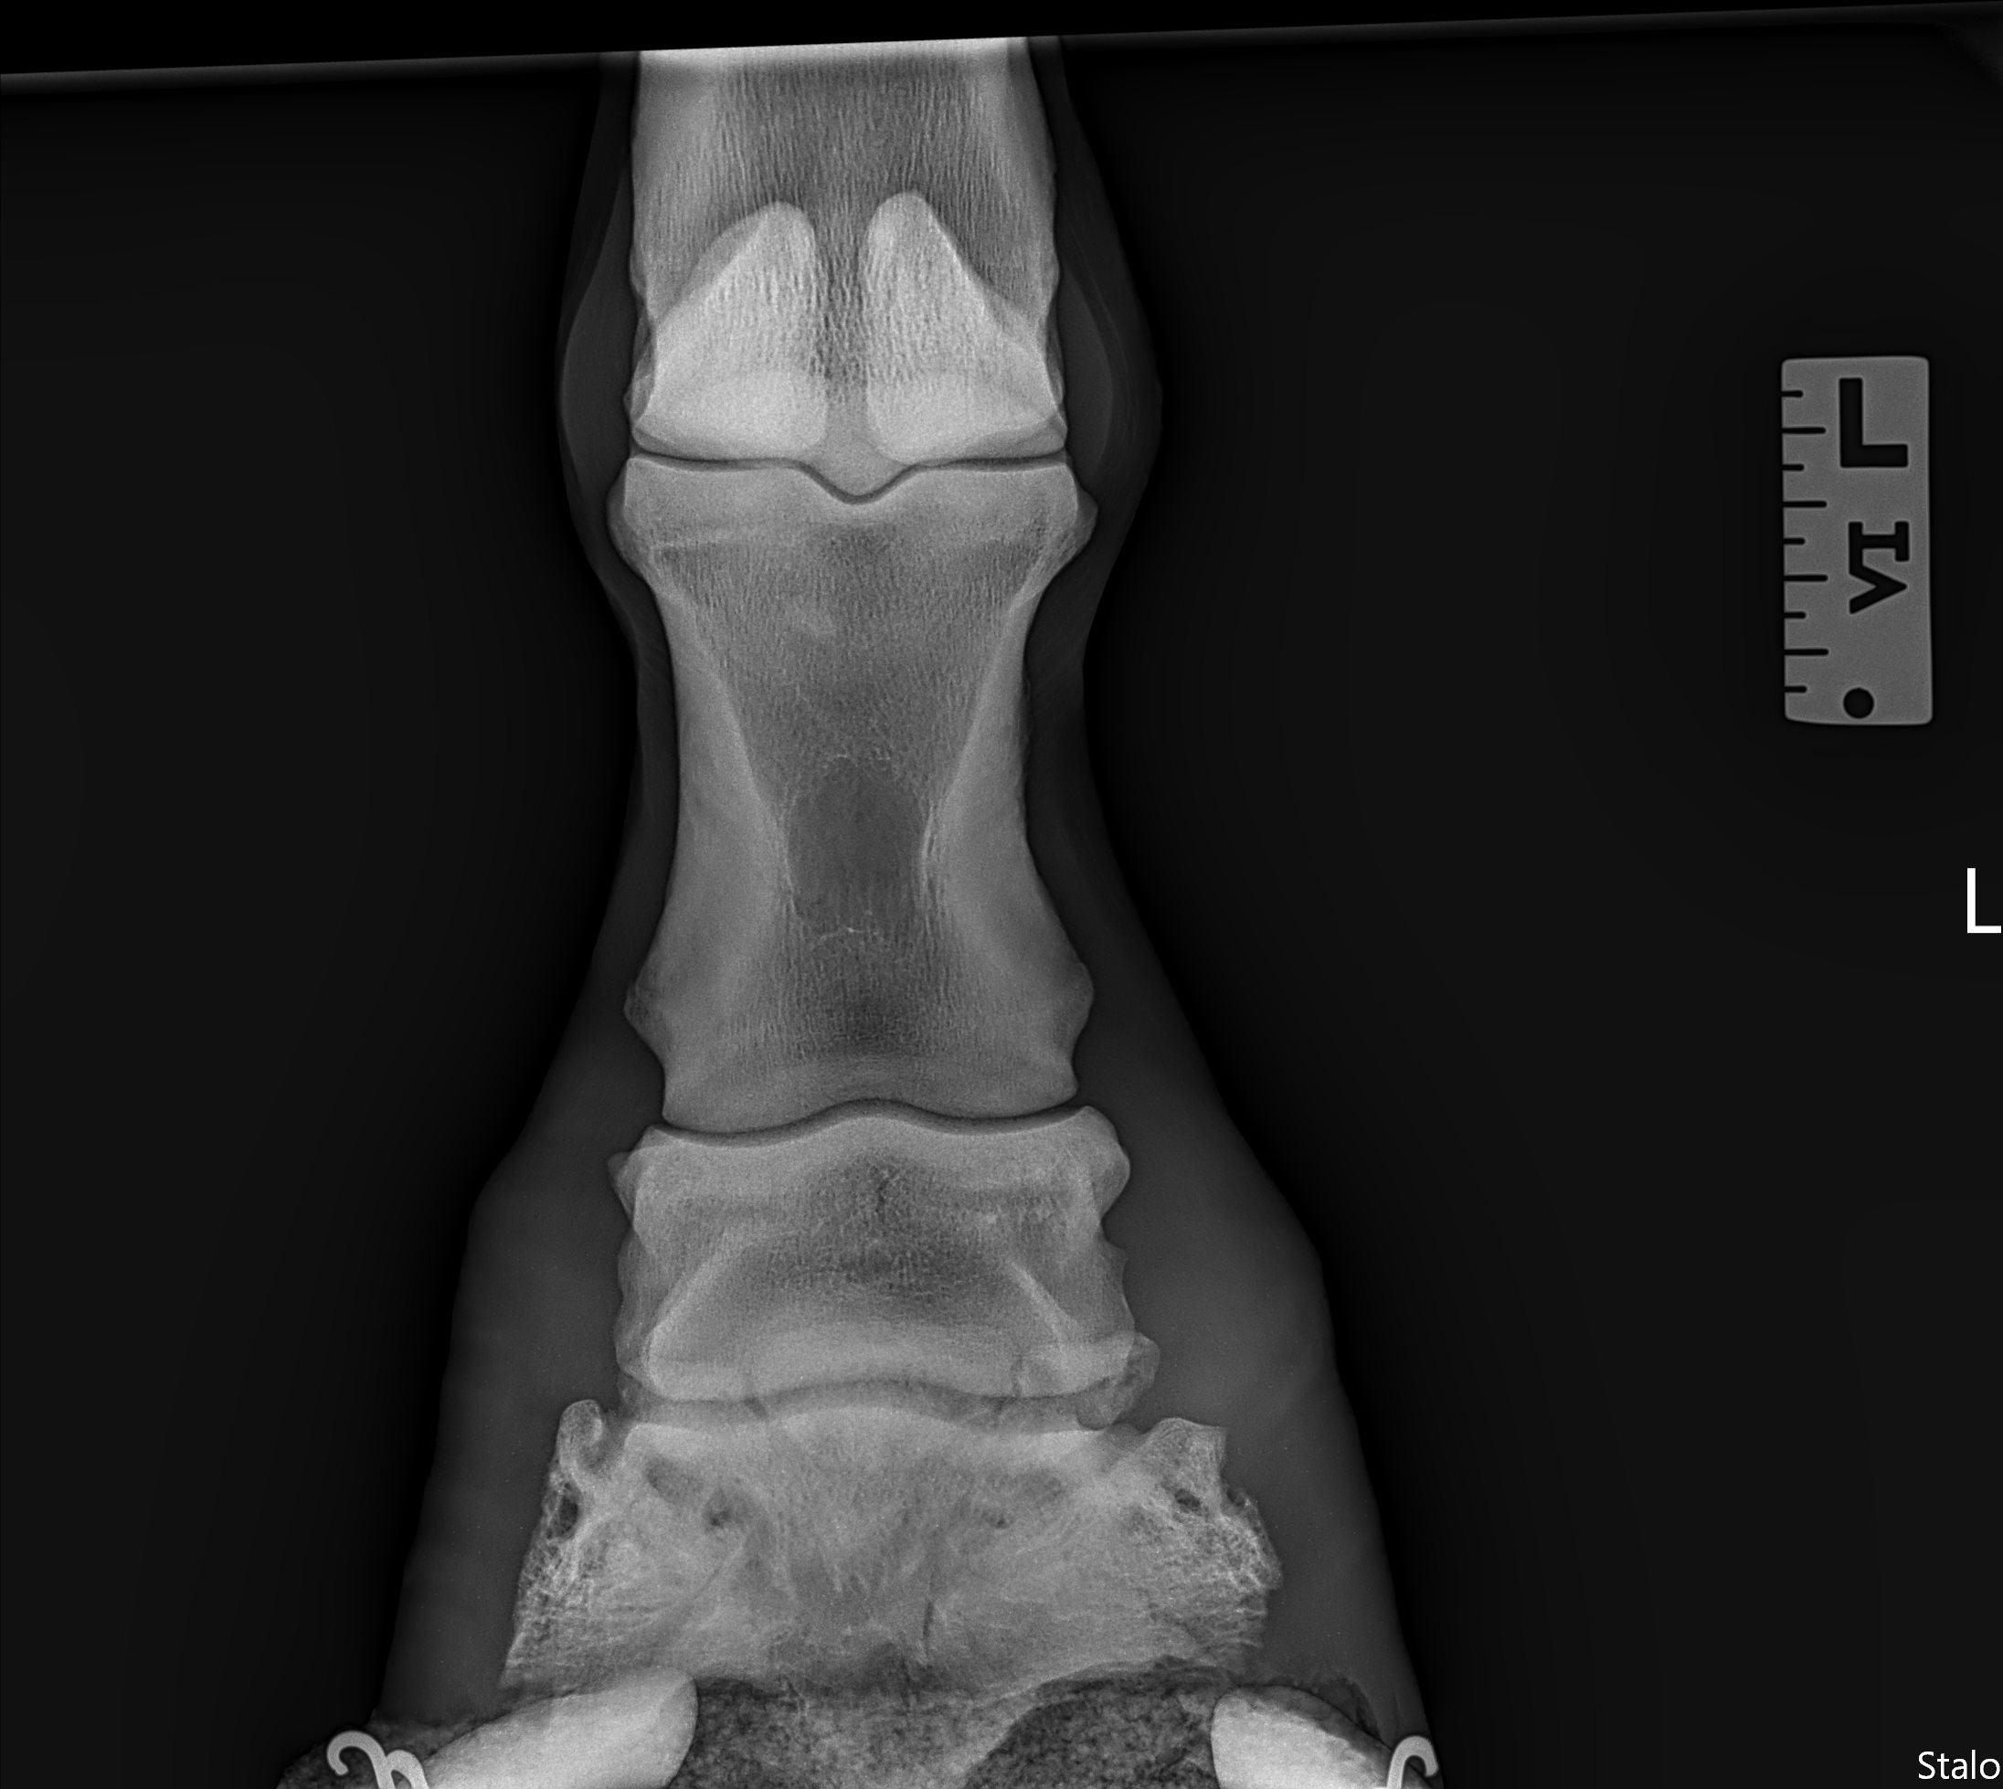
Diagnosis
DP
On LF radiographs, found a tripartite navicular bone.

Slide 12
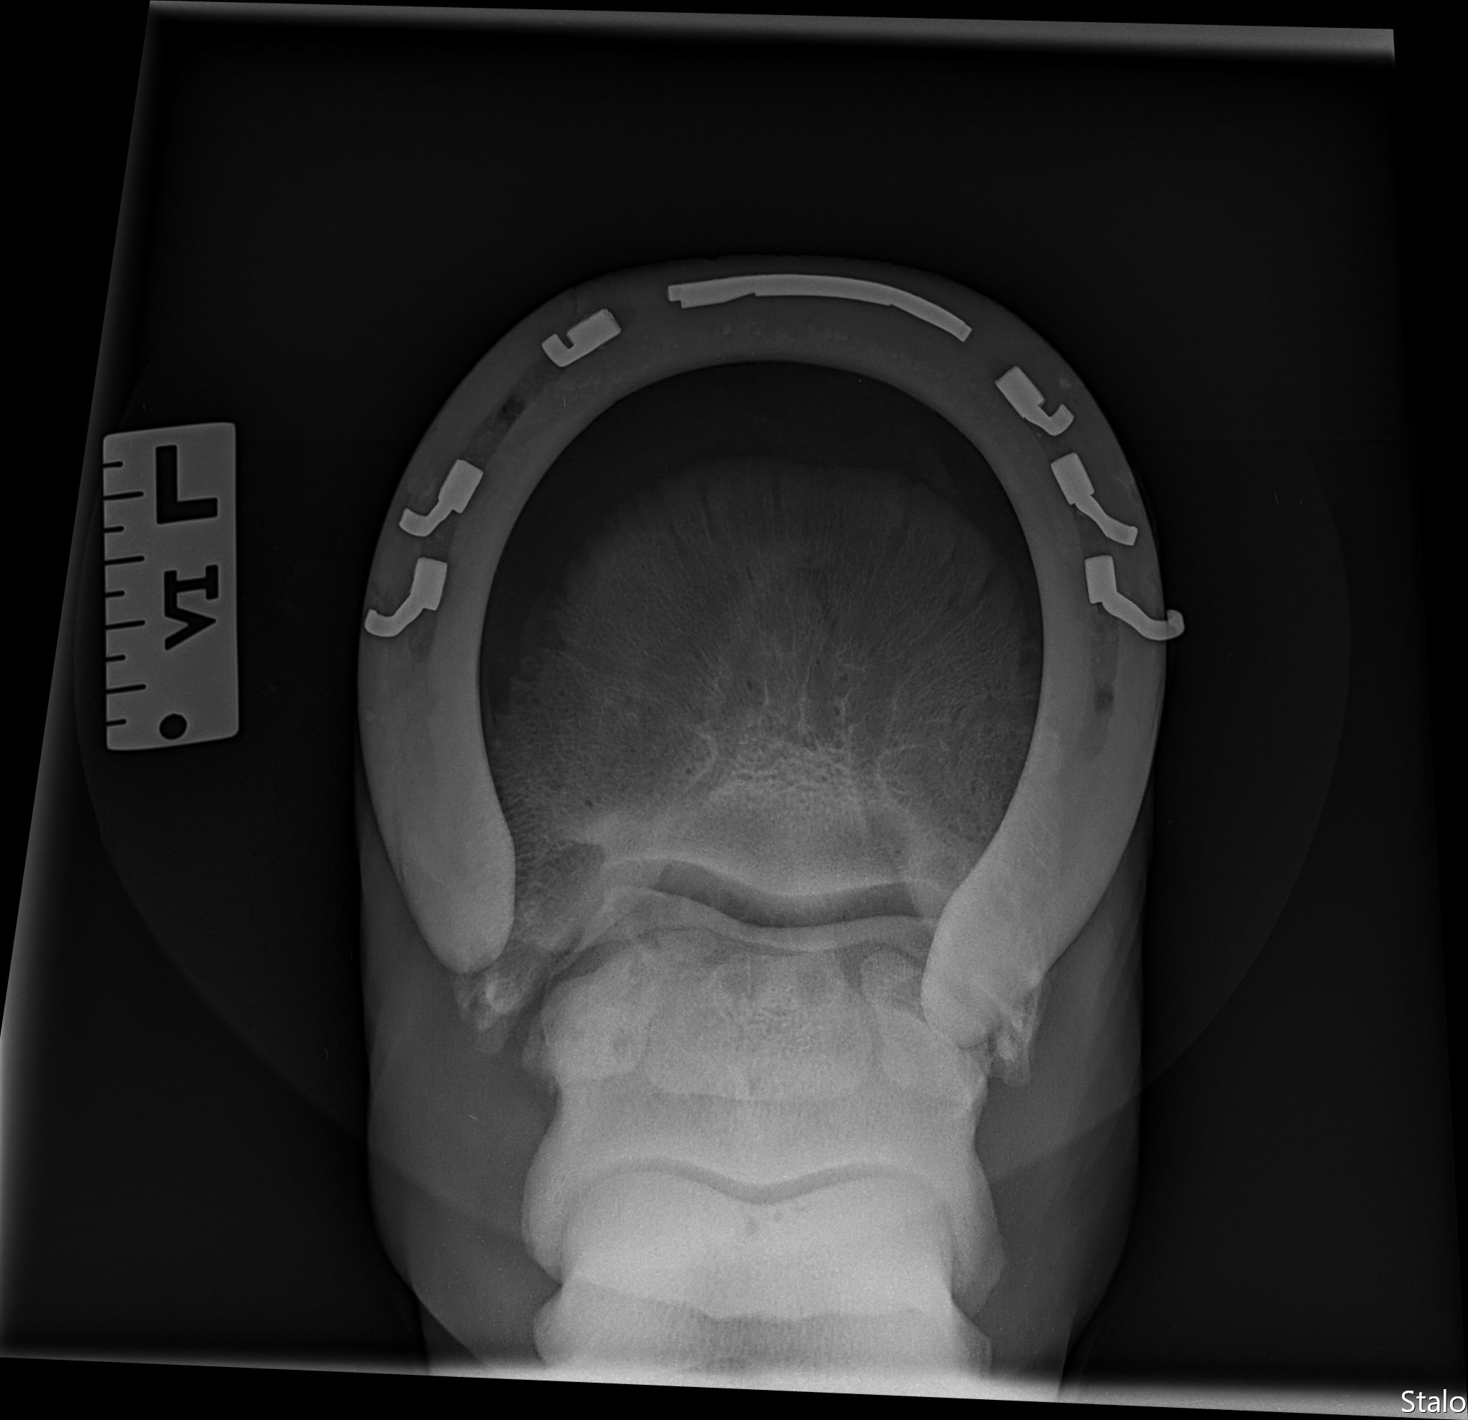
Diagnosis
65 DP
On LF radiographs, found a tripartite navicular bone.
Multifocal cysts within each part of the navicular bone.

Slide 13
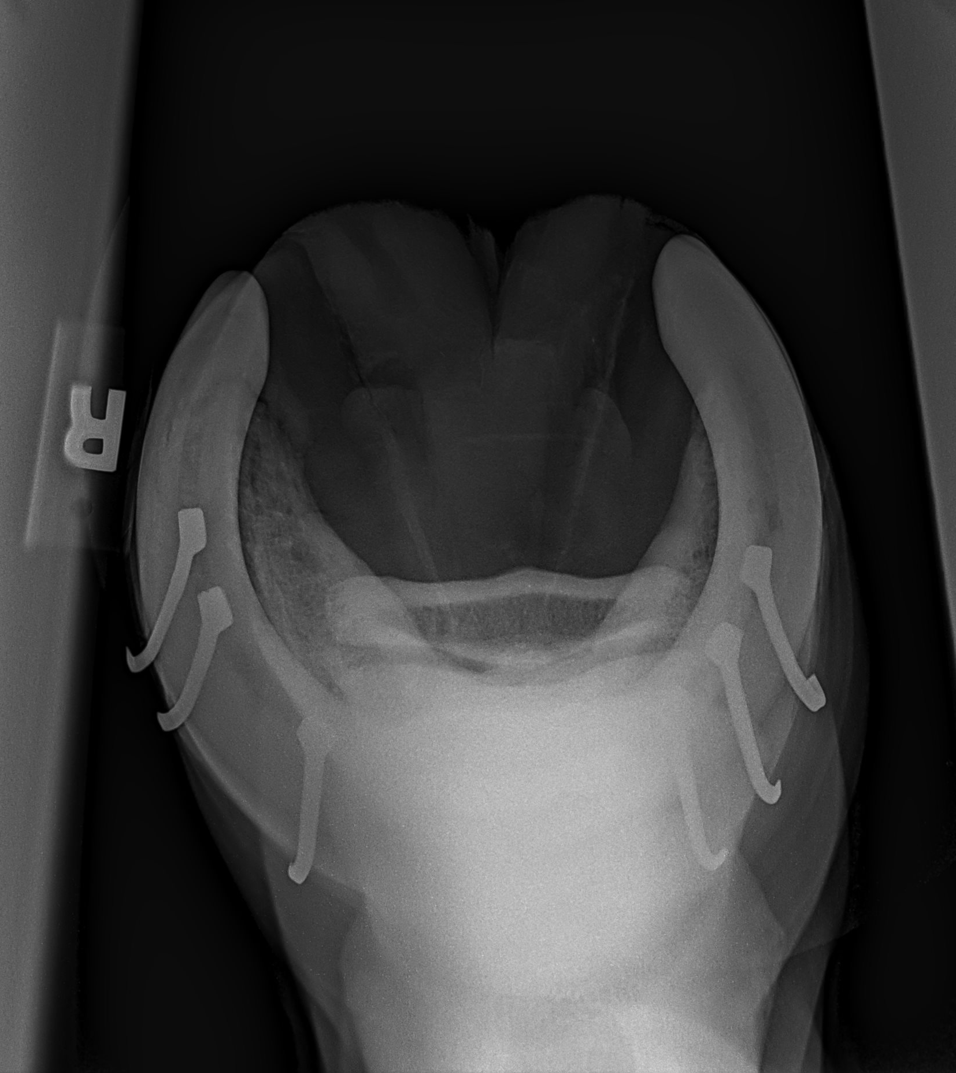
Diagnosis
RF Comparison Navicular Skyline
RF navicular bone completely intact.
No abnormal radiographic findings.

Slide 14
Final Diagnosis
Unilateral Tripartite Navicular Bone

Slide 15
Discussion – Etiology and Pathophysiology
Presentation³:
Rare, congenital condition
Can present bipartite or tripartite
Can present bilateral or unilateral
No breed predisposition
Reported cases range from ages 4-10 years old when diagnosed
Proposed pathophysiology theories⁵:
      Formation of multiple ossification centres during gestation due to a disturbance in developmental blood supply, which leads to incomplete endochondral ossification of the navicular bone
      Mild form of polydactyly – less likely due to normal formation of surrounding anatomical structures
      Subchondral cysts within the partite navicular bone often develop due to degenerative changes that occur overtime, which may be associated with progression of pain^{3,5}

Slide 16
Discussion – Diagnosis
Diagnose via radiographic imaging of the navicular bone
MRI can be useful to evaluate for potential associated lesions in the DDFT
Important to differentiate between partite navicular bone and fracture of the navicular bone when interpreting radiographs
Bi- or Tripartite navicular bone typical presentation⁵:
      Chronic, persistent lameness
      Often gradual onset of lameness
      Pain may or may not be elicited from hoof testers
      On radiographs:
      Rounded edges of adjacent bone pieces
      Wide, radiolucent gaps at partition sites
      Uniform distribution of partition sites, especially with tripartite
      Cystic development adjacent to subchondral bone
Navicular bone fracture typical presentation²:
      Acute, severe lameness
      May be non-weight bearing
      Often have increased digital pulses
      Pain easily elicited from hoof testers
      On radiographs:
      Adjacent bone edges are sharply demarcated
      Can be located anywhere within the navicular bone
      Radiolucent areas adjacent to the fracture line indicate chronicity

Slide 17
Discussion – Treatment
Published cases show few treatment options:
Most reported cases have a poor prognosis for return to function³
One case returned to competitive showjumping after steroid and HA injection of coffin joints, corrective shoeing, Pentosan polysulfate sodium injections Q4 weeks, and 3 months rest³
Palmar digital neurectomy serves as possible treatment, but consider the risks of a potential concurrent DDFT lesion²
The clinical presentation of lameness with tripartite navicular bones may be associated with the progression of subchondral cystic development⁵
Bisphosphonates – reduce osteoclast activity in bone via apoptosis of osteoclasts, used in humans for their antiresorptive effects on bone^{1,4}
No antiresorptive effects of bisphosphonates have been shown in horses, thought to instead function via anti-inflammatory and analgesic mechanisms on bone pain⁴
Bisphosphonate anti-inflammatory effects work by decreasing cytokines and nitric oxide release from inflammatory cells¹
      Treatment goal in Rascal’s case: Rascal may benefit from bisphosphonates, such as Osphos, by decreasing inflammation and pain associated with active osteoclasts of the tripartite navicular bone

Slide 18
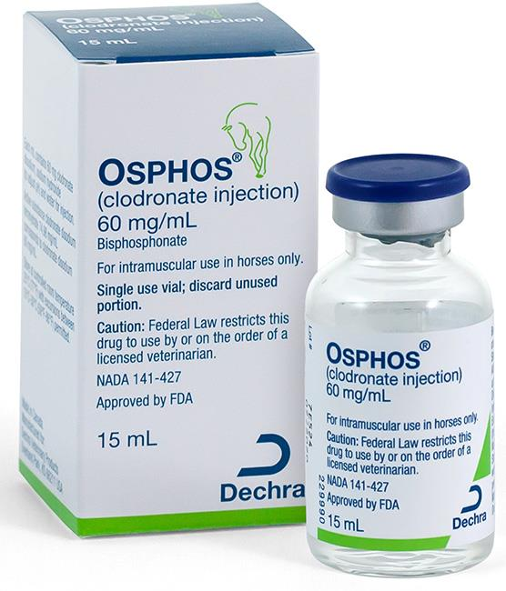
Therapeutic Plan
Osphos – administered 6/23/24 IM by owner
Osphos (clodronate injection) IM treatment 1.8 mg/kg (15 ml)
Continue 3-degree wedge LF/RF shoeing
Starting 4 days after Osphos administration, return horse to 1g phenylbutazone BID as needed while Osphos takes effect
Re-evaluate lameness for response to treatment at 30-60 days
MRI would allow for full evaluation of navicular bone, bursa, and soft tissue structures in the LF distal limb, particularly the DDFT. MRI referral declined by owner at this time.
If no improvement, next step would be injecting the LF navicular bursa
Palmar digital neurectomy possible last resort treatment

Slide 19
Outcome and Prognosis
7/29/24 - Approx 35 days post Osphos Administration
Owner reported no improvement to lameness from Osphos, but that he still improved on 1g Phenylbutazone AM and PM
Did not bring horse in for a re-evaluation
Recommended lameness re-check at 60 days post-Osphos administration to evaluate response to treatment

Slide 20
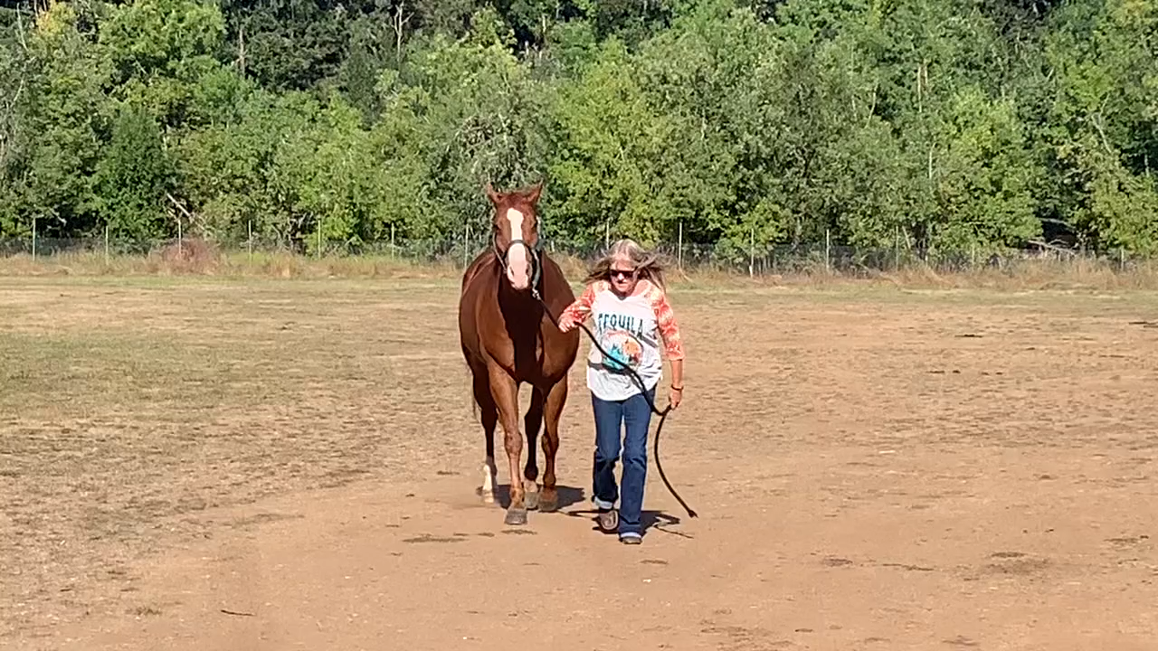
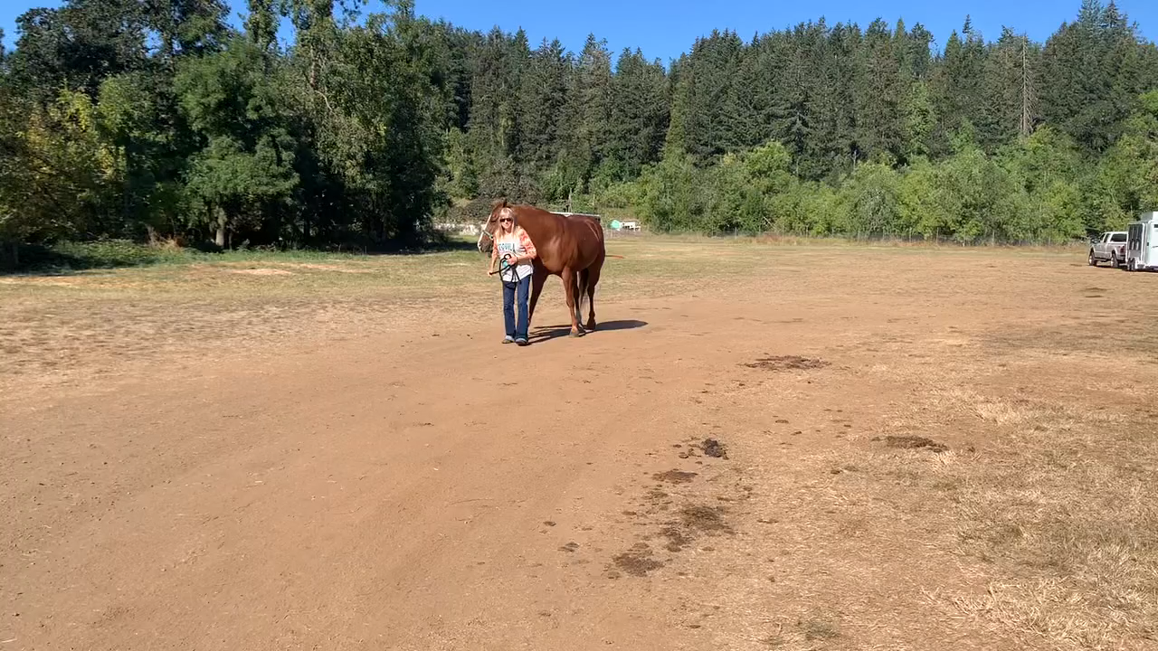
Outcome and Prognosis
9/9/24 - Approx 75 days post Osphos Administration
Owner reported sound without phenylbutazone, sent videos to confirm
Did not bring horse in for a re-evaluation
Long term prognosis for riding use is guarded, but positive response to Osphos shows potential for current maintainability.

Slide 21
Conclusion
Takeaway 1: Avoid focusing on the “most obvious” diagnosis
Left carpus at first appeared to be the primary concern, since the carpus was the only observed source of pain based on flexions and hoof testers
However, degree of lameness was not consistent with radiographic changes of the carpus, so decided to pursue further diagnostics, leading to final diagnosis of tripartite navicular bone
Had we treated the obvious by injecting the carpus and sending the horse home, we would have missed the primary source of lameness
Takeaway 2: Need for further research regarding bisphosphate use in partite navicular bones
No current studies or case reports using Osphos or other bisphosphonates for treatment of partite navicular bones
Based on Rascal’s improvement post-administration of Osphos, bisphosphonates may be useful in other cases of partite navicular bones with an otherwise poor prognosis for return to function.

Slide 22
References
Argüelles, D, Saituaa, A, Sánchez de Medina, A, et al. Clinical efficacy of clodronic acid in horses diagnosed with navicular syndrome: A field study using objective and subjective lameness evaluation. Res Vet Sci. 2019;125:298-304.
Dyson, SJ. Fracture of the navicular bone and congenital bipartite navicular bone. In: Diagnosis and Management of Lameness in the Horse. Ed: Elsevier. 2011. Pp. 343–344.
Harcourt, M, Smith, C, Bell, R, et al. Magnetic resonance and radiographic imaging of a case of bilateral bipartite navicular bones in a horse. Aust. Vet. J. 2018;96:464–469.
Mitchell, A, Wright, G, Sampson, SN, et al. Clodronate improves lameness in horses without changing bone turnover markers. Equine Vet. J. 2019;51:356–363.
Van Der Zaag, EJ, Weerts, EAWS, Van Den Belt, AJM, et al. Clinicopathological findings in horses with a bi- or tripartite navicular bone. BMC Vet. Res. 2016;12:74.

Slide 23
Questions?
Thank you to:
Solomon Benarroch, DVM, for his support and mentorship throughout this case
John Mattoon, DVM, DAVCR for providing his professional review of the radiographs
Rascal’s owner for allowing me to share and present his case

Slide 24

Triple the Problem: Case Report of a Tripartite Navicular Bone
Madison Gray, 2026, Washington State University
Signalment: Rascal
11-year-old Quarter Horse gelding.
Presenting Complaint:
June 2024: Presented for persistent lameness and pointing of left front limb.
History:
Bilateral forelimb distal interphalangeal joints injected 2 weeks prior with partial but incomplete resolution of LF lameness
Previous Osphos injection Jan 2024
Owner reported current improvement on 1-gram phenylbutazone AM and PM
Presentation:
Lameness exam:
Straight line: 2.5/5 LF
Lunge left: 3/5 LF
Lunge right: 2.5/5 LF
Flexions:
Positive left carpus.
30s stress test on left carpus: 3/5 LF with poor recovery
Hoof testers: WNL
Diagnostic Testing:
Radiographs of left carpus.
Minimal radiographic abnormalities.
Suspected carpus was not the primary source of pain.
Treatment plan:
Osphos (clodronate injection) IM at 1.8 mg/kg (15 ml). Re-evaluate at 30- and 60-days post administration.
Maintain 3-degree wedge shoe bilateral forelimbs.
Starting 4 days post-Osphos, continue 1g twice daily phenylbutazone as needed until 30-60 day rechecks.
Image 1: Rascal (left)
Image 2: Flexed lateral radiograph of left carpus (left)
Image 6: 3-degree wedge on Rascal’s left front (above)
Outcome:
75 days post-Osphos injection, owner reported resolution of lameness without the additional use of phenylbutazone.
Owner did not bring the horse in for re-evaluation but provided videos demonstrating resolution of lameness.
Prognosis:
Guarded prognosis for return to performance for most tripartite cases. However, Rascal’s improvement from Osphos administration may suggest the possibility of maintainability.
Conclusion:
No current research on the use of bisphosphonates in the treatment of partite navicular bones in horses. Based on case improvement, further research might demonstrate an improved prognosis for return to function.
2. LF PDN lidocaine block.
100% resolution of LF lameness, switched to RF
3. Radiographs of LF foot
Dx: unilateral tripartite navicular bone
4. Comparison RF navicular skyline: WNL
Proposed pathophysiology:
Thought to occur due to incomplete ossification of the navicular bone during development. Degenerative changes lead to the formation of subchondral bone cysts within the navicular bone, which may be the cause of chronic, progressive lameness observed later in life.
Images 3-5: Radiographs showing the left front tripartite navicular bone (left)
Thank you to Dr. Solomon Benarroch at Equine Sports Medicine PC and Dr. John Mattoon at Washington State University.
2025 Student and New Graduate Case Study Competition

