Slide 1


Bad to the Bone
A case of Rhodococcus equi-associated
vertebral osteomyelitis
Janae Wiley
University of Missouri, 2026
Lynn M. Martin, DVM, MPH, DACVIM (LAIM)

Slide 2

Signalment and History
May 28, 2025:
History:
3-month-old American Quarter Horse colt
Presenting for evaluation of:
                Suspected pneumonia
                Subcutaneous masses
                Multiple effusive joints
                Abrasions
                Pyrexia
  February 2025: Reportedly uneventful foaling in Iowa
  Late March 2025: Transported to farm in Kansas
  April 2025: Suspected respiratory infection
    rDVM administered Excede on farm
  May 16, 2025: Positive Rhodococcus equi culture from foal different that was foaled out at the same farm in Iowa
  May 28, 2025: Presentation to MU due to worsening clinical signs

Slide 3
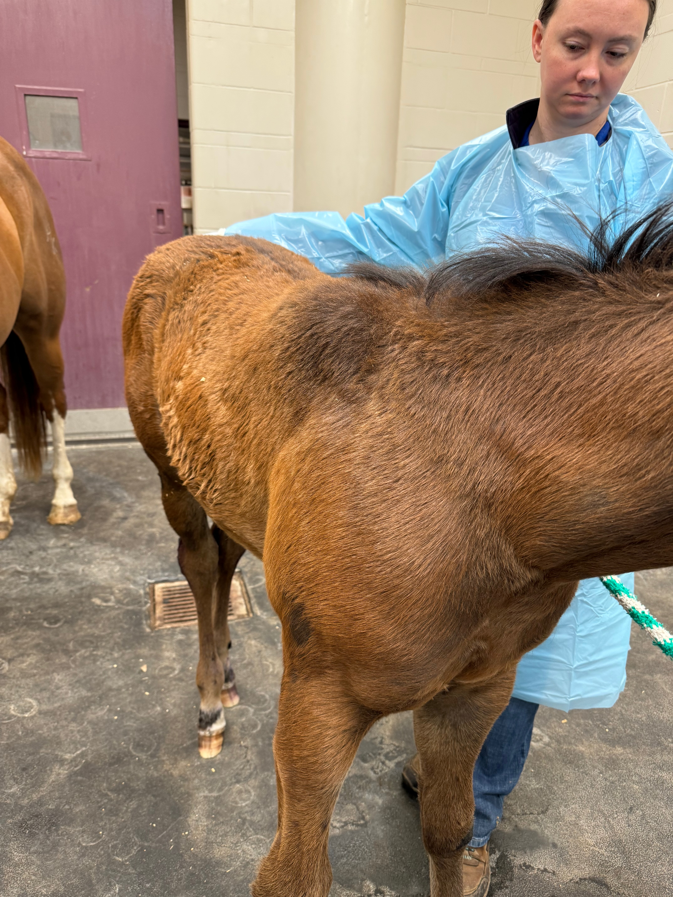
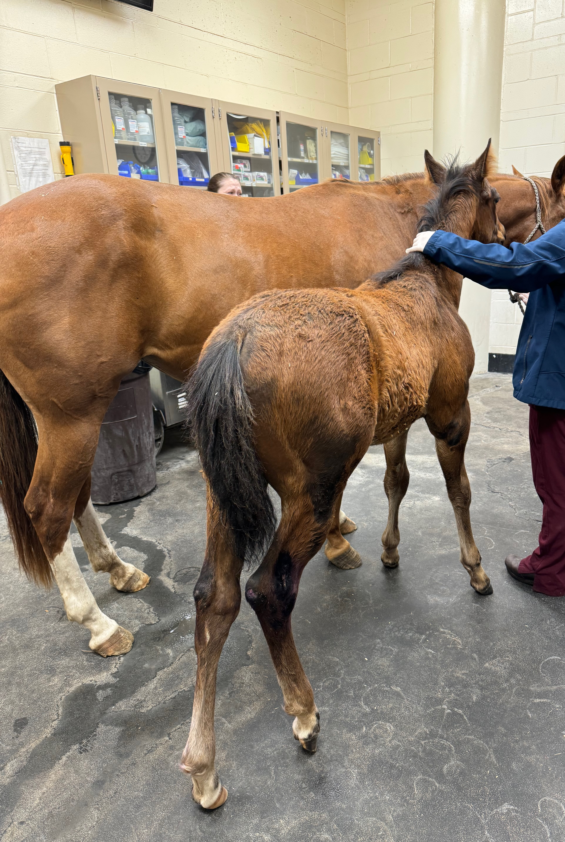
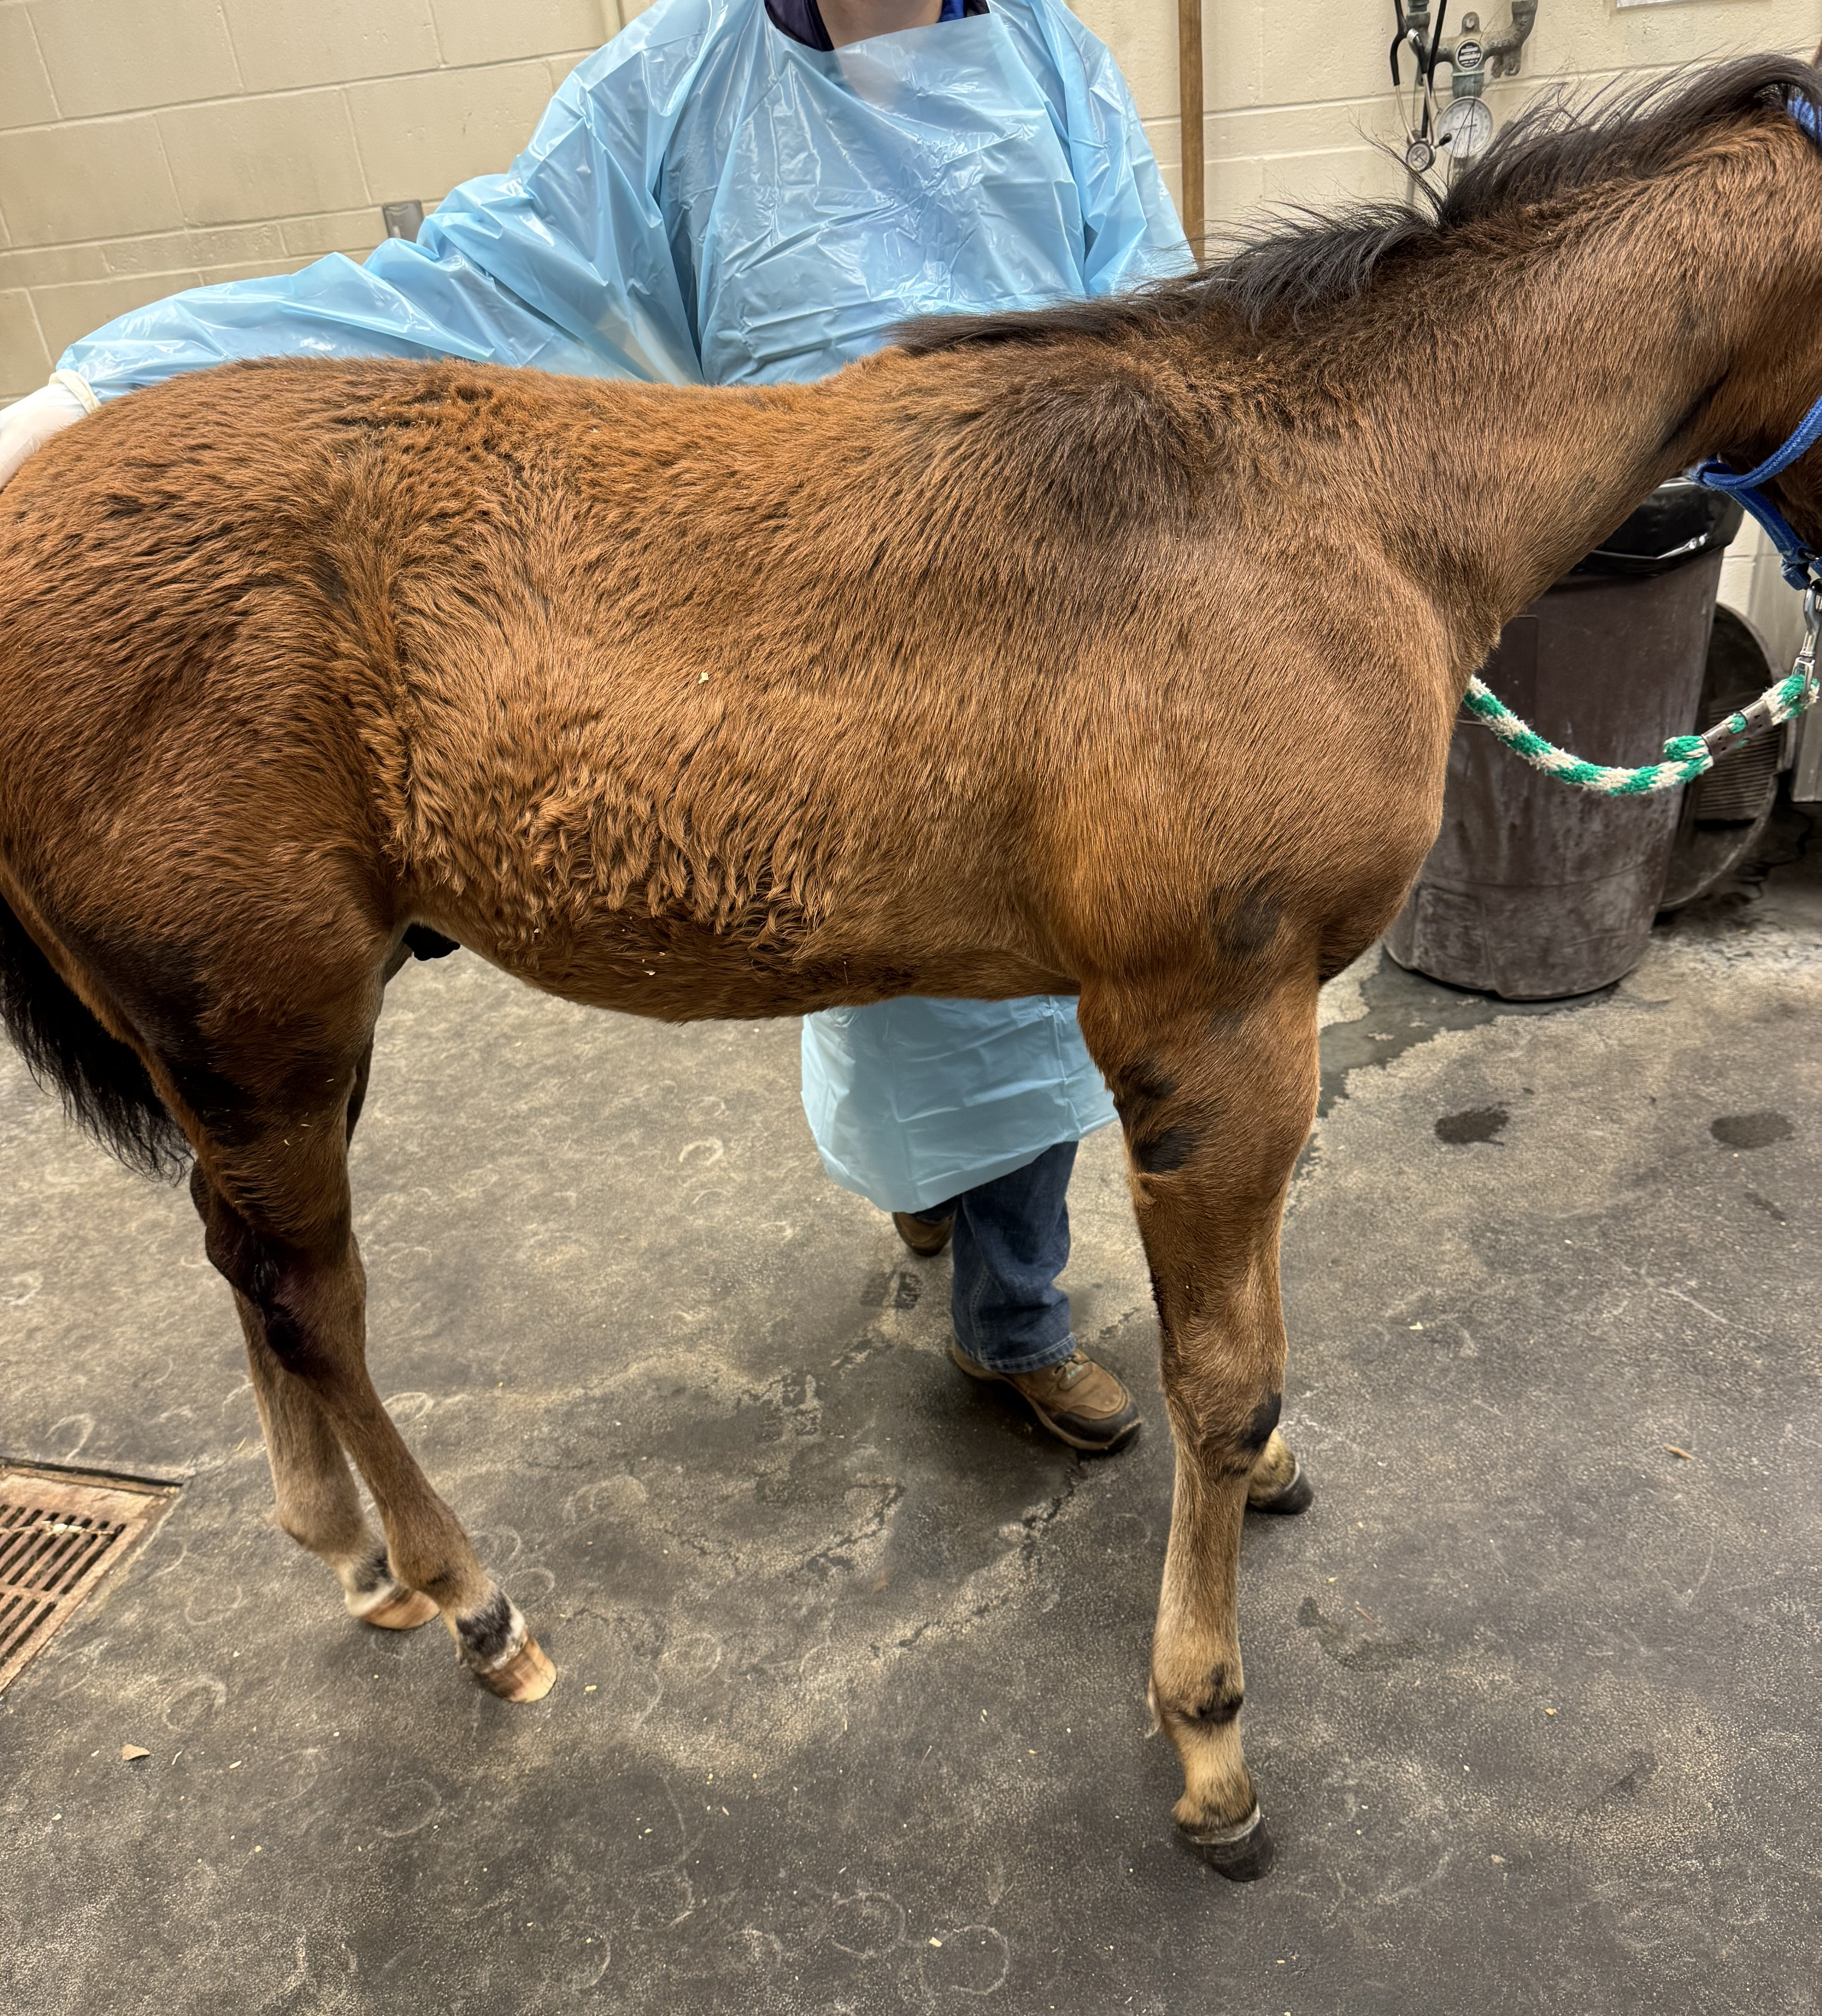
Distance Exam

Slide 4
Clinical Findings – Physical Examination
  Dull mentation
  Weight: 146 kg; BCS: 4/9 with dull haircoat
  T: 101.7 F; P: 96 bpm; R: 54 brpm
  Pink to dark mucous membranes; CRT: ~3 s
  Increased bronchovesicular sounds bilaterally
  Bilaterally symmetrical swelling over the region of the withers
      Moderately effusive joints:
        Carpi: R>L
        Tibiotarsal joints: L>R
        Left stifle
      Bilateral forelimb contracture
      Abrasions
        TMJ x 2
        Lateral aspect of fetlocks x4
        Medial point of elbow x 2
        Medial + lateral hocks x2

Slide 5
Clinical Findings – Complete Blood Count & Plasma Biochemistry Profile
Parameter​ | Result​ | Reference Interval​ | Parameter​ | Result​ | Reference Interval​
RBC​ | 8.39 | 6.55-9.68 x10⁶/µl​ | Plasma Protein | 8.0 | 6.1-7.5 g/dL​
HGB​ | 9.2​ | 11.2-17.2 g/dL​ | Fibrinogen | 0.9 | 0.1-0.5 g/dL
HCT​ | 26.0​ | 30.6-46.9 %​ | WBC​ | 38.62 | 4.84-10.38 x10³/µl​
MCV​ | 31.0 | 43.7-53.5 fL​ | Neutrophils​ | 33.79 | 2.39-5.78 x10³/µl​
MCH​ | 11.0​ | 15.8-19.7 pg​ | Band Neutrophils​ | 1.35 | 0.00-0.00 x10³/µl​
MCHC​ | 35.35 | 32.5-37.7 g/dL​ | Lymphocytes​ | 2.12 | 1.52-5.10 x10³/µl​
RDW | 25.7 | 16.6-19.6 %​ | Monocytes​ | 1.35 | 0.00-0.46 x10³/µl​
PLT​ | 219 | 93-241 x10³/µl​ | Eosinophils​ | 0.00 | 0.00-0.52 x10³/µl​
MPV​ | 8.1 | 5.9-8.0 fL​ | Basophils​ | 0.00 | 0.00-0.07 x10/µl​
Parameter​ | Res-ult​ | Reference Interval​ | Parameter​ | Result​ | Reference Interval​
Glucose​ | 113 | 77-107 ​mg/dL | Total Protein​ | 7.7 | 5.7-7.5​ g/dL
BUN​ | 10 | 11-24​ mg/dL | Albumin​ | 2.9 | 2.5-3.6 g/dL
Creatinine​ | 1.2 | 0.9-1.7​ mg/dL | Globulin​ | 4.8 | 2.4-4.1​ mg/dL
Sodium​ | 130 | 132-141​ mEq/L | Triglyceride | 39 | 14-62​ U/L
Potassium​ | 3.9 | 2.7-4.3​ mEq/L | Total Bilirubin​ | 0.9 | 0.6-2.8​ mg/dL
Chloride​ | 99 | 96-105​ mEq/L | AST​ | 112 | 203-415​ U/L
Calcium | 11.8 | 11.2-12.8​ mg/dL | GGT​ | 41 | 4-20​ U/L
Phosphorus​ | 4.6 | 1.8-4.0​ mg/dL | CK​ | 83 | 112-444​ U/L
Anion Gap | 11 | 8-15 mEq/L | GLDH | 3 | 0-22 U/L
Bicarbonate | 24 | 25-33 mEq/L | Serum amyloid A | 1674 | <50 µg/mL
Morphologic evaluation revealed mild neutrophil toxicity and few reactive lymphocytes

Slide 6
Problem List
Lethargy | Polysynovitis
Unthrifty haircoat | Neutrophilia
Subcutaneous swellings | Mild neutrophil toxicity with left shift
Pyrexia | Anemia
Hyperemic mucous membranes | Hyperfibrinogenemia
Prolonged CRT | Hyponatremia
Mucopurulent nasal discharge | Hyperproteinemia
Increased bronchovesicular sounds | Hyperglobulinemia
Mucopurulent ocular discharge | Hypoalbuminemia
Multiple abrasions | Increased serum amyloid A
Bilateral forelimb contracture

Slide 7
Differential Diagnoses
Subcutaneous/intramuscular swellings
Rhodococcus equi infection
Corynebacterium pseudotuberculosis infection
Cellulitis
Eosinophilic granuloma
Cutaneous amyloidosis
Anemia
Chronic inflammation
Iron deficiency
Hemorrhage
Increased bronchovesicular sounds
Pleuropneumonia
Rhodococcus equi infection
Profound neutrophilia
Bacterial infection
  Rhodococcus equi
  Corynebacterium pseudotuberculosis
  Streptococcus equi sbsp. equi
Chronic pneumonia
Chronic peritonitis
Vasculitis
Hyperglobulinemia
Chronic antigenic stimulation
Abscessation
Multiple myeloma
Multiple effusive synovial structures
Septicemia
Rhodococcus equi infection

Slide 8
Case Progression
      The following day (May 29):
      Unwilling to rise – paraparesis
      Hindlimbs:
        Decreased to absent skin sensation
        Deep pain present
        Withdrawal reflexes delayed to absent
        Extensor rigidity
      Forelimbs: apparently normal sensation and motor function, mild extensor rigidity
      Cutaneous trunci reflex present to area of T6-7
      Perineal reflex present
Revised Problem List:
Paraparesis
Osteomyelitis
Traumatic compression of spinal cord
Infectious causes
Neurolocalized to T3-L3 with Schiff Sherrington Posture

Slide 9
Diagnostic Plan
Dorsal spinous process radiographs
Osteomyelitis
Rhodococcus equi infection
Traumatic insult
Fracture
Fine Needle Aspiration + Cytology + Culture
Rhodococcus equi infection
Corynebacterium pseudotuberculosis infection
CT
Osteomyelitis
Soft tissue swelling
Muscular hypertrophy
Abscess
Neoplasia
Nasal swab PCR
Rhodococcus equi infection

Slide 10
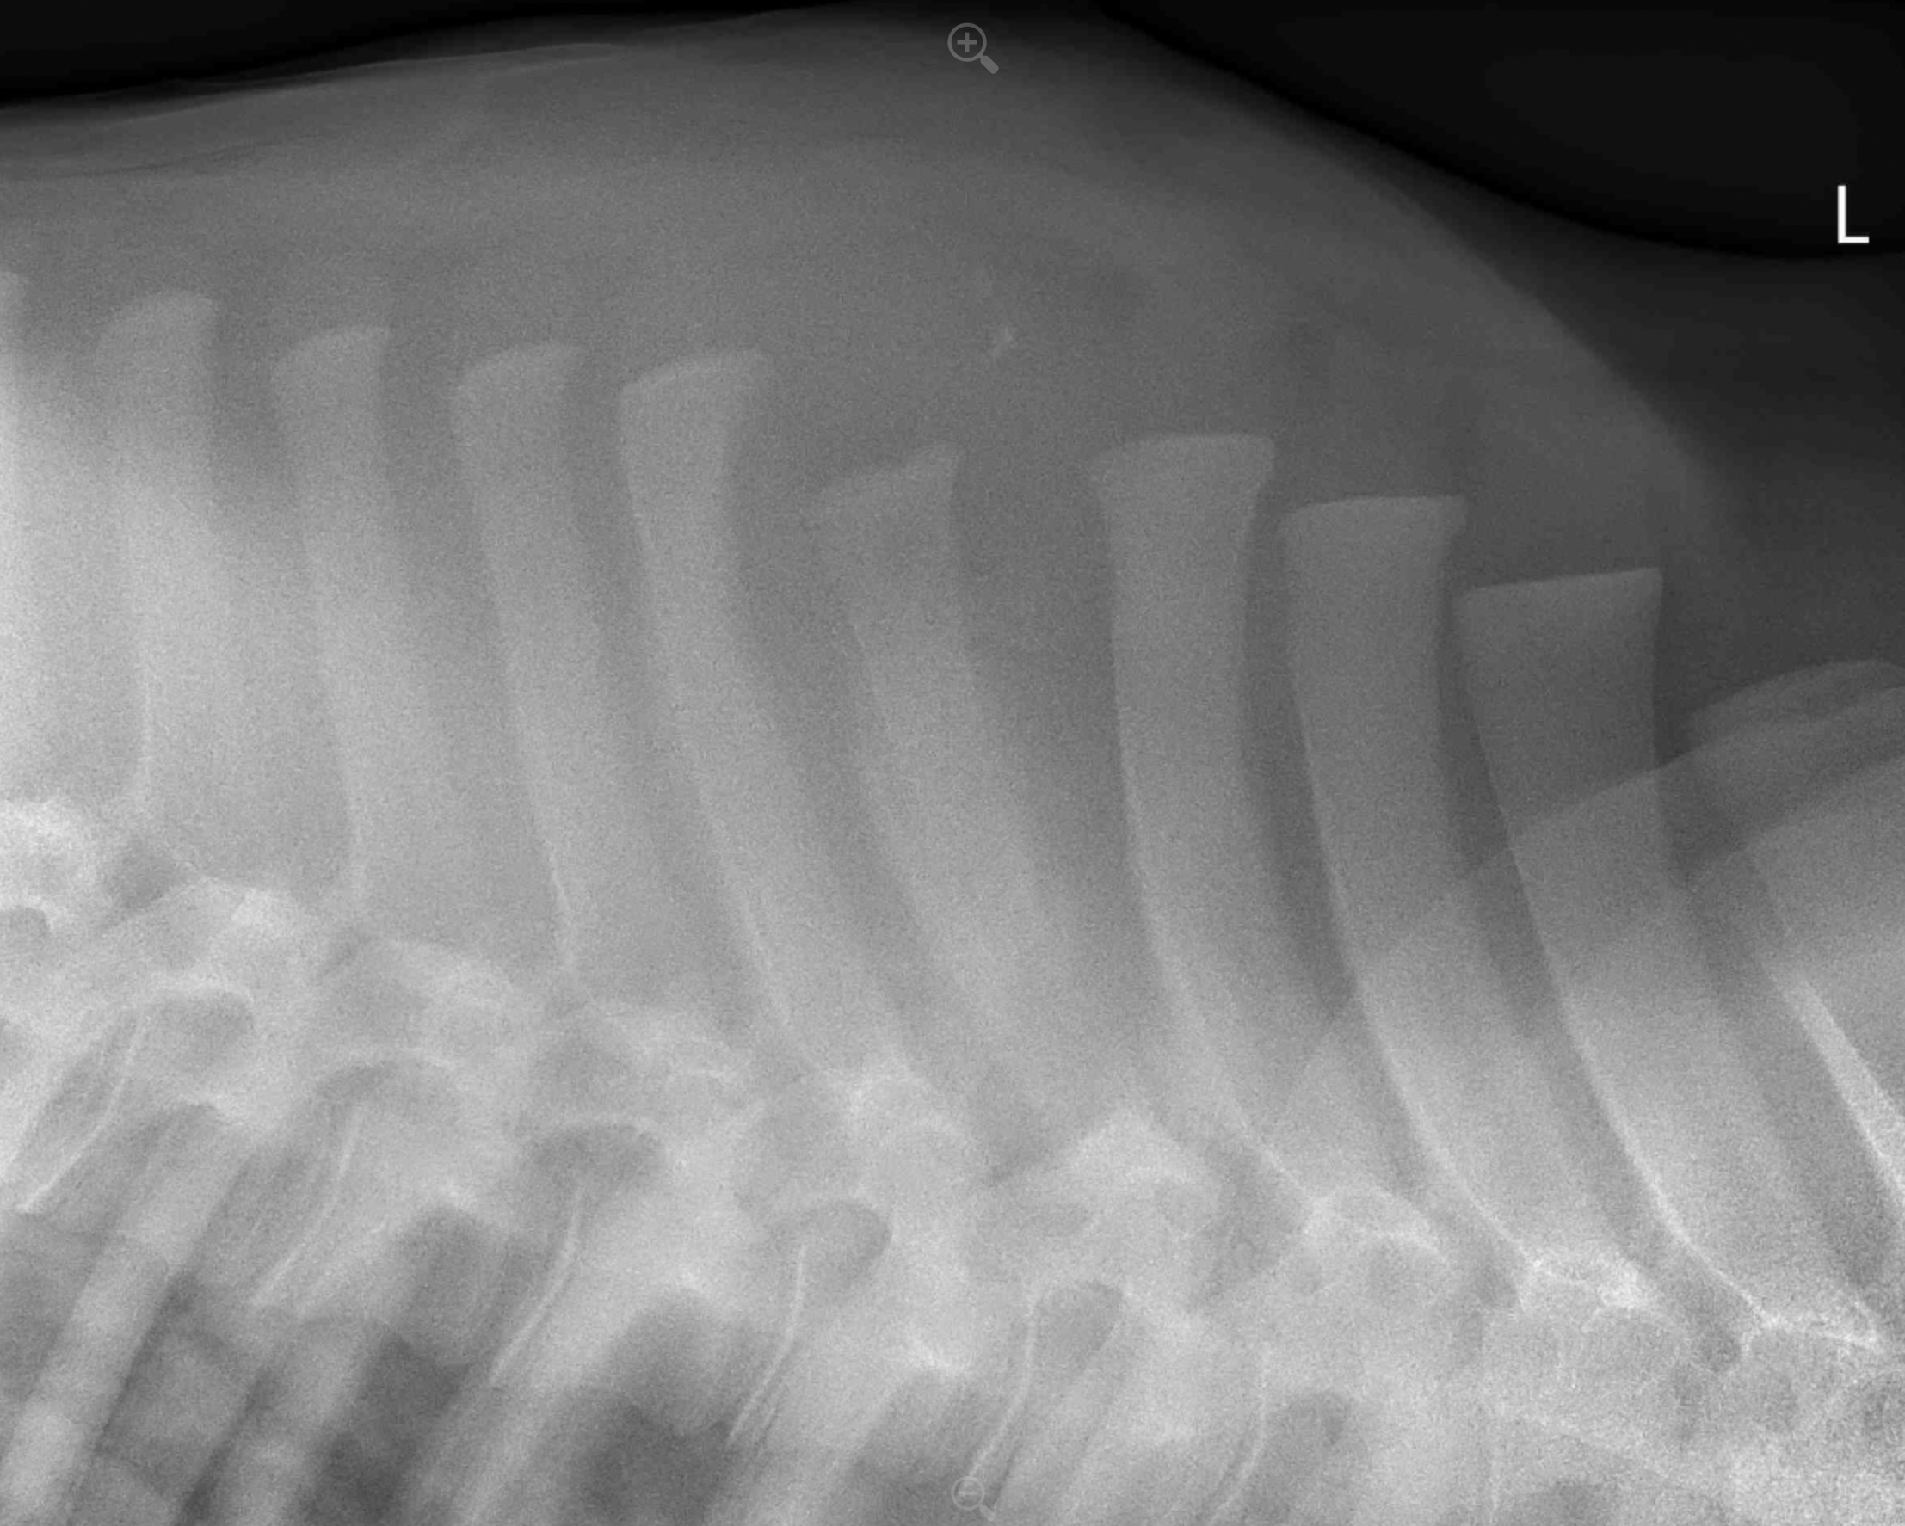
Diagnostic Test Results – Radiographs
Osteomyelitis involving the 4th, 5th, and 6th dorsal processes of the thoracic vertebrae with no overt involvement of the vertebral canal evident.
Radiographs of thoracic dorsal spinous processes, indicating the DSP of T6

Slide 11
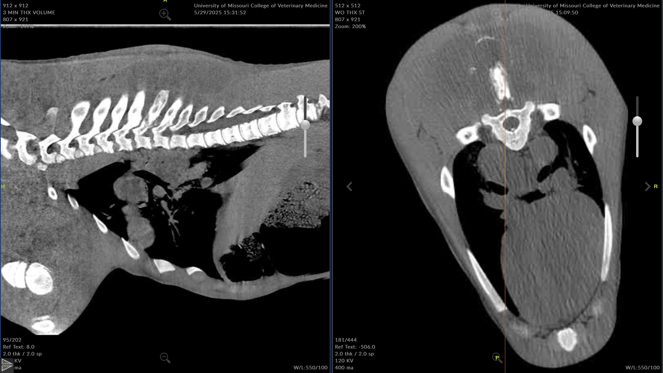
Diagnostic Test Results – CT
A
B
Spleen
FINDINGS:
Suspected large, intramuscular abscesses, T6 lysis and segmental spinal cord swelling.
Multifocal cavitated pulmonary nodules, increased accessory lung attenuation, and severe tracheobronchial lymphadenopathies/ abscessation.
Kidney
Mass
Mass
Computed tomography of thorax in sagittal (above left) and transverse (above right) section, showing lysis of DSP of T6 and intramuscular abscessation.
DSP of T6
Fluid attenuating intramuscular structures

Slide 12
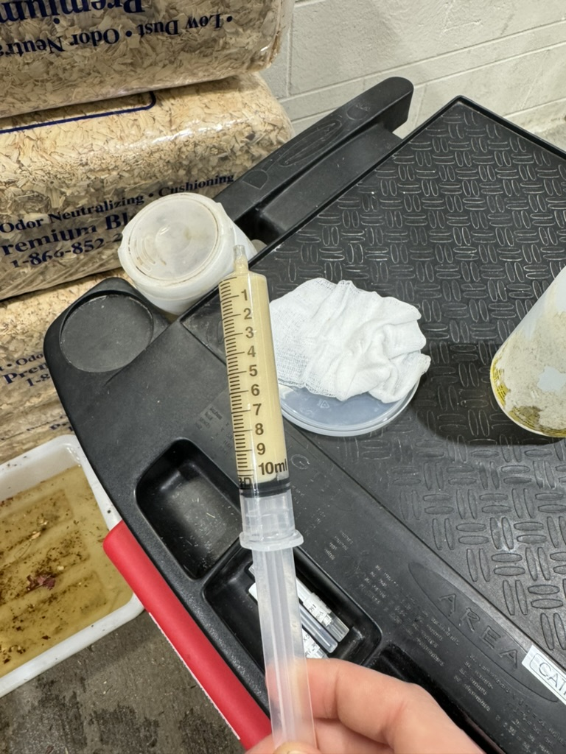
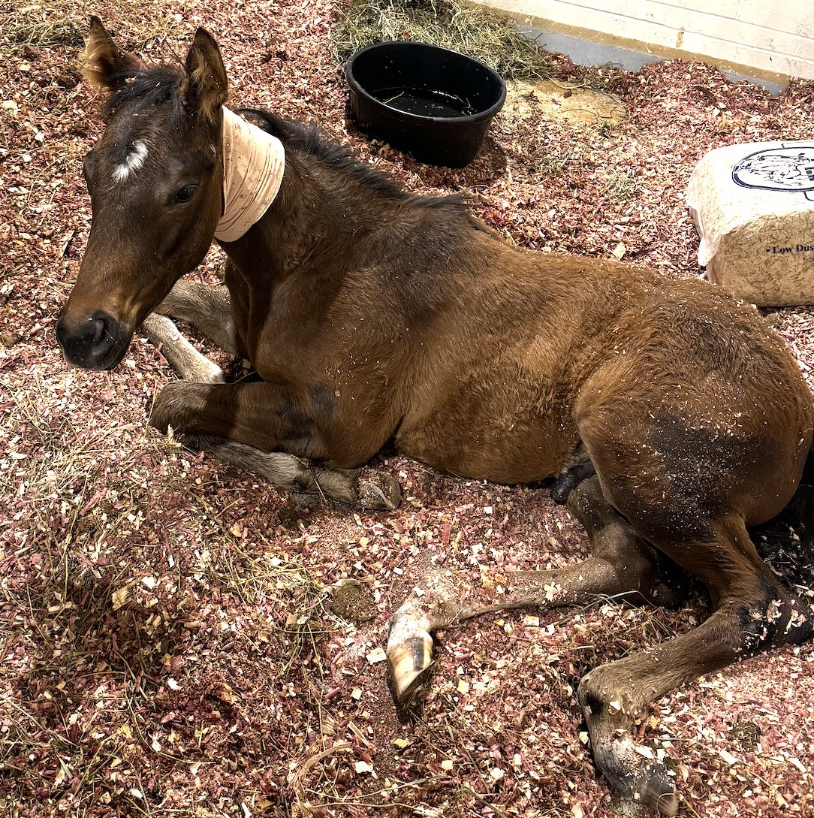
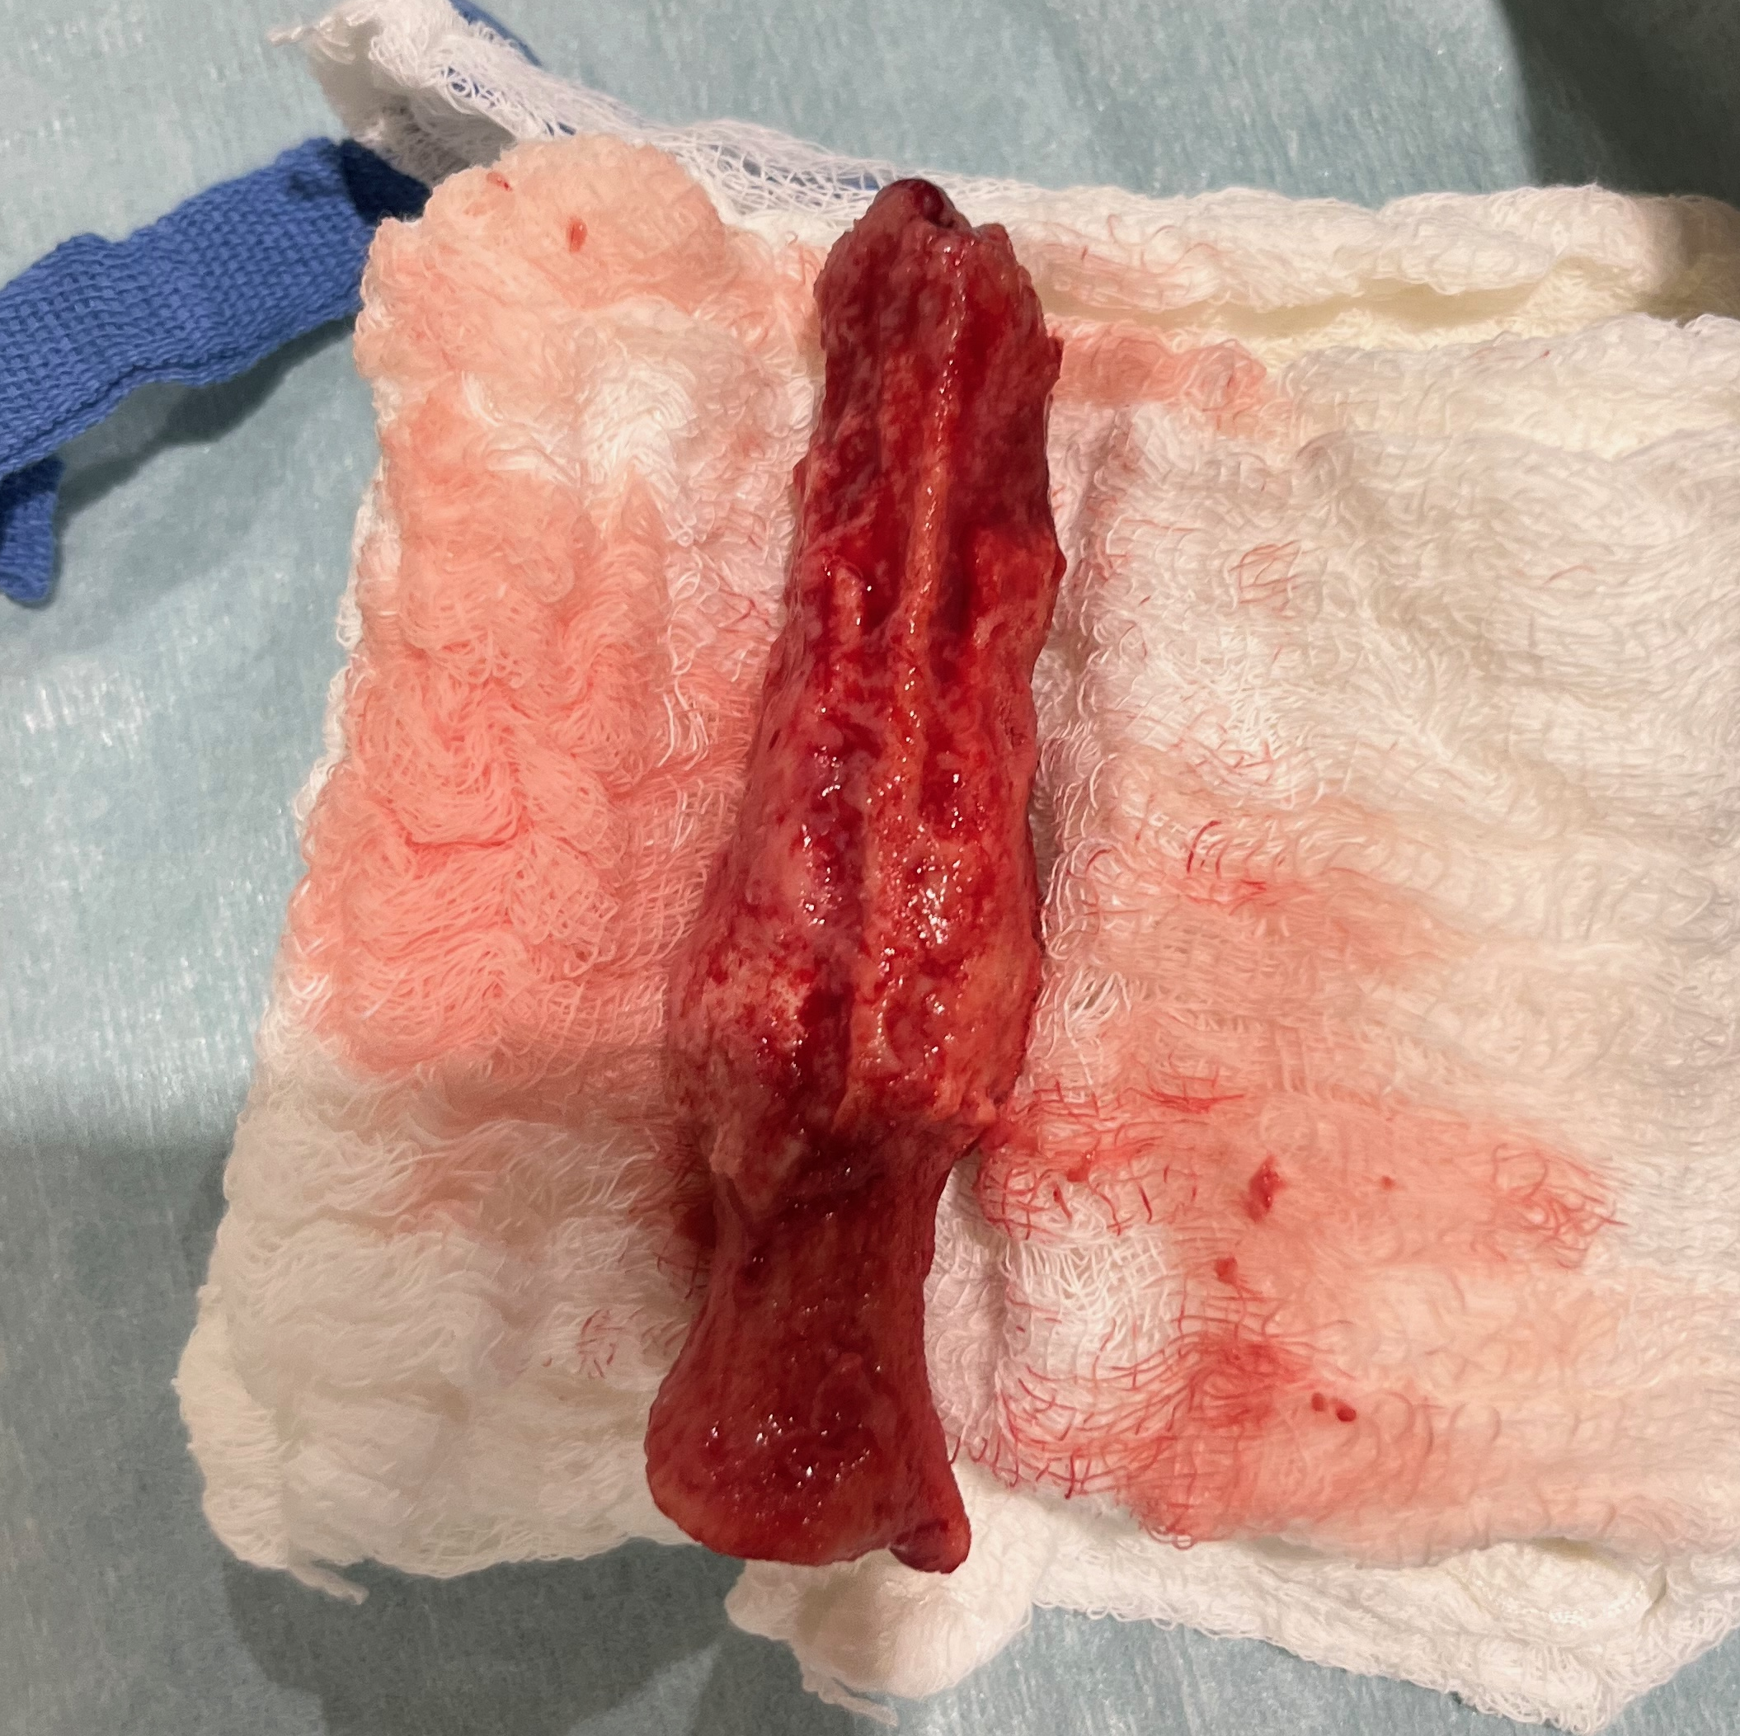
Diagnostic Test Results – Fine Needle Aspiration
Aspiration of a soft subcutaneous swelling located on the left side of the withers are submitted for cytology
The slides were predominated by marked numbers of degenerate neutrophils that often contained phagocytized bacteria consisting of pleomorphic coccobacilli to occasionally rod-shaped bacteria in a thin clear capsule. Bacteria also found extracellularly in low numbers.
Gross appearance of FNA.
The abscess was surgically drained and debrided, at which time the dorsal spinous process of T6 was removed due to severe instability and risk for sequestration.
Recumbent colt, indicating site of FNA.
Dorsal spinous process of T6

Slide 13
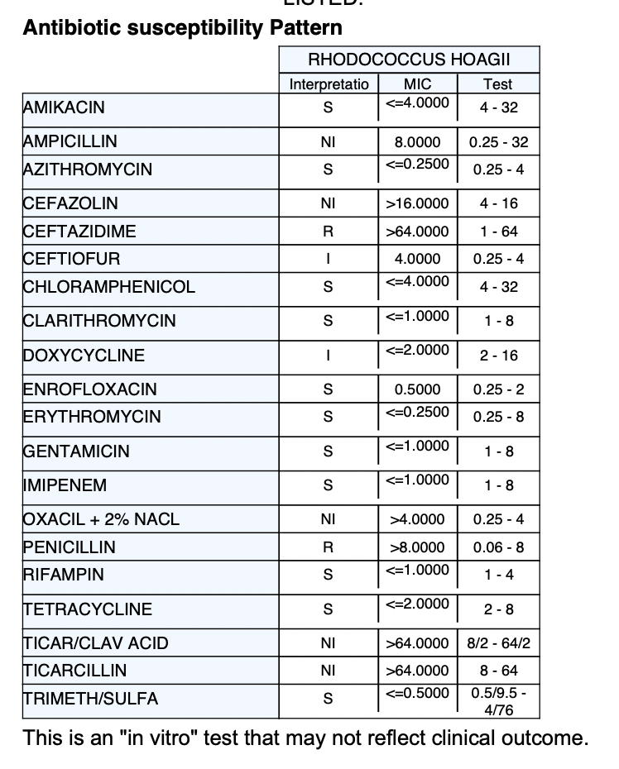
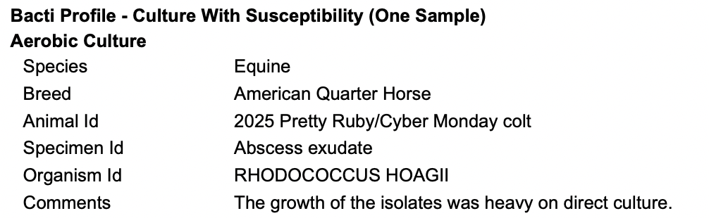
Diagnosis – Culture
*
*Also known as Rhodococcus equi

Slide 14
Diagnosis
Culture of purulent material
Rhodococcus equi
History
Foaling at farm with confirmed case of R. equi
Physical exam
Nasal discharge
Tachypnea
Increased bronchovesicular sounds
Increased respiratory effort
Rhodococcus equi
Infection
Cytology of purulent material
Marked numbers of degenerate neutrophils with intracellular coccobacillus bacteria
CBC/Chemistry
Profound acute on chronic inflammation
Toxic regenerative left shift
Hyperfibrinogenemia
Fine needle aspirate
Copious purulent material

Slide 15
Discussion – Etiology & Pathogenesis
R. equi is a facultative, intracellular coccobacillus that is soil-borne and found worldwide (except for Iceland).
Virulence is possible only with the presence of the VapA plasmid.
Most commonly seen on endemic farms, but sporadic forms are possible.
Transmission of disease begins with inhalation of dust particles containing the virulent form of R. equi
  Previously thought that foals were infected at 3-6 months, closer to the age when foals most commonly show clinical signs, but implementation of ultrasonographic techniques has established that pulmonary lesions may be present at as young as 1 month of age.¹
  Now understood that foals are infected early in life, and exposure to virulent forms of R. equi in the first 2 weeks of life is associated with the development of the disease.¹
  While generally slow growing, multiplication in alveolar macrophages can reach 10,000-fold in 2 weeks under favorable conditions.
The development of extrapulmonary disease is unclear, but it is suggested that the bacteria infect the GI through ingestion, and hematogenously to other locations outside of the pulmonary tract.
Notes:
Geography

Slide 16
Extrapulmonary Disease
Most common clinical signs include diarrhea, colic, and weight loss
However, only 39% of foals with ulcerative enterotyphlocolitis and 24% of foals with intra-abdominal abscesses had diarrhea antemortem
Polysynovitis can be septic (14%) or immune-mediated (37%)
Abdominal forms of EPDs predominate
Vertebral osteomyelitis described in 5 case reports – paraplegia developed as a sequelae of disease
Discussion – Clinical Signs
Pulmonary Disease
  Most common presentation
  Fever, cough, tachypnea, tachycardia, and abnormal bronchovesicular sounds
  Clinical signs are exacerbated in hot and humid environments
  Pulmonary lesions often extensive before clinical signs develop
  ARDS/Acute death is rare but possible

Slide 17
Discussion – Clinical Signs
Prevalence of EPDs
  One study 111/150 foals (74%) that showed clinical signs of rhodococcal infection also had at least 1 EPD present.²
  This statistic may be complicated by the fact that cases were selected from a university teaching hospital, which may contain an overrepresentation of critical patients.
  EPDs may occur in the absence of pulmonary disease (5/60 foals had no evidence of pulmonary involvement at necropsy).²
Vertebral body osteomyelitis historically difficult to detect radiographically, with only 2 of 6 foals reported in the literature having radiographic evidence despite extensive gross lesions at necropsy.²
A significant portion of foals with EPDs show no clinical signs and are not diagnosed antemortem.²
EPD | No. of affected foals (%) | No. with antemortem diagnosis | No. with postmortem diagnosis
Immune-mediated polysynovitis | 37 (25) | 36 | 1
Septic synovitis | 14 (9) | 12 | 2
Intra-abdominal abscesses | 25 (17) | 5 | 20
Peritonitis | 11 (7) | 10 | 1
Subcutaneous abscesses | 8 (5) | 8 | 0
Osteomyelitis | 5 (3) | 5 | 0
Paravertebral abscesses | 3 (2) | 3 | 0
Source: Reuss et. al; 2009

Slide 18
Discussion – Diagnosis
A definitive diagnosis is established by culture or PCR of tracheobronchial aspirate of the organism from abscesses or respiratory secretions. However:
  36% of foals tested negative with PCR from TBA that were later positive postmortem
  Only 54% of foals tested cultured positive even with presence of ultrasonographic lesions
Common findings on bloodwork include neutrophilic leukocytosis and hyperfibrinogenemia. Values suggestive but not definitive for rhodococcus are:
  WBC count above 20,000 cells/uL¹
  Plasma fibrinogen concentration above 700 mg/dL¹
Radiological and ultrasonographic evidence most practical in screening for pulmonary disease
  Screen for superficial lesions, including abscessation and consolidation.
  In the field, ultrasonographic diagnosis was successful in 95% of foals even in the absence of clinical disease
  Safe and effective for monitoring response to treatment
The use of SAA as a screening tool has been explored, but has yielded widely variable results, and no correlation with clinical disease has been established.
Fecal PCR widely considered invalid, but one study shows 54% of foals with respiratory infection are positive on fecal

Slide 19
Discussion – Treatment & Prognosis
Antibiotic Therapy
  Macrolide + rifampin: main recommendation for treating foals with clinical signs of infection for 40 years.
    Adverse effects: In foals: antibiotic-induced colitis & anhidrosis. In mares: fatal colitis
  Macrolide monotherapy: May be equally as effective as in combination with rifampin, but increased risk of development of resistance compared to combination with rifampin
  Doxycycline: effectively reaches MIC₉₀ for most causes of bronchopneumonia in foals, and less adverse effects are noted with doxycycline compared to macrolides.
  Liposomal gentamicin: Exceeds MIC₉₀ for 48h, but concerns for nephrotoxicity
  Concerns for increasing number of resistant strains. 76% of strains tested from farms endemic with R. equi showed resistance to either one or both antimicrobials
Supportive Care
  Stabilize with fluid support and oxygen therapy as needed
  Anti-inflammatories: NSAIDs

Slide 20
Therapeutic Plans & Outcome
Medical Management
Euthanasia
Medical management was elected and colt was hospitalized with supportive care and antibiotic therapy.
Long-term antibiotic therapy
Anti-inflammatory drug therapy
Surgery site care
Pulmonary and EPD suspected
Paraplegia carries a guarded prognosis
Cost constraints
May 31, 2025: Owners elected to continue medical management on farm
  At time of discharge, motor function was gradually improving, and foal could stand with assistance to nurse
The colt continued to make positive progress: Stronger in limbs and improved movement of hind limbs
June 2, 2025
  2 days following discharge, colt was acutely found dull, hyporexic and cold to the touch and decompensated quickly, expiring on his own.
Medical management plan:
  Azithromycin 10mg/kg PO SID
  Rifampin 5mg/kg PO BID
  Flunixin meglumine 1.1 mg/kg IV BID
  Dexamethasone 0.1mg/kg IV SID
  Omeprazole 3mg/kg PO SID
  Plasma 2 liters IV
  Change recumbency q4hr

Slide 21
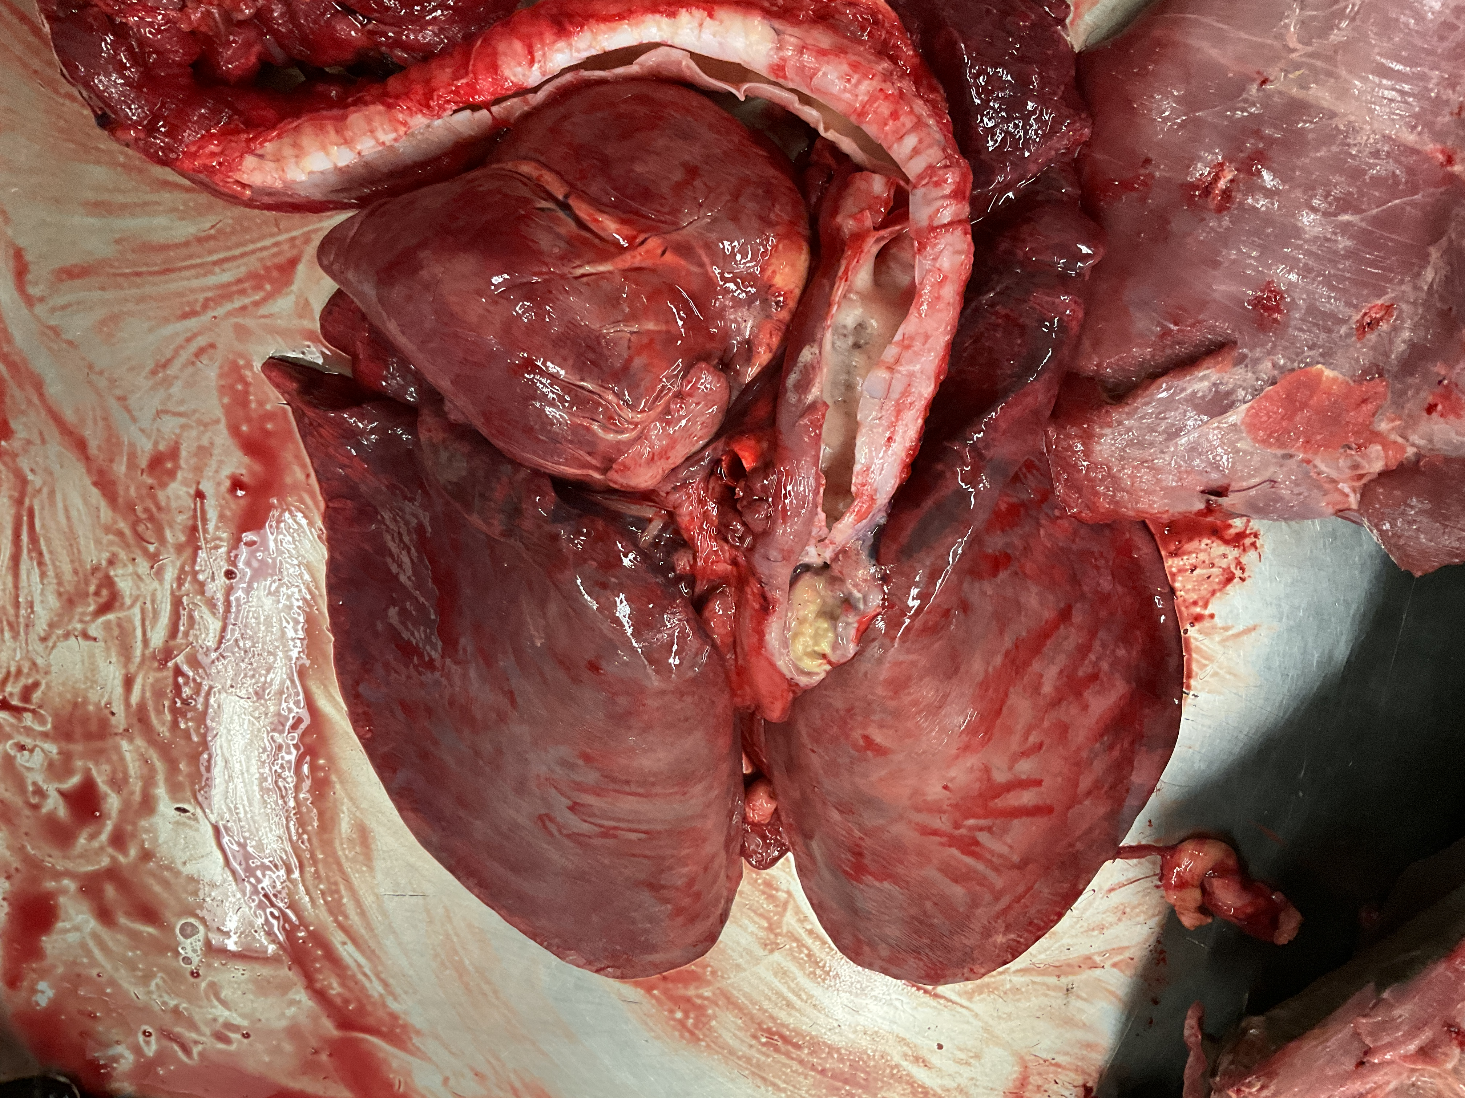
Postmortem Findings
MICROSCOPIC FINDINGS
Lungs, accessory lobe: Approximately 80% of pulmonary parenchyma is effaced by multifocal to coalescing nodules composed of large numbers of neutrophils, macrophages, lymphocytes mixed with moderate numbers of plump fibroblasts, edema, and fibrous connective tissue with scattered areas of erythrocytes (hemorrhage).
Pulmonary artery in the left caudal lung lobe: The lumen is occluded by a thromboembolism.
Tracheobronchial lymph nodes: 2-3x their normal size and contain abundant amounts of tan to yellow caseous material.
Lungs are diffusely purple to red and mildly rubbery. No intraparenchymal gross nodules seen on cut section.
Left lung
Right lung

Slide 22
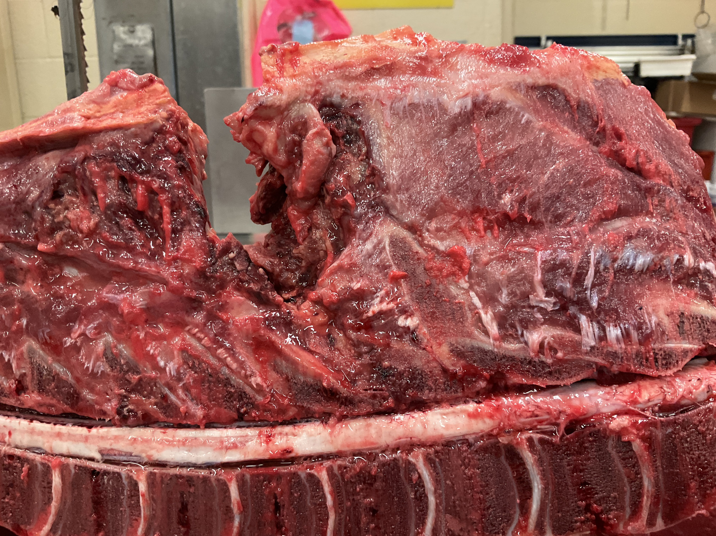
Postmortem Findings
Dorsal
T6 DSP
space
Spine: Two large intramuscular abscesses measuring 13 x 7 x 3 cm on the right and 9 x 3 x 2 cm on the left surround the lateral aspect of T6 bilaterally and converge to a central pocket at the site of the missing T6 dorsal spinous process.
MICROSCOPIC FINDINGS:
Vertebra T6: There is a large abscess containing tremendous amounts of fibrin, hemorrhage, amorphous eosinophilic cellular material, karyorrhectic, and pyknotic debris (necrosis).
T6-T7 spinal cord: Surrounding and infiltrating the nerve roots are multifocal aggregates of lymphocytes.
Spleen
Cranial
Caudal
Lung
Ventral

Slide 23
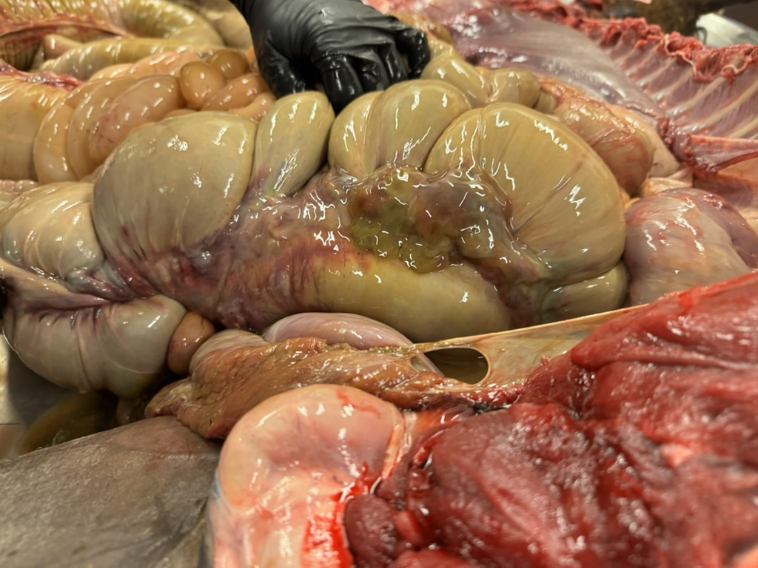
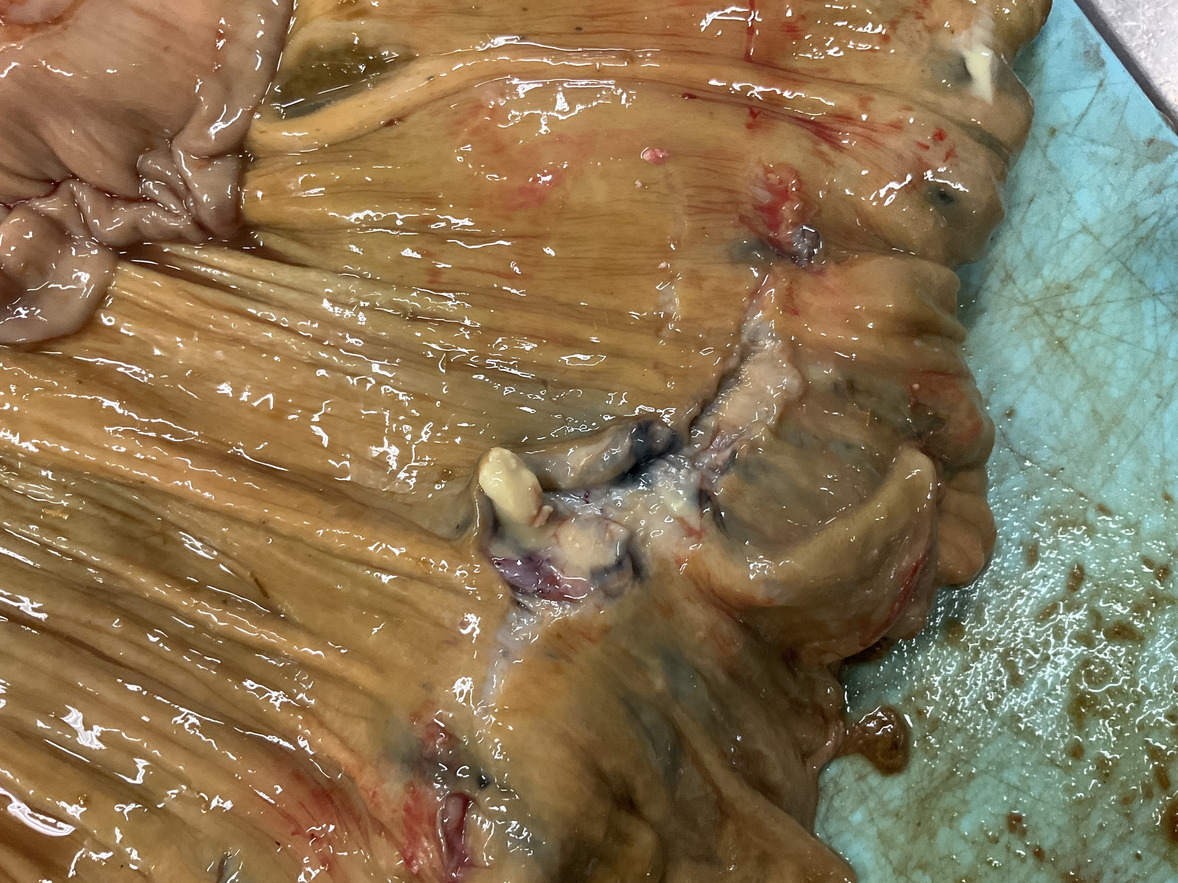
Postmortem Findings
The intestinal serosa is diffusely dull and yellow with multifocal enlarge mesenteric lymph nodes along the large colon and cecum (2 to 3x their normal size), and when incised, exude yellow tan opaque caseous material.
Cecal lymph nodes
Apex of cecum
Spleen
Base of cecum
Mass
Lung
The Peyer’s patches in the cecum: prominent, slightly raised, contain caseous material on cut section

Slide 24
Discussion – Paraparesis in the Literature
Vertebral body osteomyelitis is historically difficult to detect radiographically (2/5 foals showed radiograph findings antemortem)
Suspected that hematogenous spread is responsible for osteomyelitis
Hindlimb paraparesis/paraplegia is historically associated with non-survival
Osteomyelitis is a rare but described form of extrapulmonary R. equi infection.
Case | Age (weeks) | Presentation | Outcome
Case 1⁴ | 22 | Paraparesis with firm swelling over T3–T5; initially bright, alert; progressive hindlimb deficits; rads: lysis of T3–T5 DSPs | Euthanized on Day 2 due to worsening spinal cord compression
Case 2⁴ | 16 | History of R. equi pneumonia; relapsed with respiratory signs and later hindlimb weakness; CSF: septic meningitis | Euthanized on Day 8 after developing seizures, rigidity, and coma
Case 3⁵ | 10 | Acute paraplegia; harsh lung sounds; L2-L3 vertebral osteomyelitis | Euthanized after 36h due to loss of deep pain
Case 4⁵ | 16 | Tetraplegia; neck mass; C5 osteomyelitis; prior deaths on farm | Died within 5h of admission
Case 5⁵ | 16 | Acute tetraplegia; no warning signs; C3 osteomyelitis; same farm as Case 2 | Euthanized after 48h due to lack of improvement

Slide 25
Acknowledgements
A special thank you to those who were involved with this case:
Lynn M. Martin, DVM, MPH, DACVIM (LAIM)
Gabrielle González, DVM
Equine technicians and assistants
Veterinary student peers
Barn crew
MU Veterinary Medical Diagnostic Laboratory
Our attentive clients for presenting the patient and allowing us to learn from their colt
Most importantly, our patient, 2025 Pretty Ruby/Cyber Monday.

Slide 26
References
Sanz MG. Rhodococcus equi-What is New This Decade?. Vet Clin North Am Equine Pract. 2023;39(1):1-14.
Reuss SM, Chaffin MK, Cohen ND. Extrapulmonary disorders associated with Rhodococcus equi infection in foals: 150 cases (1987-2007). J Am Vet Med Assoc. 2009;235(7):855-63.
Rakowska, A., Cywinska, A., & Witkowski, L. Current Trends in Understanding and Managing Equine Rhodococcosis. Animals. 2020;10(10), 1910.
Olchowy TWJ. Vertebral body osteomyelitis due to Rhodococcus equi in two Arabian foals. Equine Vet J. 1994;26:79–82.
Giguére S, Lavoie JP. Rhodococcus equi vertebral osteomyelitis in 3 quarter horse colts. Equine Vet J. 1994;26:74–77.

Slide 27


Rhodococcus equi-associated vertebral osteomyelitis
Janae Wiley, 2026 – University of Missouri
Signalment: 3-month-old American Quarter Horse colt
Presenting Complaint:
Suspected pneumonia, subcutaneous masses over the withers, polysynovitis
Figure 1. Patient presentation (above)
History:
    Foaled out at a farm in Iowa with previous history of R. equi and transported to Kansas in March of 2025. Suspected respiratory infection in April and rDVM administered Excede on farm.
    Presentation:
Dull mentation, febrile, increased bronchovesicular sounds, subcutaneous swellings over withers, multiple effusive synovial structures, multiple abrasions
CBC and Plasma Biochemistry:
  Anemia
  Neutrophilia
  Hyperglobulinemia
  Hyperfibriginemia
Diagnostics:
Radiographs:
Osteomyelitis of T4-6 DSPs, no overt involvement of vertebral canal.
Figure 2. Radiograph of cranial thoracic vertebrae (above)
Computed Tomography:
Pathologic fracture of DSP of T6, large bilateral intramuscular swellings with T6 osteomyelitis and segmental myelitis with cord swelling. Suspect left pleural abscessation.
Figure 3. CT of thorax (above)
Diagnostics Continued:
Fine Needle Aspiration:
Purulent material aspirated
and submitted for culture
grew heavy growth of
Rhodococcus equi.
The abscess was surgically
drained and debrided,
and the DSP of T6 was
removed due to severe instability
Treatment Options:
Medical Management with long-term antibiotic and anti-inflammatory drug therapy and surgery site care
Euthanasia
Outcome
Medical management was elected and the colt was hospitalized with gradual improvements seen. After 3 days of hospitalization, colt was discharged with oral antibiotics and anti-inflammatories and continued to improve in strength and movement of hindlimbs. 2 days following discharge, the colt was found dull, hyporexic and cold and decompensated quickly, expiring on its own.
A necropsy was performed.
Postmortem Findings:
Approximately 80% of the accessory lobe of the lungs contains multifocal to coalescing nodules of purulent material.
Tracheobronchial lymph nodes are 2-3x their normal size and contain tan to yellow caseous material.
Two large intramuscular abscesses measuring 13 x 7 x 3 cm on the right and 9 x 3 x 2 cm on the left surround the lateral aspect of T6.
The vertebral body of T6 contains a large abscess and microscopic evaluation of the nerve roots of T6-T7 revealed multifocal aggregates of lymphocytes.
Colonic and cecal lymph nodes are 2-3x their normal size and exude yellow tan caseous material when incised.
Figure 4. FNA + T6 DSP
Dorsal
T6 DSP
space
Cranial
Caudal
Ventral
Figure 5. Gross necropsy findings
2025 Student and New Graduate Case Study Competition

