Slide 1
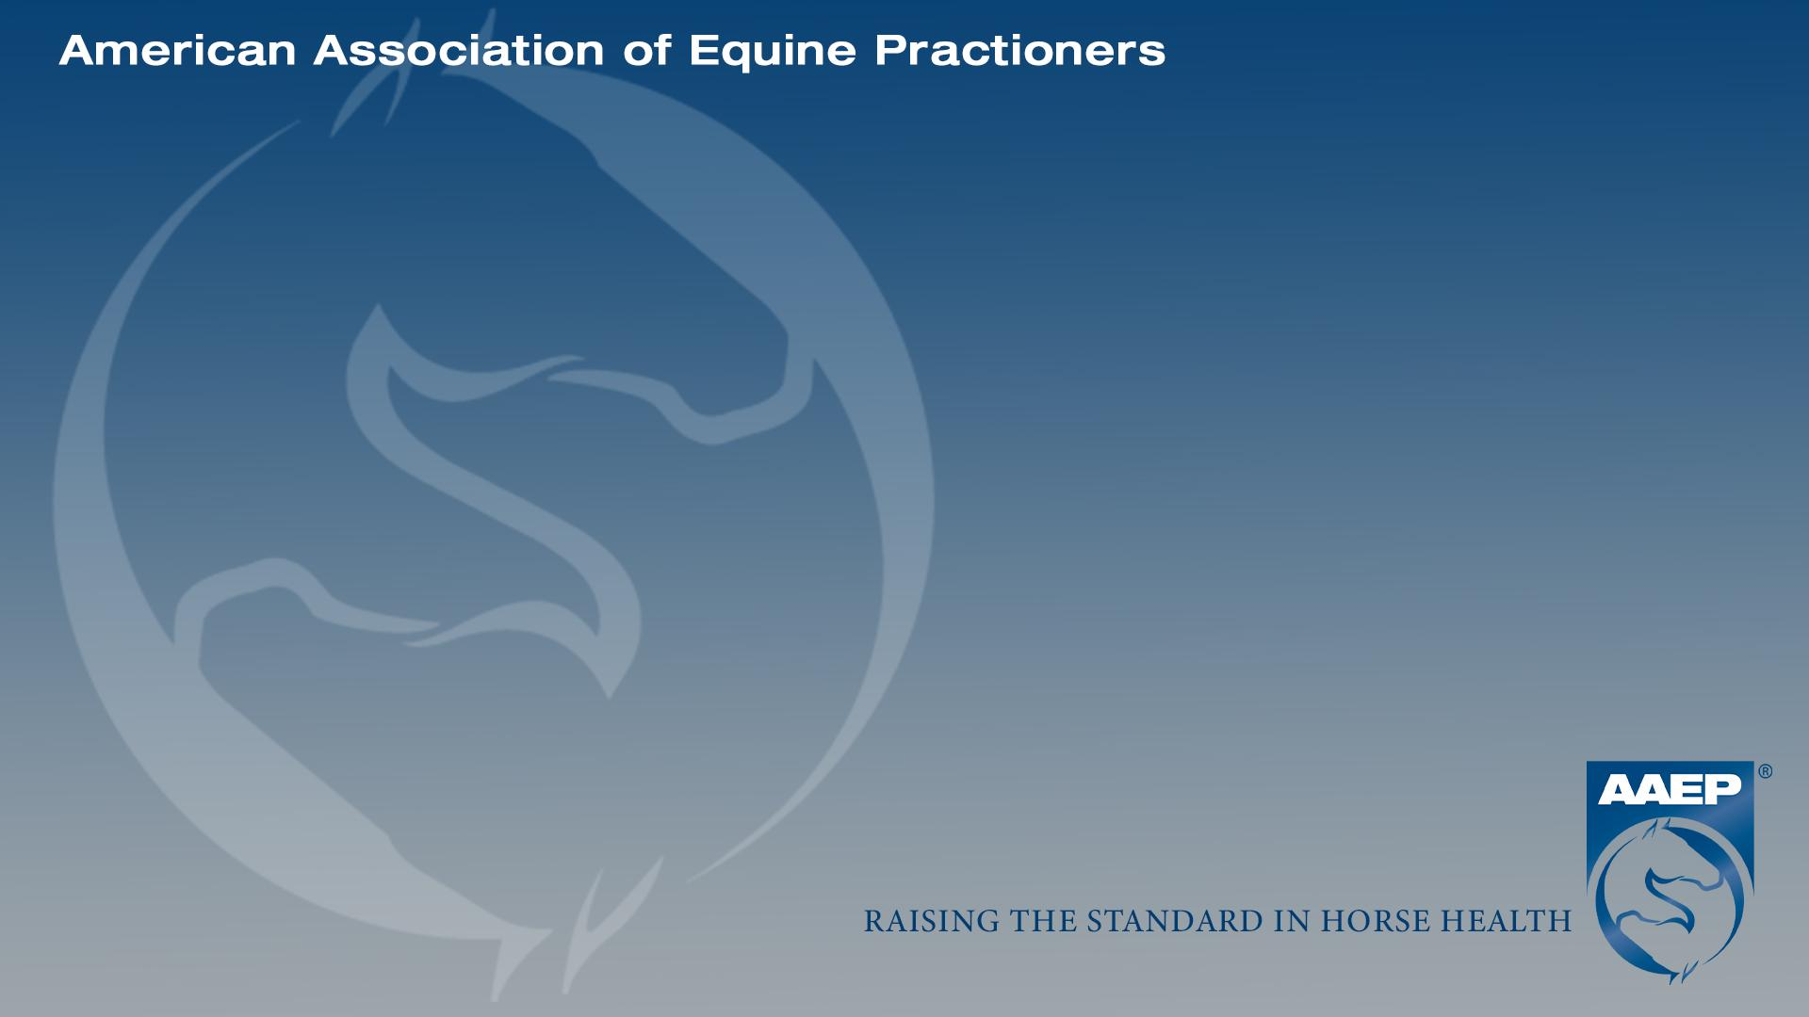

A Tale of 3 Services: Idiopathic Enteritis,
C-Section, and Multidrug Resistant Bacterial Infection in a Multiparous Arabian Mare
Olivia Bodner
University of California, Davis,
School of Veterinary Medicine
Class of 2028
Dr.Julie Dechant, DVM, MS, Diplomate ACVS and ACVECC
Dr.Sandra Valdez, DVM, Diplomate ACVS and ABVP (Equine)
Dr. Melissa Chromik, DVM, MS

Slide 2

Signalment and History
Signalment
Nine-year-old multiparous Arabian mare
On admission, 302 days of gestation
Housed on a commercial Arabian breeding facility
Prior breeding history: foals delivered at 321 and 318 days of gestation
Owner reports colic, fever, and anorexia at home
Vaccinated with 4-way and Flu/Rhino 4 days prior to presentation
Notes:
Note: Patient image was not included due to extremely unique identifying features.

Slide 3
Signalment and History
Treatment History
Seen by the referring veterinarian 2 days prior to presentation for low intensity colic and a 103°F fever
Treated with IV fluids and lidocaine
Additional treatments: enteral fluids, ceftiofur, flunixin meglumine, omeprazole, sucralfate, pentoxifylline, and altrenogest
Refluxed 15L over the 2 days and remained painful → referral to the UC Davis Equine Medicine and Equine Reproduction Services
Mare priority over foal

Slide 4
Clinical Presentation and Findings: Colic Workup
Due to colic symptoms, Equine Emergency Surgery Service was also consulted for work up
IV catheter was placed in the left jugular vein (LJV).
Nasogastric tube (NGT): obtained 1.5L of net reflux and the tube was left in place.
Abdominal Ultrasound: no abnormal findings. Fetus alive and moving, fetal heart rate 84-92 bpm.
Abdominocentesis → no fluid obtained.
Abdominal radiographs: no enterolith or sand accumulation. Rib cage of fetus was evident.
  Why do we (almost) always do abdominal radiographs in colic patients? (hint: California)

Slide 5
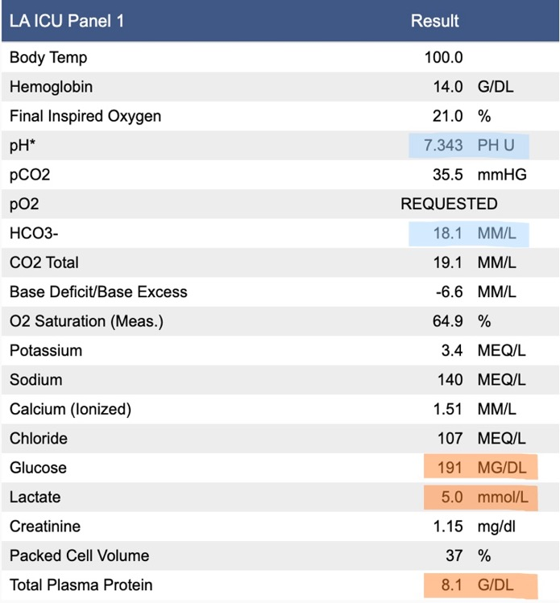
Clinical Presentation and Findings: Physical Exam and Admit Bloodwork
Upon admission to ICU…
HR: 56 // RR: 16 // T: 101.5°F
Mucous membranes were pale pink
CRT 1-2 seconds
Quiet/absent borborygmi
DPs WNL
Point of care blood work interpretation: hyperlactatemia, hyperproteinemia, hyperglycemia, mild metabolic acidosis

Slide 6
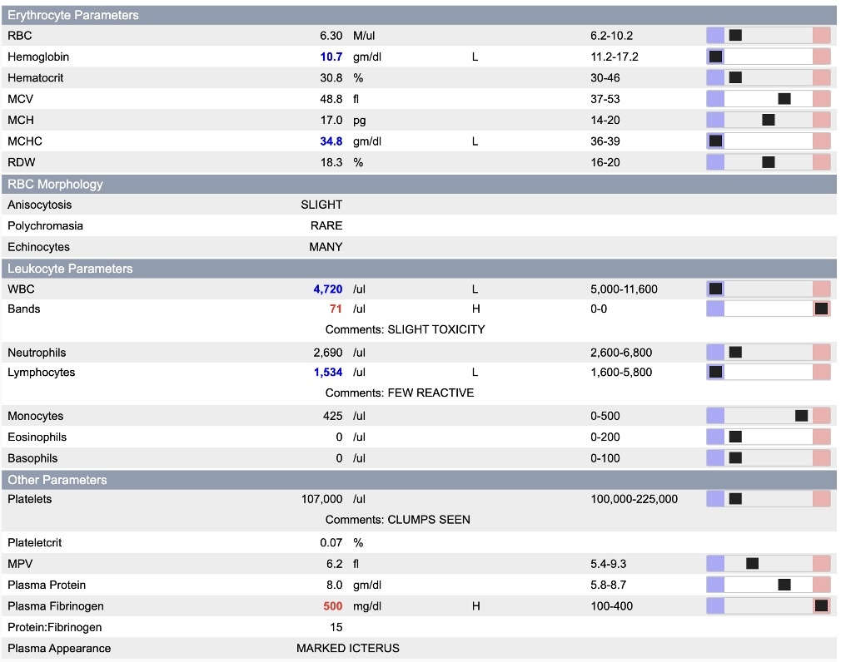
Clinical Presentation and Findings: CBC
CBC interpretation: Anemia, hypochromia, leukopenia, lymphopenia, hyperfibrinogenemia.
Band neutrophils w/ slight toxicity were noted along with a few reactive lymphocytes.
Triglycerides: 383 mg/dL (Ref: 17-63)
Results are consistent with possible infection, illness, and/or systemic inflammation resulting in secondary anorexia and subsequent negative energy balance.

Slide 7
Problem List
Acute colic
Systemic inflammation
  a. Pyrexia
  b. Hyperfibrinogenemia
  c. Leukopenia + band neutrophils
  d. Hyperglycemia
Negative energy balance
  a. Elevated triglycerides
Hyperlactatemia
Mild metabolic acidosis
Pregnant multiparous mare with a history of premature foaling

Slide 8
Differential Diagnoses
Systemic Inflammation
History of Premature Foaling
Colic
Mechanical
Functional
Infectious
Noninfectious
Placentitis
Nutritional Imbalance
Stress
EHV1
+ more
Impaction
Displacement
Strangulating Lesion
+ more
Enteritis/Colitis
Peritonitis
+ more
Notes:
At this stage, it was hard to make any rule outs or rule ins based on initial colic workup. Given her presentation, enteritis/colitis and/or placentitis could explain many but not all of the clinical findings.

Slide 9
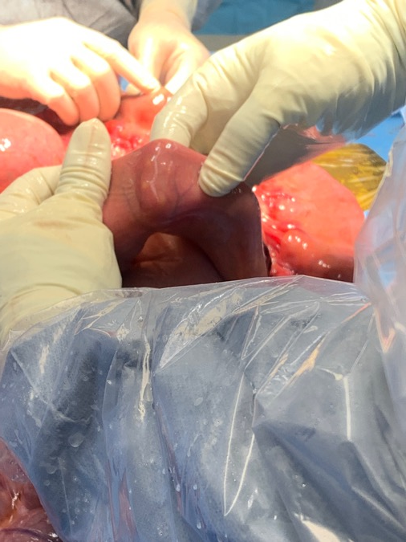
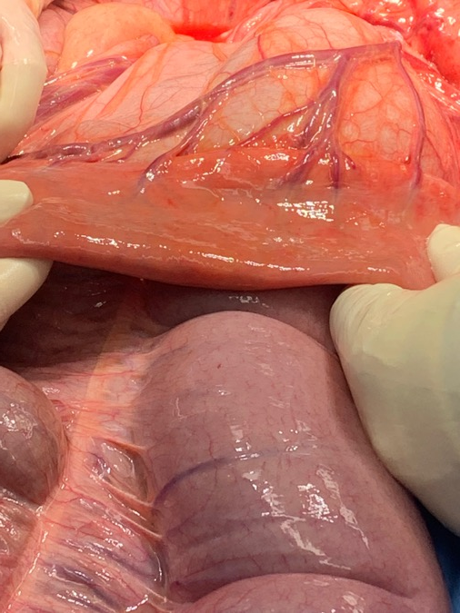
Emergency Exploratory Laparotomy
Due to persistent pain, the mare was induced for an exploratory laparotomy later that evening.
~7ft of edematous small intestine were identified with petechiae, multifocal nodules in intestinal wall, and congestion of mesenteric vessels.
No other clear cause of colic was identified. Small intestinal biopsy collected.
Nodules in small intestinal wall (left) and section of edematous small intestine as it returns to normal thickness (right)

Slide 10
Revised Problem List + Differential Diagnoses
Infectious
C. difficile
Coronavirus
Salmonella spp.
Large/Small Strongyles
+ others
Enteritis
Other presenting symptoms - colic, pyrexia, inflammatory bloodwork - may all have resulted from the enteritis identified in surgery.
Non-Infectious
Idiopathic
Autoimmune

Slide 11
Diagnostic + Therapeutic Plan
Send small intestinal biopsy to pathology for analysis.
Consult with Equine Reproduction.
Monitor and treat while awaiting biopsy results.
Phylyte 1.5L/hr Vit. B and C q12 KCl and/or Ca Gluc PRN | Hydration + electrolyte stabilization
Amino Acid 15% + Dextrose 50% CRI (IV) | Partial parenteral nutrition
Lidocaine CRI (IV) | Analgesia + GI motility
Flunixin Meglumine q12 (IV) | Analgesia + anti-inflammatory/anti-endotoxin
PPG q12 + Gentamicin q24 (IV) | Prophylactic postoperative antibiotic therapy
Omeprazole q24 (PO) | Proton pump Inhibitor (PPI); reduces gastric acid production
Pentoxifylline q8 (PO) | Improves microcirculation and reduces inflammation
Altrenogest q24 (PO) | Synthetic progestin for pregnancy maintenance
Enoxaparin q24 (SQ) | Thromboprophylaxis, adhesion prevention

Slide 12
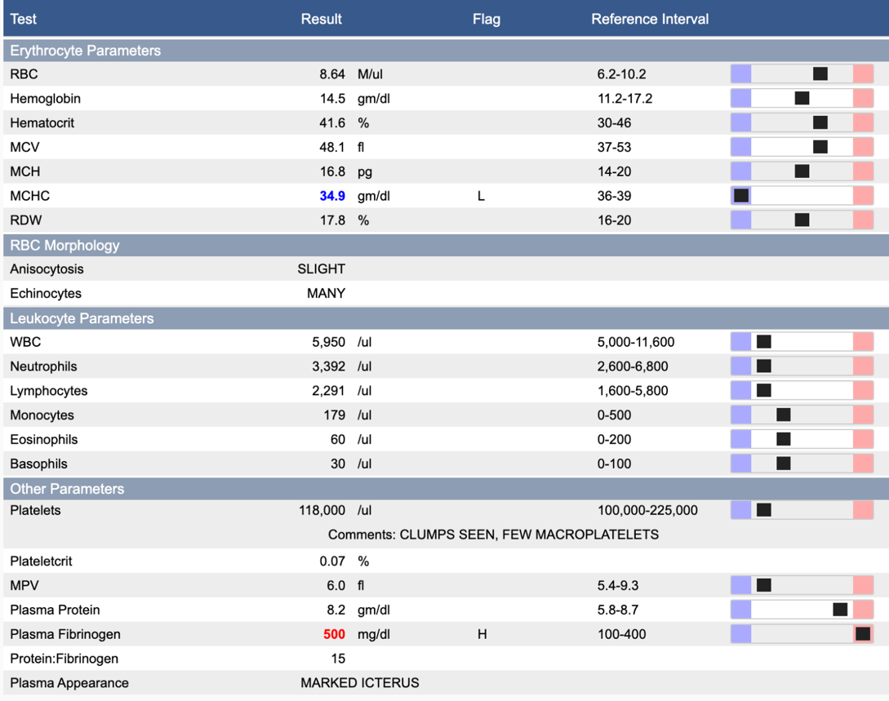
Case Progression
Day 1 Post-Op: Restless and pawing. Started passing soft feces later in the evening. Exam by Equine Reproduction Service WNL.
Day 2: Clinically improving, more comfortable. Decent appetite in the afternoon, but it became poor overnight. Passing cowpie feces. Triglycerides: 871 mg/dL
Day 3: Waxing and waning comfort. NGT passed, reflux checks q2 produced a total of 9L, stopped refluxing late evening. Triglycerides: 861 mg/dL
    Improved recheck CBC → resolved neutropenia, no bands noted. Hyperfibrinogenemia persistent.

Slide 13
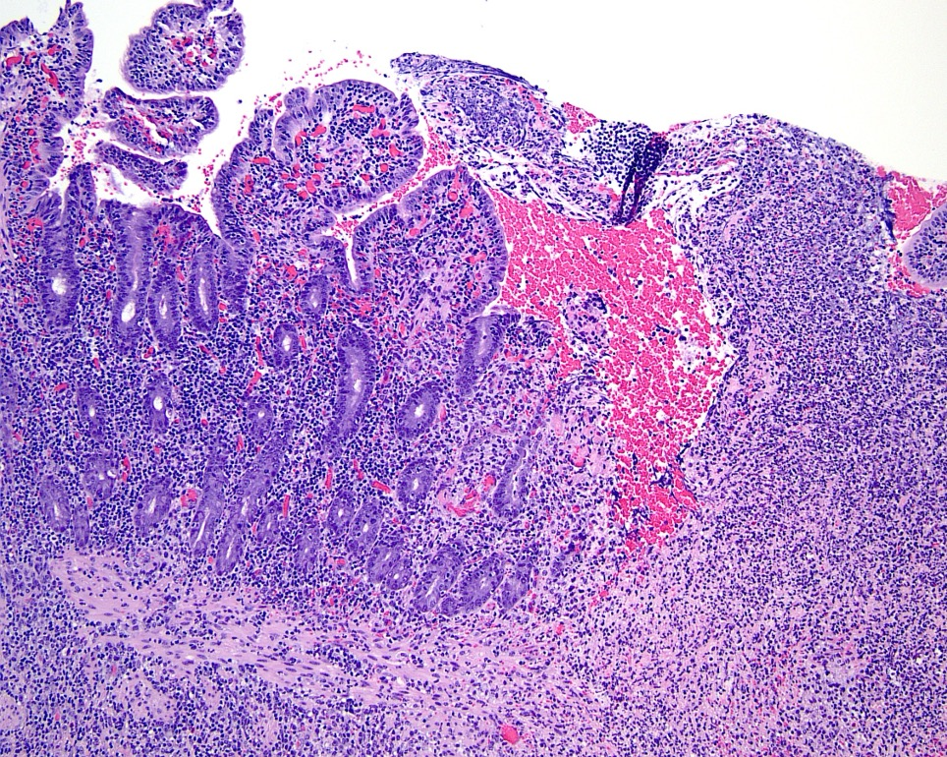
Case Progression
Biopsy Results
  95% of mucosal epithelium was ulcerated. Overlying areas of ulceration were degenerate neutrophils, fibrin, hemorrhage, and small aggregates of bacteria.
  Throughout the tissue were multiple vessels occluded by fibrin.
  Submucosa was infiltrated with large numbers of histiocytes, neutrophils, and reactive fibroblasts with edema.
  Serosa was markedly edematous with congestion and hemorrhage.
  Gram staining identified a few gram-negative coccobacilli along the mucosal surface.
  Conclusion: severe ulcerative fibrinonecrotizing enteritis w/multifocal fibrin thrombi.
Histopathology of jejunal sample taken in surgery. Sections of blunted/fused villi (left) and an area of ulceration (right).

Slide 14
Case Progression
Day 4: Comfort still declining. HR: 44bpm, RR: 16bpm, T: 99.6°F.
Day 5: Very uncomfortable overnight → taken to surgery with a plan to do a C-section and perform a small intestinal resection.
MgSO₄ added to fluids
Ketamine and hydromorphone CRI started for analgesia
Reflux checks q2
Concern that the nodules in the small intestinal wall were inhibiting motility
Fetus was potentially contributing to discomfort
Removing the fetus would also reduce the mare’s energy demand and help correct her negative energy balance
Concern for integrity of abdominal incision in late gestation following 2 laparotomies

Slide 15
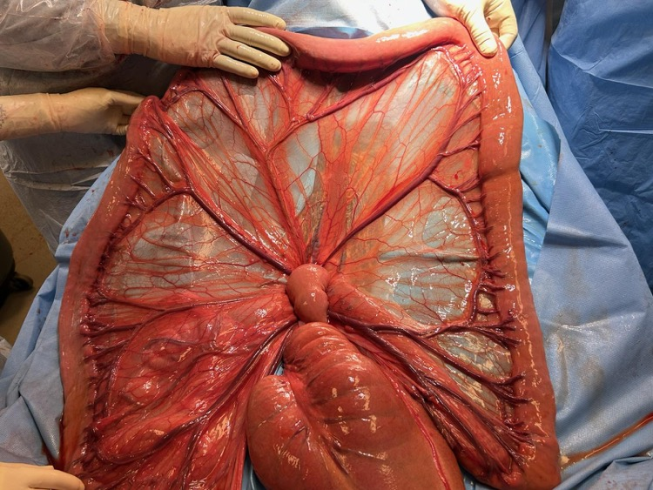
Case Progression - C-Section
Fetus was identified in the correct position; uterus was exteriorized and incised to allow for the delivery of the fetus using sterile OB chains.
The jejunum showed marked improvement, with the previously noted nodules and edema no longer present.
  No small intestinal resection needed.
A stent bandage was fixed to the incision, and a sterile abdominal bandage was placed.
Markedly improved small intestine; difficult to discern normal vs. abnormal tissue.

Slide 16
Case Progression - C-Section
Teamwork makes the dreamwork! Two other services were crucial to this process, along with an amazing team of technicians.
Equine Medicine Service
  Present to receive foal once exteriorized. Though a live filly was delivered, aggressive attempts at resuscitation were ceased after 2.5 hours due to prematurity and poor prognosis.
Equine Reproduction Service
  Applied 10 crushed tablets of misoprostol combined with sterile lube to the cervix in surgery. Unable to exteriorize the chorioallantois, but were able to puncture it in the stall post-op.
  Intact placenta passed ~3hrs after surgery.
  Managed post-operative metritis with uterine lavages and oxytocin.

Slide 17
Case Progression - C-Section Recovery
Equine Emergency Surgery Service
Day 1-2: Improving comfort, began refeeding. DMSO added, ampicillin and gentamicin used for postoperative prophylactic antibiotic therapy. On day 2, lidocaine and dextrose were discontinued.
Day 3: Clinical improvement → increased refeeding to ¼ flake grass hay and mashes. Painful and refluxing 3-5L in the evening.
Day 4: Patient comfortable, stopped refluxing overnight. A medium bore NGT was passed. No net reflux, 3L mineral oil given and tube removed.
    Purulent discharge noted at surgical site with limited granulation present. Staples removed to facilitate draining, ultrasound revealed multiple small fluid pockets. Lavaged with saline.
Problems: Post-operative ileus (resolved) and surgical site infection

Slide 18
Case Progression - C-Section Recovery
Day 6: Consistently passing formed feces, comfortable. Surgical site still draining.
Swelling over the catheterization site of the right jugular vein was present. On ultrasound, a 4cm subcutaneous abscess was noted with no venous involvement. 1mL of thick purulent red/gray material was obtained, small incision was made to facilitate drainage.
Examination of the left jugular vein, also previously catheterized, identified a thrombosis.
Problem: Bilateral jugular vein septic thrombophlebitis

Slide 19
Revised Problem List
Post-Op Ileus
Secondary to repeat laparotomy
Metritis
Secondary to c-section
Resolved
Surgical Site Infection
Secondary to c-section + repeat laparotomy
Bilateral Jugular Vein Septic Thrombophlebitis
Secondary to IVC Placement
Ongoing

Slide 20
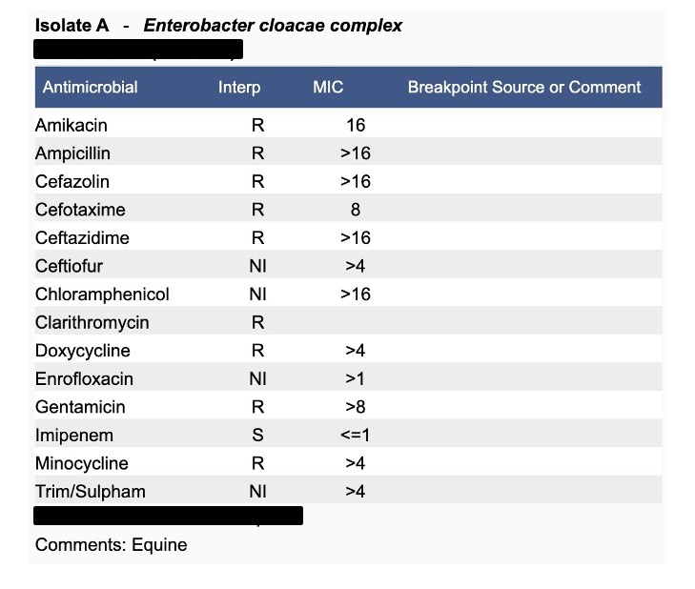
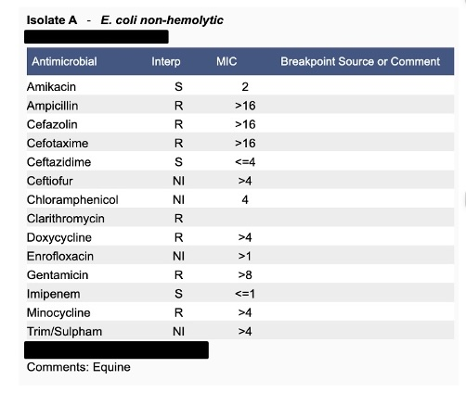
Revised Diagnostic Plan + Results
Catheter site infection: Cultured 2 colony types of Enterobacter cloacae complex demonstrating multidrug resistance (MDR).
Surgical site infection: Submitted culture yielded a mixed growth included non-hemolytic E. Coli and Enterobacterales. Both demonstrated MDR.

Slide 21
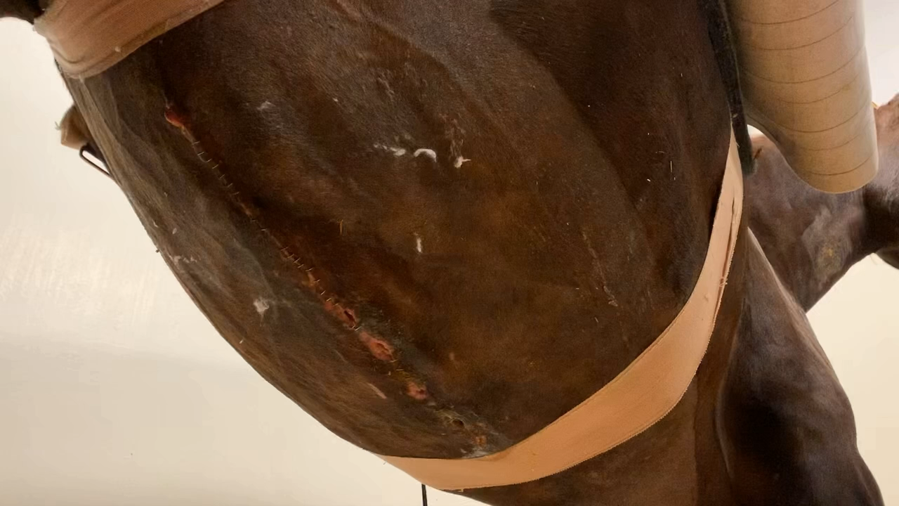
Revised Therapeutic Plan
Catheter site infection
Hot pack
Apply DMSO and diclofenac topically
Surgical site infection
Bandage changed and cleaned 1-2x daily
Treated with medical grade honey
Hernia belt
Antibiotic therapy switched to Equisul (sulfadiazine/trimethoprim). The mare was placed on minimal contact protocols and moved into a stall distanced from other patients to prevent the spread of the MDR bacteria.
Surgical site cleaning 10 days post-op
Notes:
Speaker note: Equisul therapy more for metritis/other concerns, NOT to treat these infections.

Slide 22
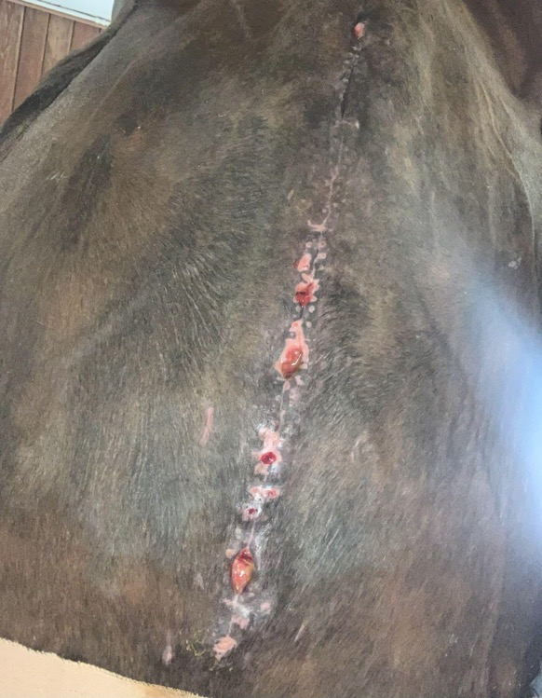
Case Progression
Week 2: Comfortable with excellent appetite. Continued drainage from both RJV and surgical site.
Week 3: Patient comfortable and passing formed manure with an excellent appetite. Bandage changes continued.
Week 4: Continued bandage changes. Surgical site steadily improving, treatments stopped on both jugular veins.
Surgical site on day 18

Slide 23
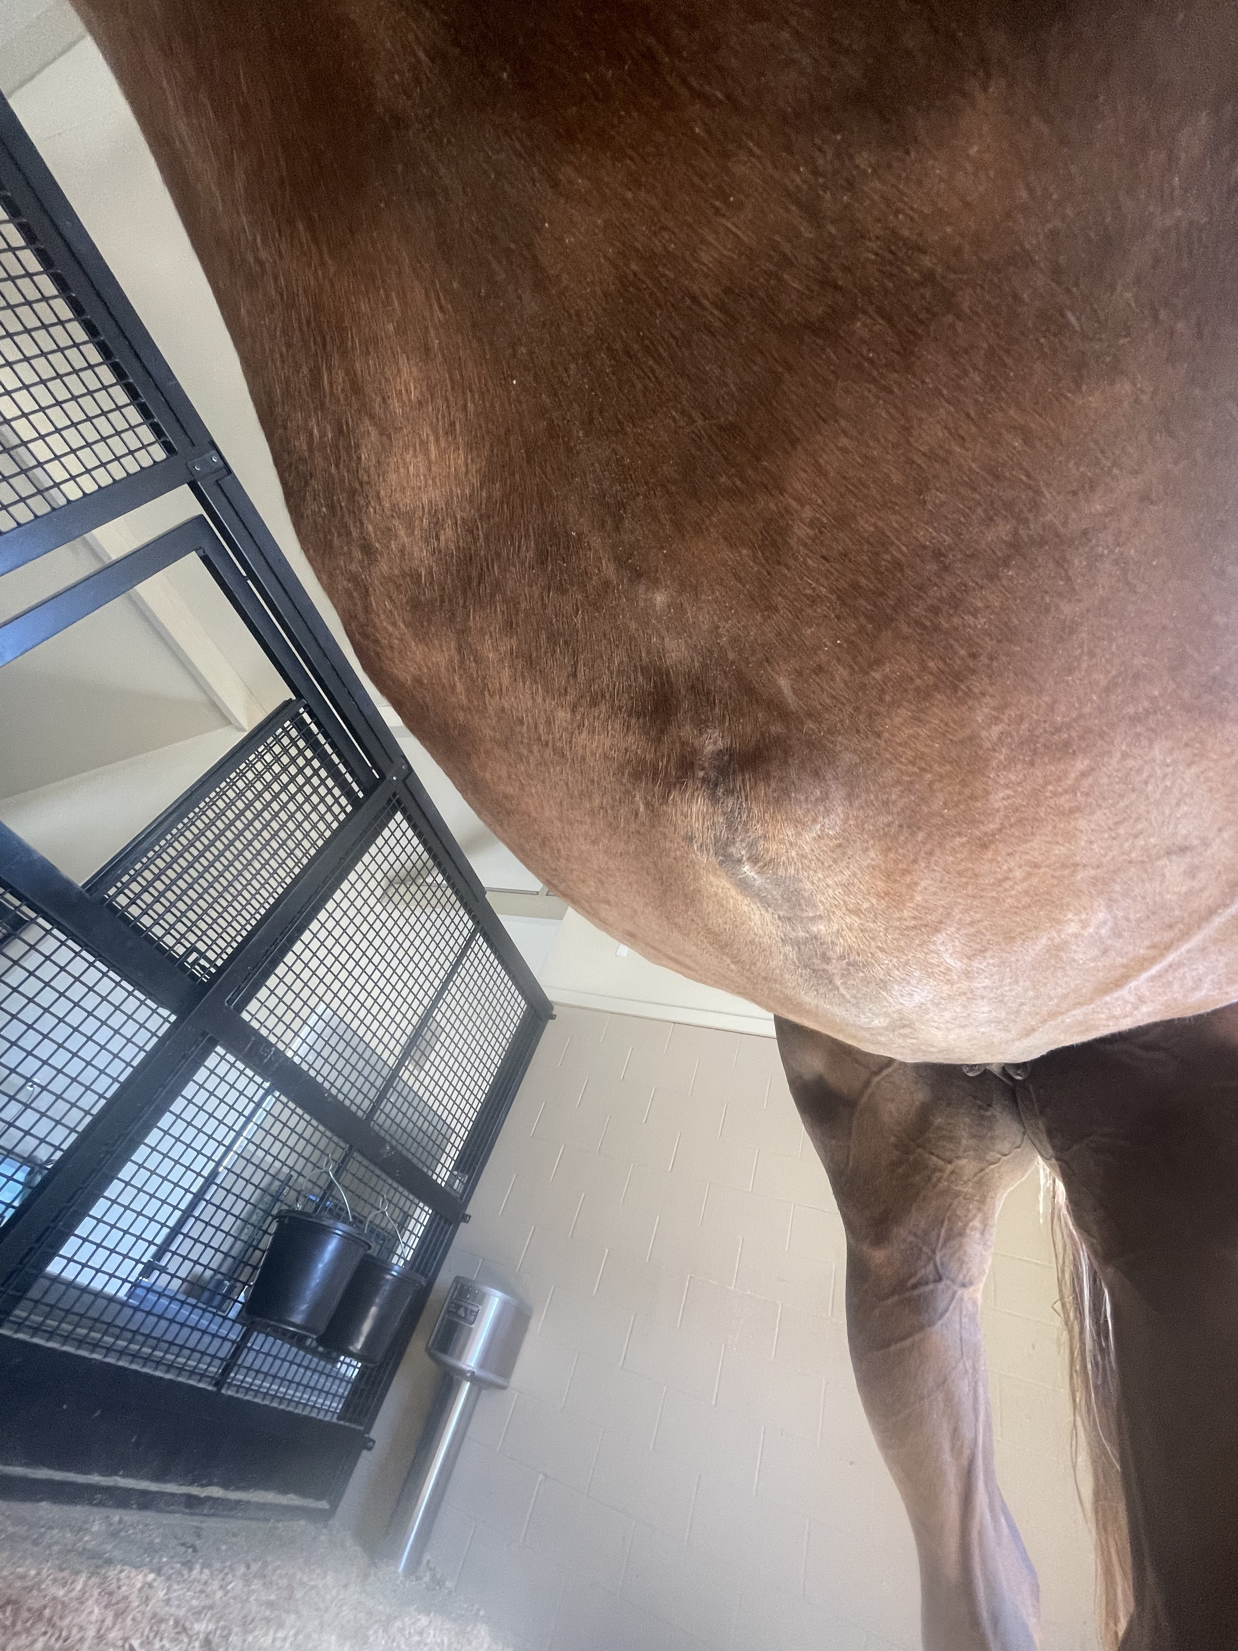
Outcome
Day 32: Discharge!
No medications
Continued surgical site cleaning w/ hernia belt in place.
Stall rest → gradual return to controlled exercise.
Total Days in ICU: 32
Total Charges: $38,346.11
Prognosis: Good prognosis for life but recommended against carrying another foal. Good prognosis as a donor mare for embryo transfer or intracytoplasmic sperm injection (ICSI) to a recipient mare.
Owner report her doing well at home 3 months after discharge.
Surgical site 2 months after discharge

Slide 24
Discussion
Idiopathic Enteritis
The exact cause of the mare’s enteritis and colic symptoms - and why they resolved - was never identified.
Wide range of infectious and noninfectious causes of enteritis, and a cause is not identified in a significant number of cases (Uzal and Diab, 2015).
Of horses that recover from anesthesia, relaparotomy has demonstrated a survival rate of 64.2% (Findley et. al, 2023), in comparison to 80% after initial laparotomy (Spadari et. al, 2023).
Future use of the horse, owner’s goals, and financial constraints need to be considered.
In this case, treatment and repeat surgical intervention were pursued due to the breeding potential of the mare and willingness of the client to continue despite a lack of clear answers or promise of recovery.

Slide 25
Discussion
Antibiotic Resistance
In recent years, extended spectrum beta-lactamase (ESBL) producing strains of Enterobacteriaceae have been identified (Knych and Magdesian, 2021).
Preliminary data from a 2024 randomized clinical trial demonstrated that there was no difference in post-op complications between horses that received antibiotics for 24-hr or 72-hr after colic surgery (Perez et. al. 2024).
→ this mare was on antimicrobials for 11 days.
Overall, recent research indicates that recommendations for surgical antibiotic prophylaxis in horses after colic surgery could be adapted to improve future antimicrobial stewardship.
  These microbes are resistant to beta-lactam antibiotics such as penicillins, cephalosporins, and aztreonam.
Some evidence that ampicillin administration predisposes horses to the development of these infections.
This creates a significant one health issue, as these bacterium are typically zoonotic.
  → careful IDC and PPE protocols were followed with this case to mitigate this.

Slide 26
Further Reading and References
Embertson RM. Indications and surgical techniques for caesarean section in the mare. Equine Vet Educ. 2002;14:60–4.
Findley JA, Salem S, Burgess R, Archer DC. Factors associated with survival of horses following relaparotomy. Equine Vet J. 2017;49:448–53.
Knych HK, Magdesian KG. Equine antimicrobial therapy: Current and past issues facing practitioners. J of Vet Pharmacol Ther. 2021;44:270–9.
Spadari A, Gialletti R, Gandini M, Valle E, Cerullo A, Cavallini D, et al. Short-Term Survival and Postoperative Complications Rates in Horses Undergoing Colic Surgery: A Multicentre Study. Animals (Basel). 2023 Mar 20;13(6):1107.
Uzal FA, Diab SS. Gastritis, Enteritis, and Colitis in Horses. Vet Clin North Am Equine Pract. 2015 Aug;31(2):337–58.
    Huge thank you’s go out to Drs. Dechant, Valdez, Chromik, and Pesavento at the University of California, Davis in the development of this presentation and provision of photographs and histopathology images.
    Appreciation also goes out to the mare’s treatment teams in the Equine Medicine, Equine Reproduction, and Equine Emergency Surgery services, as well as the amazing group of technicians, barn crew, laboratory staff, and so many more that made this mare’s recovery possible. Lastly – thank you to the client and the mare for the opportunity to see this case to a happy ending and learn from it.
Acknowledgements

Slide 27

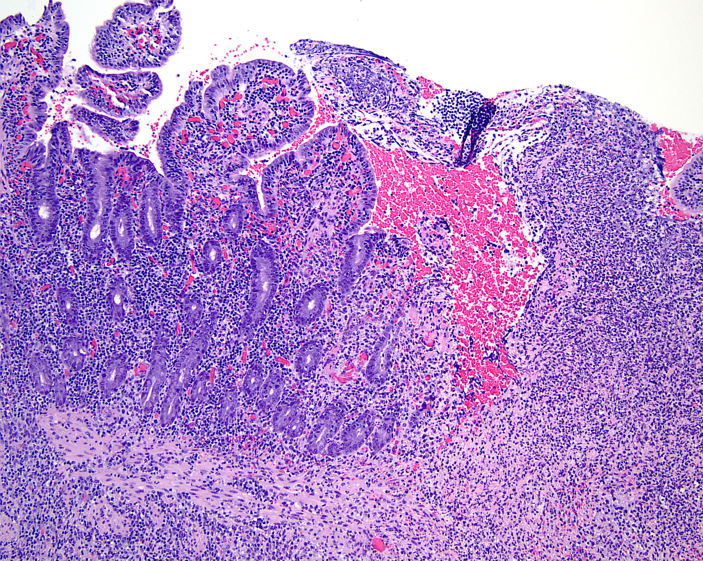
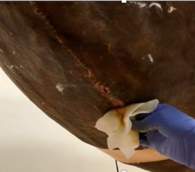




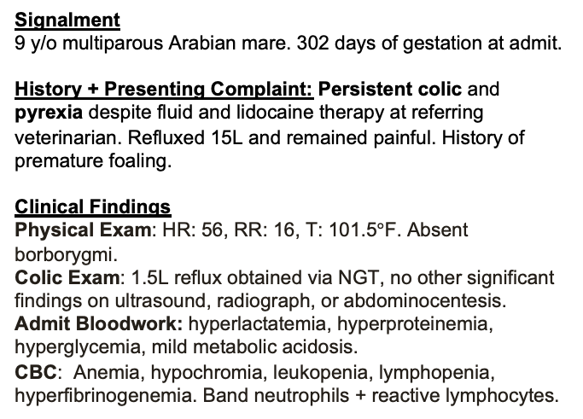
Idiopathic Enteritis, C-Section, and Multiresistant Bacterial Infection in a Multiparous Arabian Mare
Olivia Bodner, ℅ 2028 – University of California, Davis, School of Veterinary Medicine
Signalment
9 y/o multiparous Arabian mare. 302 days of gestation at admit.
History + Presenting Complaint: Persistent colic and pyrexia despite fluid and lidocaine therapy at referring veterinarian. Refluxed 15L and remained painful. History of premature foaling.
Clinical Findings
Physical Exam: HR: 56, RR: 16, T: 101.5$°$F. Absent borborygmi.
Colic Exam: 1.5L reflux obtained via NGT, no other significant findings on ultrasound, radiograph, or abdominocentesis.
Admit Bloodwork: hyperlactatemia, hyperproteinemia, hyperglycemia, mild metabolic acidosis.
CBC: Anemia, hypochromia, leukopenia, lymphopenia, hyperfibrinogenemia. Band neutrophils + reactive lymphocytes.
Treatment Plan
Fluid + electrolyte therapy
Parenteral nutrition
Flunixin meglumine
Lidocaine
PPG
Gentamicin
Omeprazole
Sucralfate
Enoxaparin
Pentoxifylline
Altrenogest
Post-Op Complications
Metritis
Post-op ileus
Surgical site Infection
Jugular vein septic thrombophlebitis
Biopsy Results
Severe ulcerative fibrinonecrotizing
enteritis w/ multifocal fibrin thrombi.
8 days later
Surgical site @ day 10
Surgical site @ day 18
Histopathology of jejunal sample taken in surgery (right)
Culture + Susceptibility Testing
2 colony types of MDR Enterobacter cloacae complex cultured at catheter site.
Non-hemolytic MDR E. Coli and Enterobacterales cultured at surgical site.
Updated Treatment Plan
Clean and change surgical site bandage, apply medical grade honey.
Hot pack, diclofenac, DMSO on RJV.
Equisul
Recovery + Prognosis: Went home after 32 days of ICU care on no medications. Good prognosis for life and for breeding as a donor mare.
Emergency Laparotomy
C-Section: Mare remained painful and continued to reflux. C-section and repeat laparotomy elected 5 days after initial laparotomy. Marked improvement in appearance of jejunum. Foal delivered via C-section, euthanized due to prematurity.
~7ft of edematous small intestine were identified with petechiae, multifocal nodules in intestinal wall, and congestion of mesenteric vessels
5 days later
Nodules in small intestinal wall (left) and section of edematous small intestine (right)
Markedly improved small intestine; difficult to discern normal vs. abnormal tissue.
2025 Student and New Graduate Case Study Competition

